Slide 1
Public Access to Priority Investment Approach (PIA) Data
2018
Notes:
Hi everyone,
Today I will be telling you about a new way to access the Priority Investment Approach research dataset.
In the first session I will provide a short background on the data that is available and briefly introduce one way of accessing the data using TableBuilder. In the second session I will show you a few ways you can use TableBuilder by working through some examples. The second session is for those of you who are interested in a deeper understanding of how to use the dataset. You are welcome to leave after the first session if that doesn’t interest you.
The notes from these presentations will be available afterwards on the community grants hub website for your reference, so please don't feel that you need to remember everything!
We think the Tablebuilder tool will be very useful to a wide number of researchers as well as those applying for TTL Fund grants. I hope that this presentation will enable you to make use of this data yourself.

Slide 2
How might this be relevant to your grant application for the TTL Fund?
The assessment criteria outlined in the Try Test and Learn Fund grant opportunity guidelines encourages you to provide ‘evidence’
provide evidence that the people targeted by your project are at risk of long-term welfare dependence (e.g. evidence may include Priority Investment Approach data, research, government reports, empirical evidence, etc.);
provide evidence of the need for your project among those it would support (e.g. evidence may include Priority Investment Approach data, research, government reports, empirical evidence, etc.)
Notes:
An important place to start this session is to consider how might this be relevant to you. In particular for your grant application for the TTL Fund.
The assessment criteria outlined in the Try Test and Learn Fund grant opportunity guidelines encourages you to provide ‘evidence’.
Both of these examples refer to the Priority Investment Approach data as one source of evidence that you might use. Your evidence is likely to include your own information and data from your experience, however this can be given greater context and supported by the data that is now available to you from the Priority Investment Approach.
So what is the Priority Investment Approach?

Slide 3
The Australian Priority Investment Approach to Welfare (PIA) policy initiative was established as part of the 2015-16 Budget
What is it?
  The Priority Investment Approach, or PIA, uses data analysis to identify groups at risk of long-term welfare dependence and uses insights from the data to find innovative ways to help more Australians live independently, reducing their need for welfare.
  The PIA data includes administrative data collected for the purpose of recording eligibility for benefits, service delivery activities and payments.
Notes:
The Australian Priority Investment Approach to Welfare (PIA) policy initiative was established as part of the 2015-16 Budget
What is it?
The Priority Investment Approach, or PIA, uses data analysis to identify groups at risk of long-term welfare dependence and uses insights from the data to find innovative ways to help more Australians live independently, reducing their need for welfare.
The PIA data includes administrative data collected for the purpose of recording eligibility for benefits, service delivery activities and payments.

Slide 4
The PIA data includes 14 years of information about payment recipients over 56 quarterly snapshots
What is in it?
  The data is a series of quarterly snapshots taken from the July-September 2001 quarter to the April-June 2015 quarter.
  The data contains information about those people who have received one of 21 benefits including Aged Pension, Disability Support Pension, Newstart Allowance and Carer Payment.
  The de-identified information includes demographic and geographical information, as well as information relating to accommodation, primary medical conditions, education and income.
  Demographic variables of the partner are also available for some of the recipients.
Notes:
The PIA data includes 14 years of information about payment recipients over 56 quarterly snapshots
What is in it?
The data is a series of quarterly snapshots taken from the July-September 2001 quarter to the April-June 2015 quarter.
The data contains information about those people who have received one of 21 benefits including Aged Pension, Disability Support Pension, Newstart Allowance and Carer Payment.
The de-identified information includes demographic and geographical information, as well as information relating to accommodation, primary medical conditions, education and income.
Demographic variables of the partner are also available for some of the recipients.

Slide 5
Part of the PIA policy is to provide access to the data to help improve the lives of Australians who are receiving welfare
Where is it?
  In September 2016, Minister Porter announced a plan to allow limited access to PIA data.
  There are three points of access that differ by level of information provided, as well as cost and ease of access.
  For example, those researchers who have a high level of skill and need more detailed information for their research, can apply for access to the secure enclave (SURE).
  For others, TableBuilder provides non-restricted access to less detailed information with free registration
Notes:
Part of the PIA policy is to provide access to the data to help improve the lives of Australians who are receiving welfare
Where is it?
In September 2016 the then Minister for Social Services announced a plan to allow researchers limited access to PIA data.
There are three points of access that differ by level of information provided, as well as cost and ease of access.
For example, those researchers who have a high level of skill and need more detailed information for their research, can apply for access to the secure enclave (SURE).
For others, TableBuilder provides non-restricted access to less detailed information with free registration

Slide 6
Three Access Points to PIA
 | PIA in SURE | TableBuilder | Synthetic Data
Accessibility | Applications are considered and approval based on user expertise and need for the data in context of a specific project. | Unrestricted access. | Unrestricted access.
User Access | User pays an access fee. | Free registration. | Free registration.
User Experience | Once approved, access is within a secure enclave and users will see unit record data. All analyses are run remotely within the secure enclave. Output must be approved before being taken out of SURE. | Once users log in, they are able to construct tables of aggregate data freely, without constraint. These tables can then be downloaded as .csv files without review. Users do not see the unit level record data at any stage. | Users can download the complete dataset of unit level record data to use on their own system.
Sources | AIHW secure environment | ABS Tablebuilder site | Dataverse.
Number of Variables | 60 | 38 | 31
Format of Date of Birth | Rounded to the month | Rounded to the year | Rounded to the decade
Geographic Information | Country (Birth, Residence and Citizenship), State, Postcode | Country by Region (Birth and Residence), State, Postcode, Address at SA3 level | Country (Birth and Residence), Postcode.
Notes:
This table is a very brief overview of the three access points for the PIA data. It shows the range of access types we have developed, to reflect the range of possible uses and users we expect to be interested in the PIA data. I would like to point out the relative accessibility of the Tablebuilder
(i.e., free registration and unrestricted access) and also some of the key differences in how the data has been made confidential for privacy purposes. For example, you can see there are
less variables in TableBuilder compared to the PIA data that is available in the Secure Enclave of SURE and that the date and geographic information is less specific. For example,
country of birth is only shown by region in TableBuilder whereas the specific country is shown in SURE.

Slide 7
PIA in TableBuilder
Who it is meant for?
Everybody
  Teachers and students
  Journalists
  Academics
  Non Government Organisations
How it can be used?
Create and download both tables and graphs
Notes:
Who it is meant for?
Users are expected to include teachers and students in an educational context, journalists preparing data for reports, as well as academics and NGO’s looking for data to use in their grant applications.
I will provide some examples of both tables and graphs at the end of this session and we will work through how to create and download both tables and graphs in the next session.

Slide 8
PIA in TableBuilder
As this data is publicly accessible, a number of steps have been taken to ensure privacy is maintained.
What is not in it?
  Fewer Variables
    38 variables (not 60)
  Less Detail
    Some variables have been modified (e.g., month and Year to Year only)
  Fewer people
    A 5% sample of the population
Notes:
As this data is publicly accessible, a number of steps have been taken to ensure privacy is maintained. So let’s look at what is NOT in it.
There are Fewer Variables. There are 38 variables in TableBuilder as opposed to the 60 that are available in the secure environment of SURE.
There is Less Detail. Some variables have been modified, for example a date might be available as year only in TableBuilder where it is available as month and year in the secure enclave.
There are Fewer People. TableBuilder uses a 5% sample of the original PIA dataset. This is large enough to provide a representative subsample of the whole population while maintaining individual privacy. One implication of this is that if you are reporting population estimates in your grant application, you will need to multiply the figures in the table by 20.

Slide 9
Why you might be interested in using TableBuilder to access the PIA data
TableBuilder is good for a wide range of data analysis expertise; from beginner to advanced
TableBuilder allows for population estimates
Notes:
TableBuilder is good for a wide range of data analysis expertise. Some people here are likely to be analysts or researchers and have experience in working with population data, perhaps even have experience with TableBuilder using other datasets
Some people here are likely to have no research experience and not be familiar with working with population data at all.
Due to it’s user interface, TableBuilder suits both of these populations.
While the 5% serves to protect individual privacy, it does allow for reportable estimates that can be used in reports and grant applications.

Slide 10
Some examples using TableBuilder
Notes:
For now, I will show you just a few examples of how you might use TableBuilder.

Slide 11
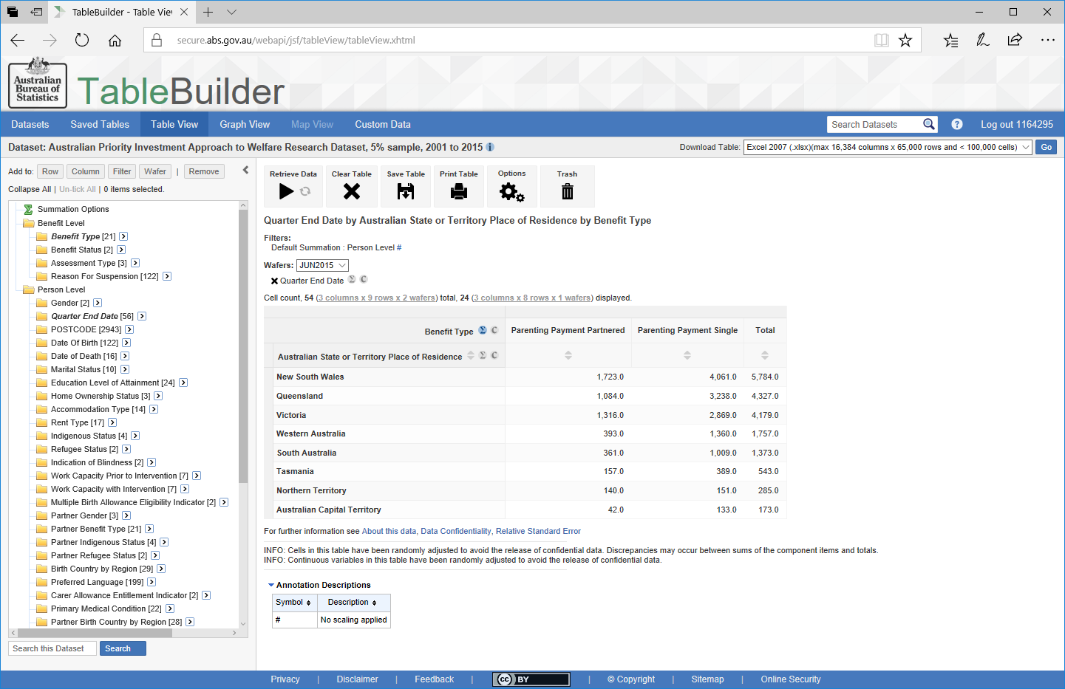
Parenting Payment by State/Territory
Notes:
Everything you can see with TableBuilder is always group level or aggregate data. You will never see the individual unit level data that sits ‘behind’ the tables.
Here, we have a table that displays the number of recipients of two benefit types (Parenting Payment Partnered and Parenting Payment Single)
Across the top in Columns, and the states and territories,
Down the left in Rows,
for June 2015.

Slide 12
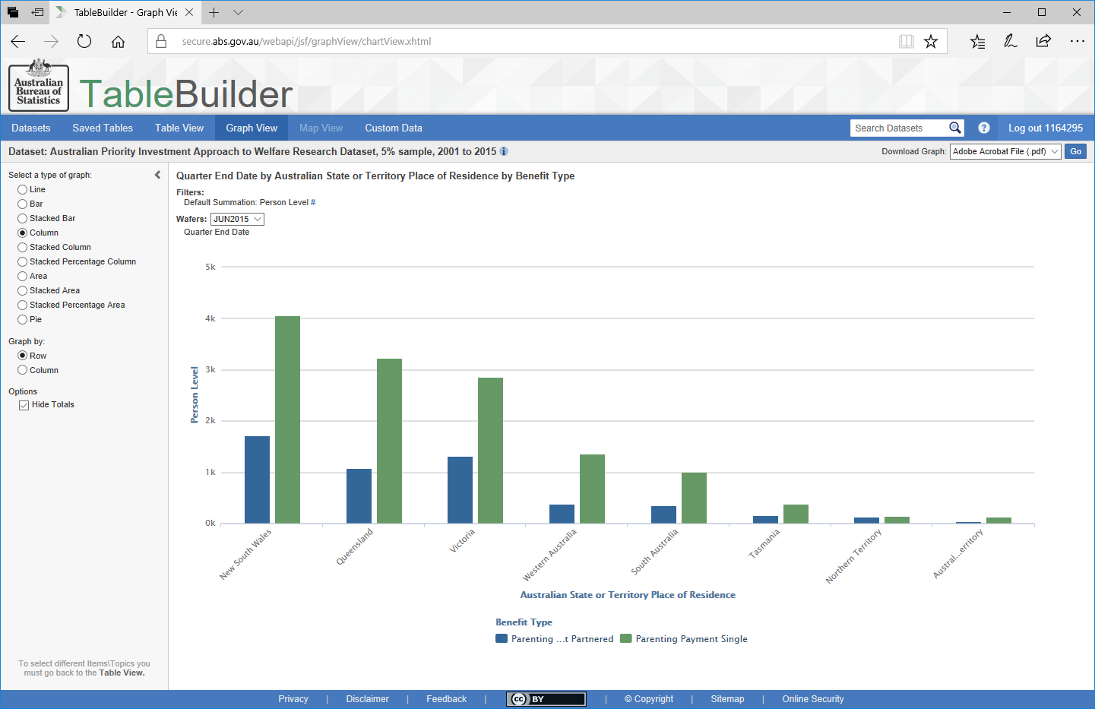
Parenting Payment by State/Territory
Notes:
Switching between Table View and Graph View allows you to visualise the data
Here we can see the count of the two parenting payments for each state.

Slide 13
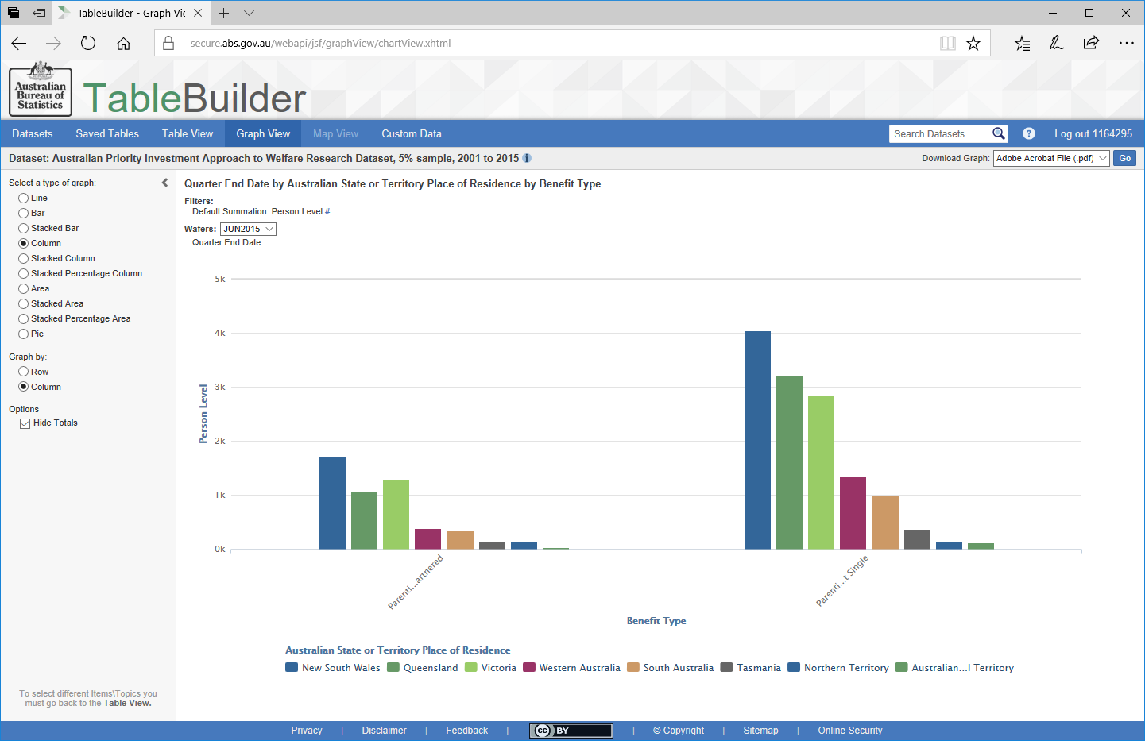
Parenting Payment by State/Territory
Notes:
By using the options on the left we can now see the same data displayed as the number of recipients across the states for each payment.

Slide 14
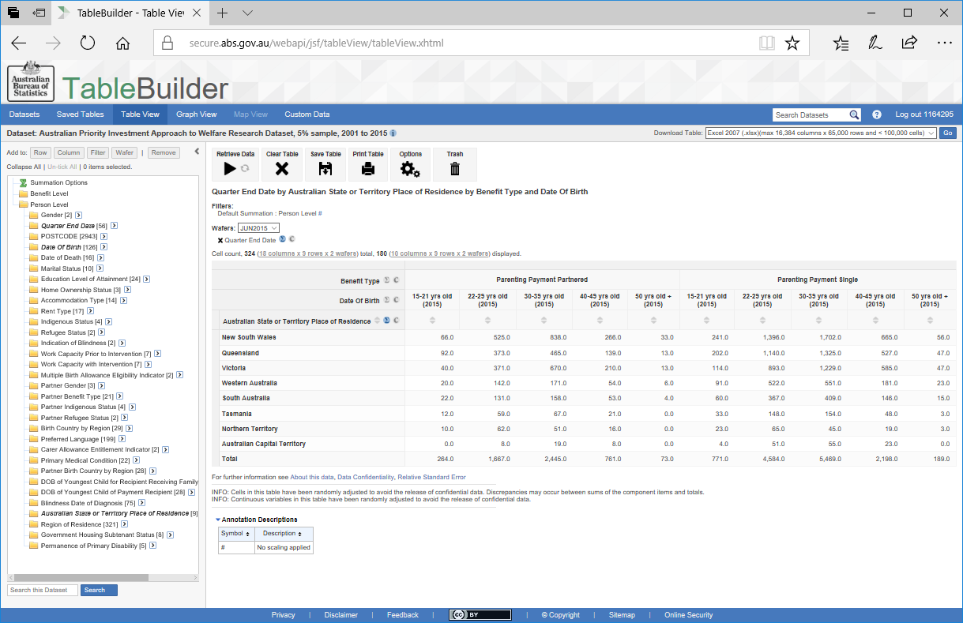
Parenting Payment by State/Territory
Notes:
We can break this down to see the number of recipients for
PPP and PPS by
age groups for each of the states (I have zoomed out so that you can see the whole table).
We also have the option of showing or hiding totals. In this case we can see the total count for the country as well as the count for each state.

Slide 15
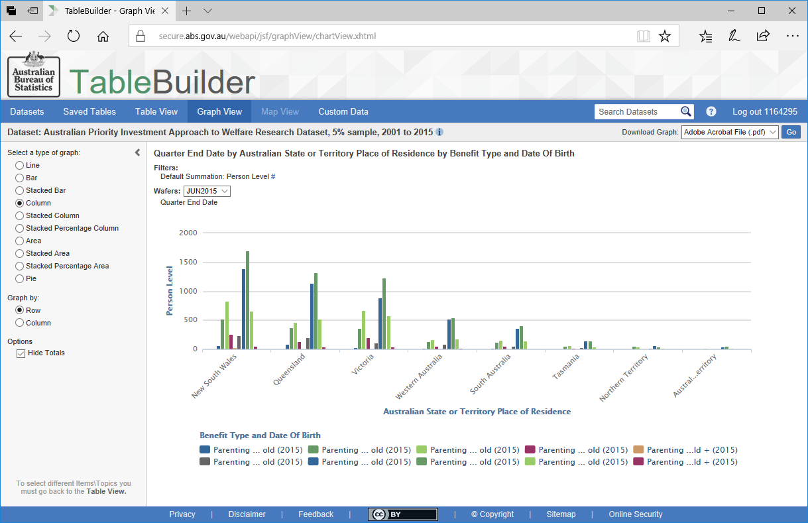
Parenting Payment by State/Territory
Notes:
Switching to Graph View I now have the states across the bottom and can see the count of PPP and PPS recipients by the age groups.
We have the colour key across the bottom for each age group for the two payment types.

Slide 16
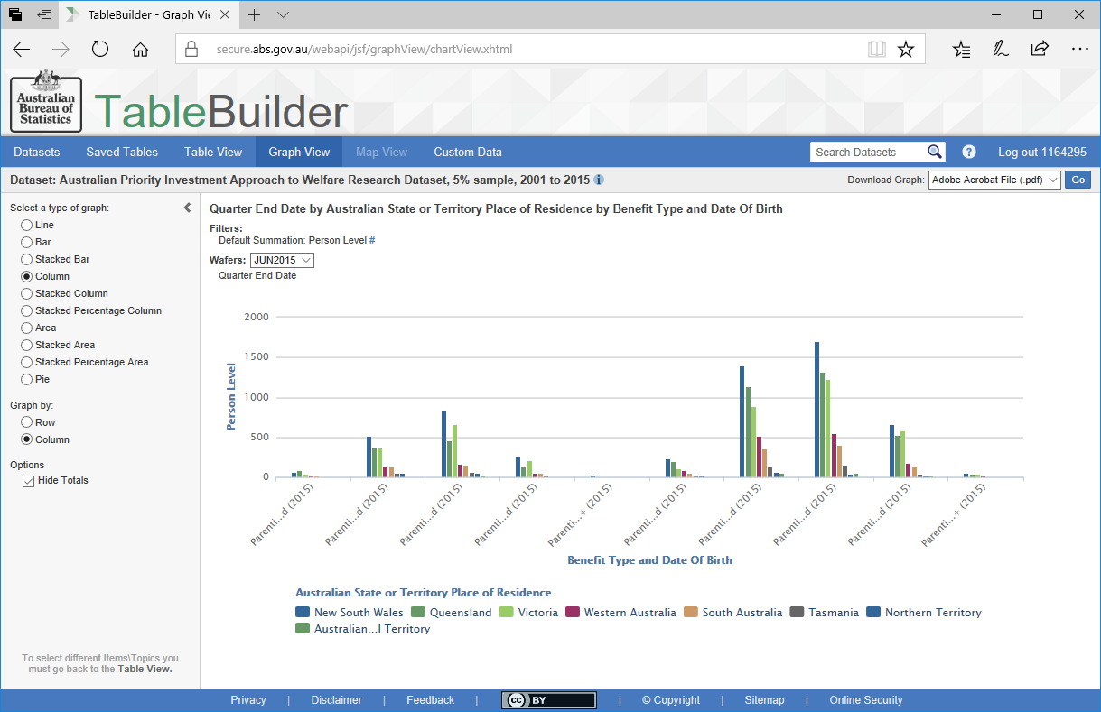
Parenting Payment by State/Territory
Notes:
Alternatively we can view the data by payment for each age group and comparing the states next to each other.
You can see now we have the colour key across the bottom for each state.

Slide 17
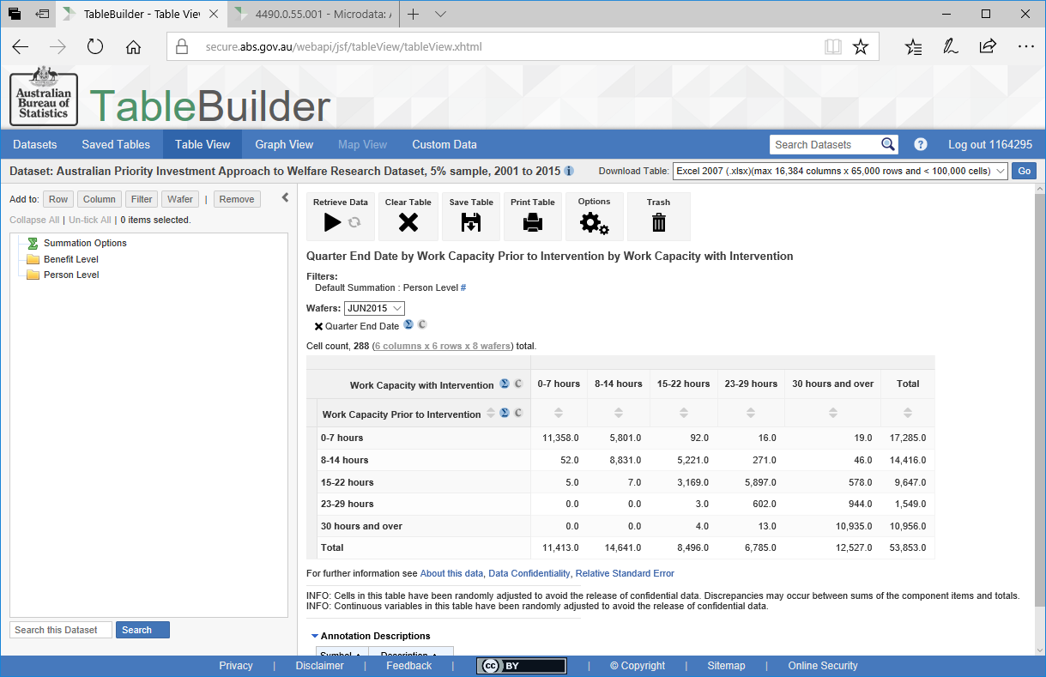
Work Capacity Assessment before and after an Intervention
Notes:
In this table I have chosen to compare recipient’s work capacity prior to an intervention and after an intervention. That is, the number of hours per week a recipient is assessed as being able to work. These will include those recipients who have partial working capacity and have had a Job Capacity Assessment or Employment Services Assessment where there are barriers to work.
In this case, where a recipient was assessed as having 8-14 hours capacity prior to an intervention and assessed as having the same 8-14 hours capacity with an intervention, they are represented here
Where a recipient was assessed as having 8-14 hours capacity prior to an intervention and then assessed as having 15-22 hours capacity with an intervention, they are represented here

Slide 18
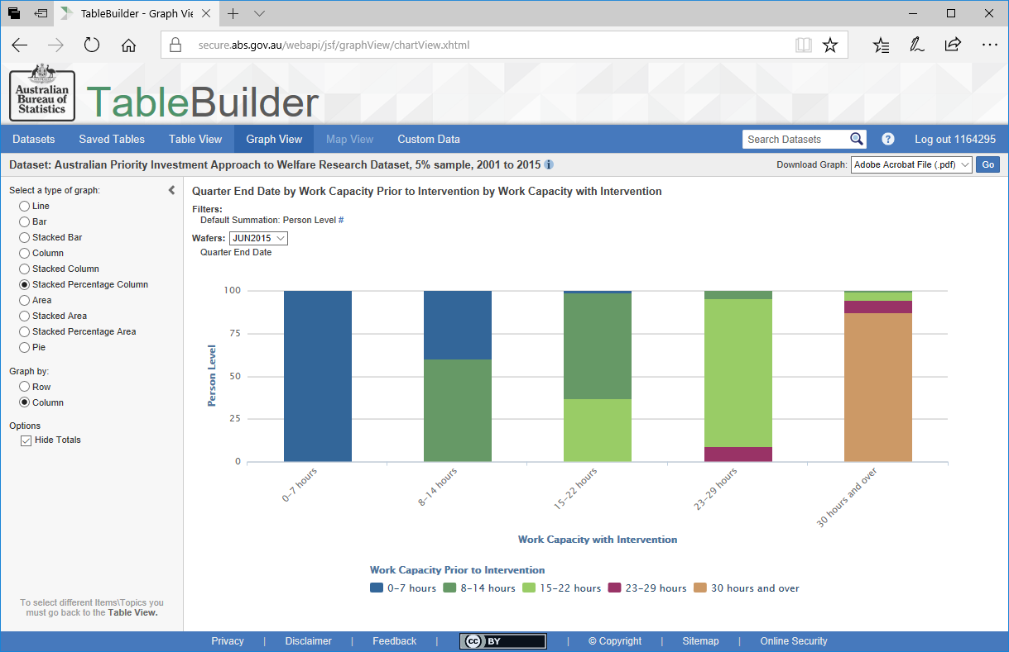
Work Capacity Assessment before and after an Intervention
Notes:
Using a different graphing option we can visually represent the trend of an increasing number of hours assessed for work capacity with an intervention.
For example you can see that of those who were assessed as being able to work 15-22 hours after an intervention, a large proportion were able to work 8-14 hours prior to an intervention (dark green).
Similarly, a large proportion of those who were assessed as being able to work 23-29 hours after an intervention were able to work 15-22 hours prior to an intervention (light green).
That is we can see an increase in capacity as assessed from a Work Capacity Assessment after an intervention.

Slide 19
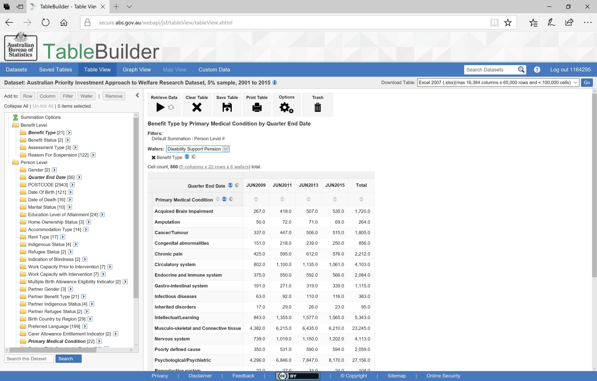
Changes in Primary Medical Condition across time
Notes:
Now to look at changes in primary medical condition across time, this table presents the primary medical condition in the rows and the April-June quarters across four different years across the top in the columns.

Slide 20
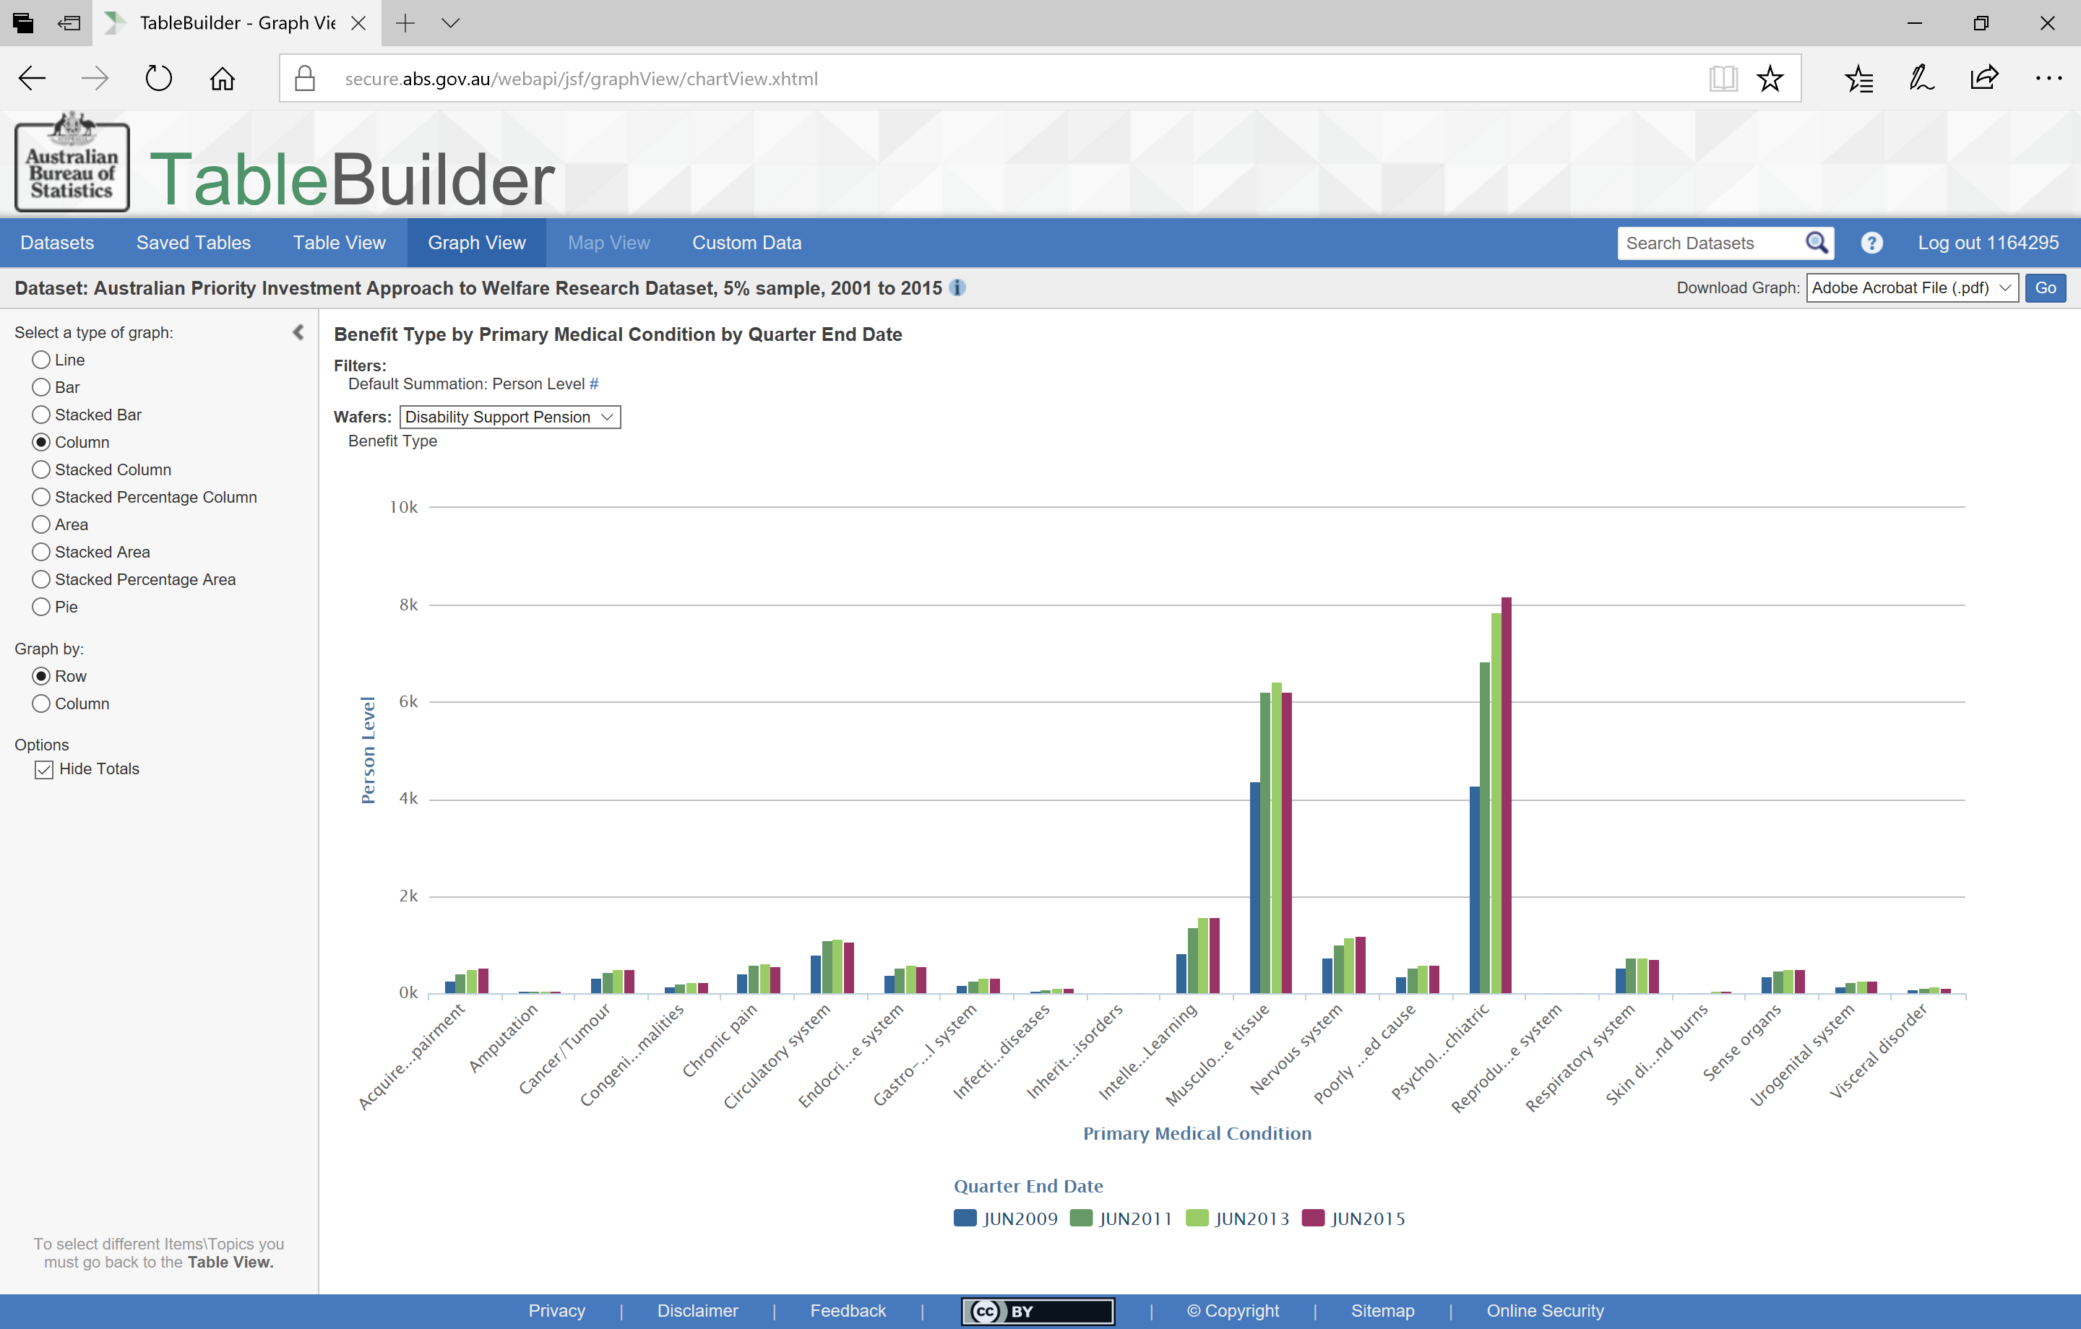
Changes in Primary Medical Condition across time
Notes:
We can see here that both
musculoskeletal conditions and psychological or psychiatric conditions are the two main primary medical conditions. In this case we are looking at
people receiving Disability Support Pension. By comparing across the four years, we can also see that this number is increasing
for psychological or psychiatric conditions.

Slide 21
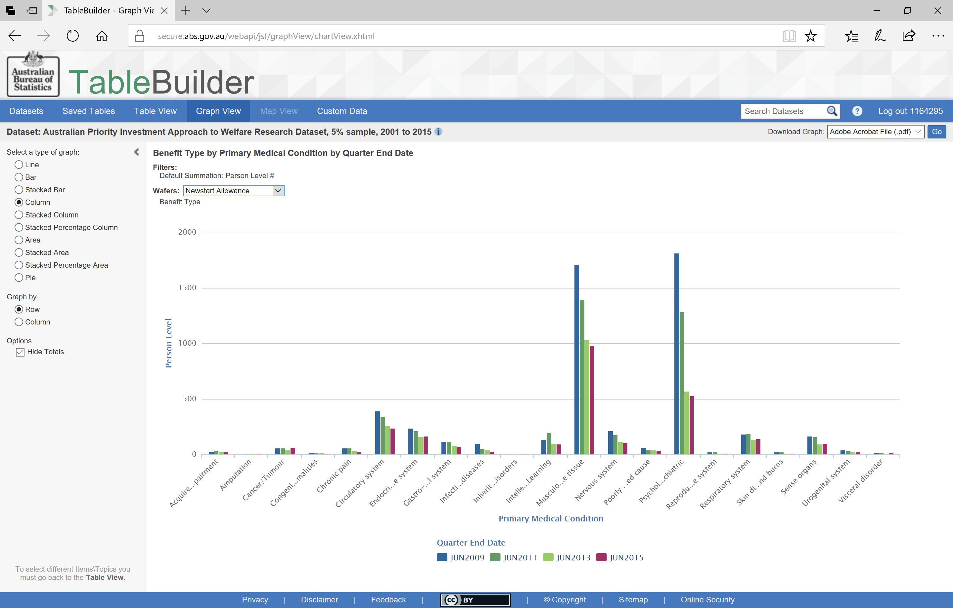
Changes in Primary Medical Condition across time
Notes:
We can use
this drop box to compare medical condition to recipients of other benefit types, in this case we are looking at those receiving Newstart Allowance. In this case, the number of recipients with psychological or psychiatric condition as their primary medical condition is
decreasing across the years.

Slide 22
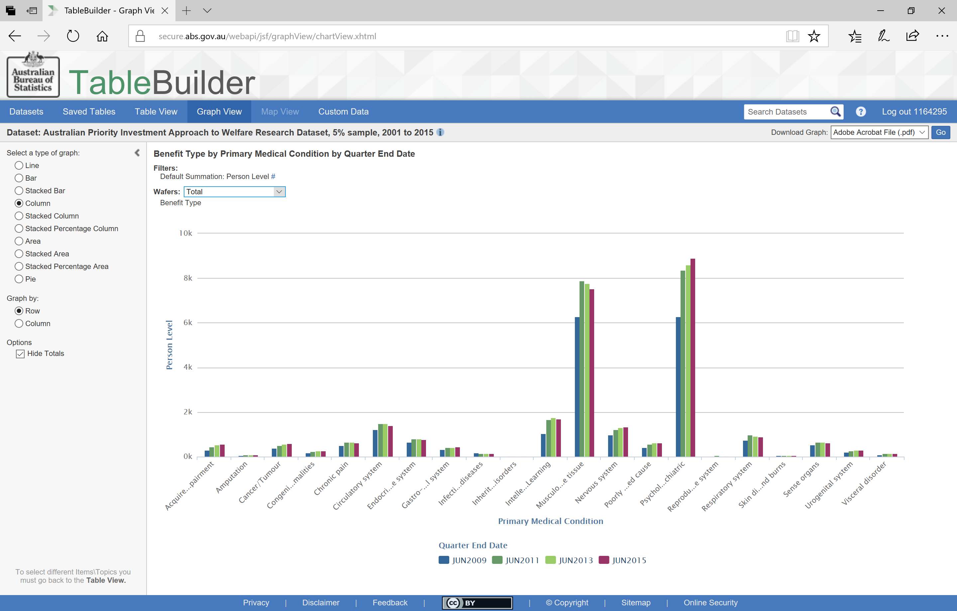
Changes in Primary Medical Condition across time
Notes:
By looking at all recipients, regardless of the type of benefit
(using ‘total’ figures), we can see that overall the number of people whose primary medical condition is psychological or psychiatric in nature, is increasing across the years.

Slide 23
Any Questions?
Thank you.
Tara Spokes, PhD
Policy Research Officer
tara.spokes@dss.gov.au
Notes:
The following session will provide some basic instructions on how to use TableBuilder, including some of the features and formatting options, using a number of research questions as examples. This session runs for approximately 15-20 minutes. I also have a list of the available variables and categories in the dataset for you to refer to in the break if you like.
Are there any questions from this session?

