Slide 1
How to use TableBuilder
2018
Notes:
Hi everyone
In this session we will walk through how to use TableBuilder using a few examples. The notes from these presentations will be available afterwards on the community grants hub website for your reference, so please don't feel that you need to remember everything!
We think the Tablebuilder tool will be very useful to a wide number of researchers as well as those applying for TTL Fund grants. I hope that this presentation will enable you to make use of this data yourself.
This presentation has been designed as a ‘how to’, with tips and tricks, to enable you to get the data from TableBuilder that you need for your grant application.

Slide 2
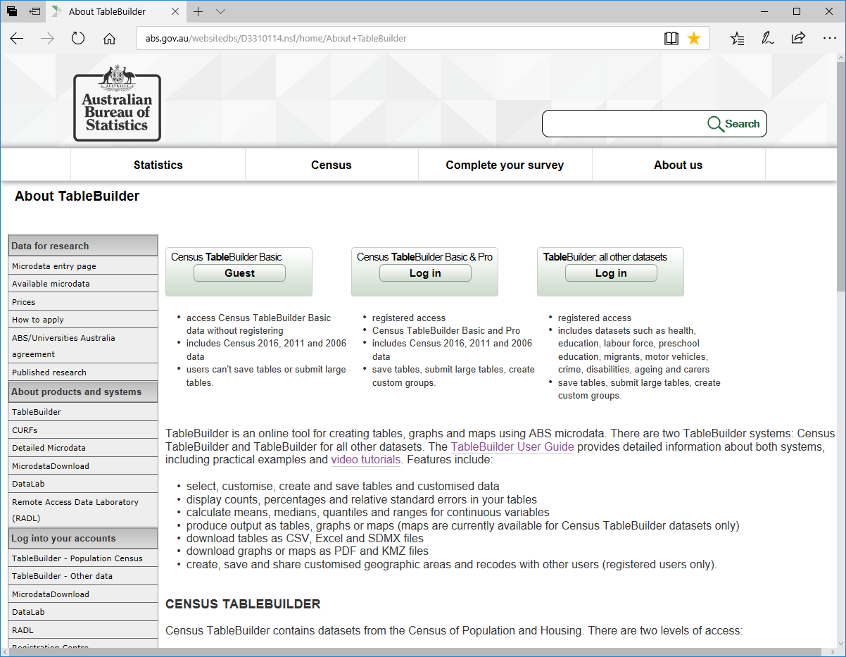
TableBuilder Log In Page
Notes:
TableBuilder holds over 50 datasets other than PIA. The first two buttons here will take you to the Census data.
There is an open version of the Census data that you are able to go in and play with as a ‘Guest’ without needing to register. This might be good to do if you would like to get a feel for what you can do in TableBuilder before getting access to the PIA dataset.
Once you have registered you can log in to the PIA dataset using this “All other datasets button on the right.

Slide 3
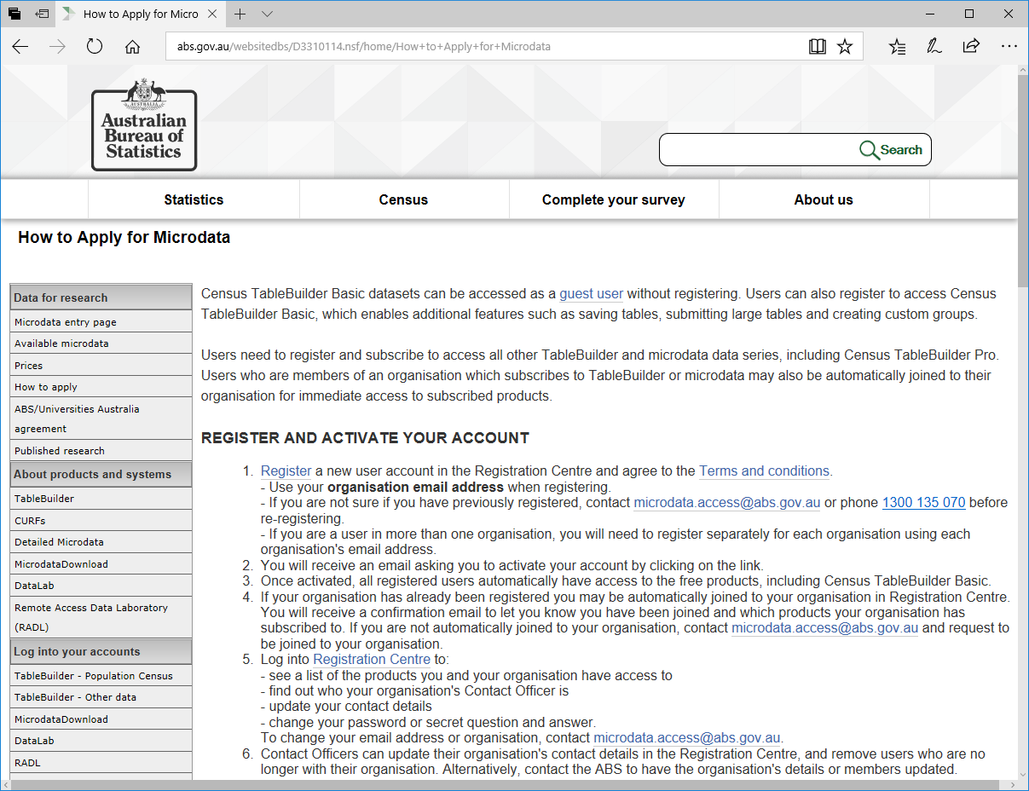
ABS Registration Page
Notes:
To apply for access to TableBuilder go to ‘How to apply’ and select
Register. If your organisation hasn’t registered for data access with ABS before, you will need to provide some additional information about your organisation as part of the registration process.
This is the email address you need to write to with any access questions you might have.

Slide 4
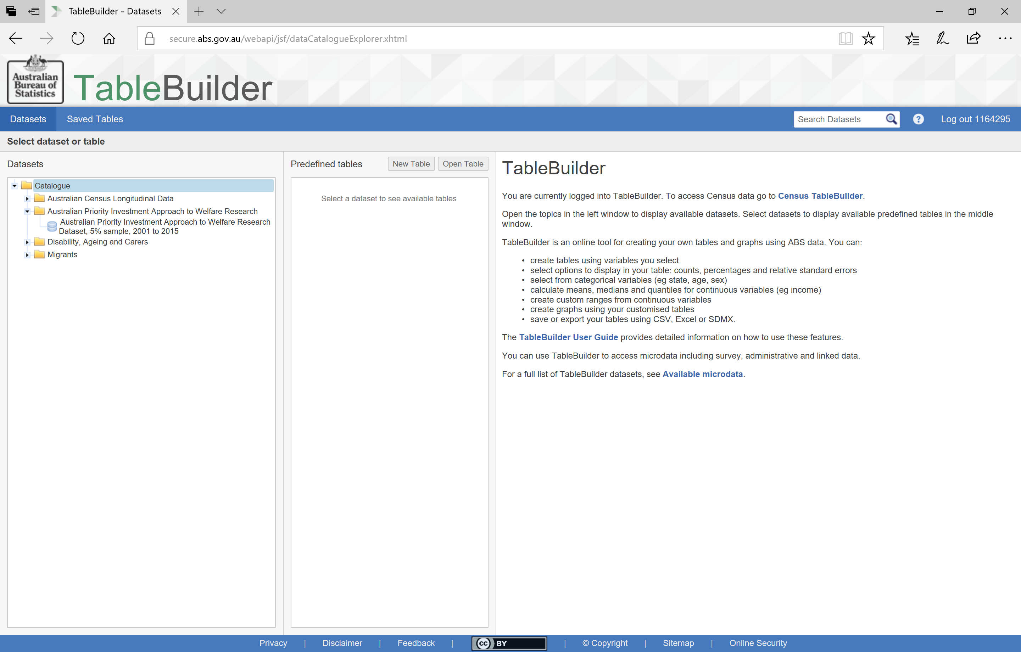
TableBuilder Front Page
All datasets that the user has access to
Three predefined tables and tables the user has saved
Information about TableBuilder and access to the User Guide
Notes:
Once you have registered with TableBuilder and have logged in, this is the first screen you will see.
The datasets you have access to will be listed here in the left column and this will depend on the datasets that your organisation has access to. For this reason it is important to register using your organisation email, not a personal email account like bigpond or gmail.
You should see the Priority Investment Approach, or PIA, dataset listed here. If you don’t see it, please write to the email I highlighted in the previous slide to ask for access.
The middle column will display the predefined tables and any tables you save over time (we will go into this later).
When no dataset has been selected on the left, the right hand column provides background information to TableBuilder and links to the User Guide.
You can also access the TableBuilder User Guide at any time by this Help button at the top right.
And you can come back to these pages anytime by selecting the Datasets tab.

Slide 5
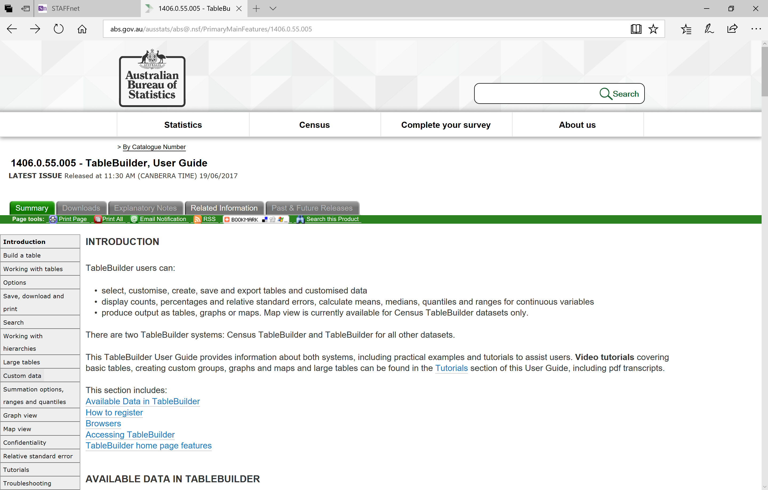
ABS TableBuilder User Guide
Notes:
As a side note, this is the TableBuilder User Guide
Use the navigation links on the left to move through the topics.
The tutorials link will take you to a selection of videos created by ABS using the Census TableBuilder.

Slide 6
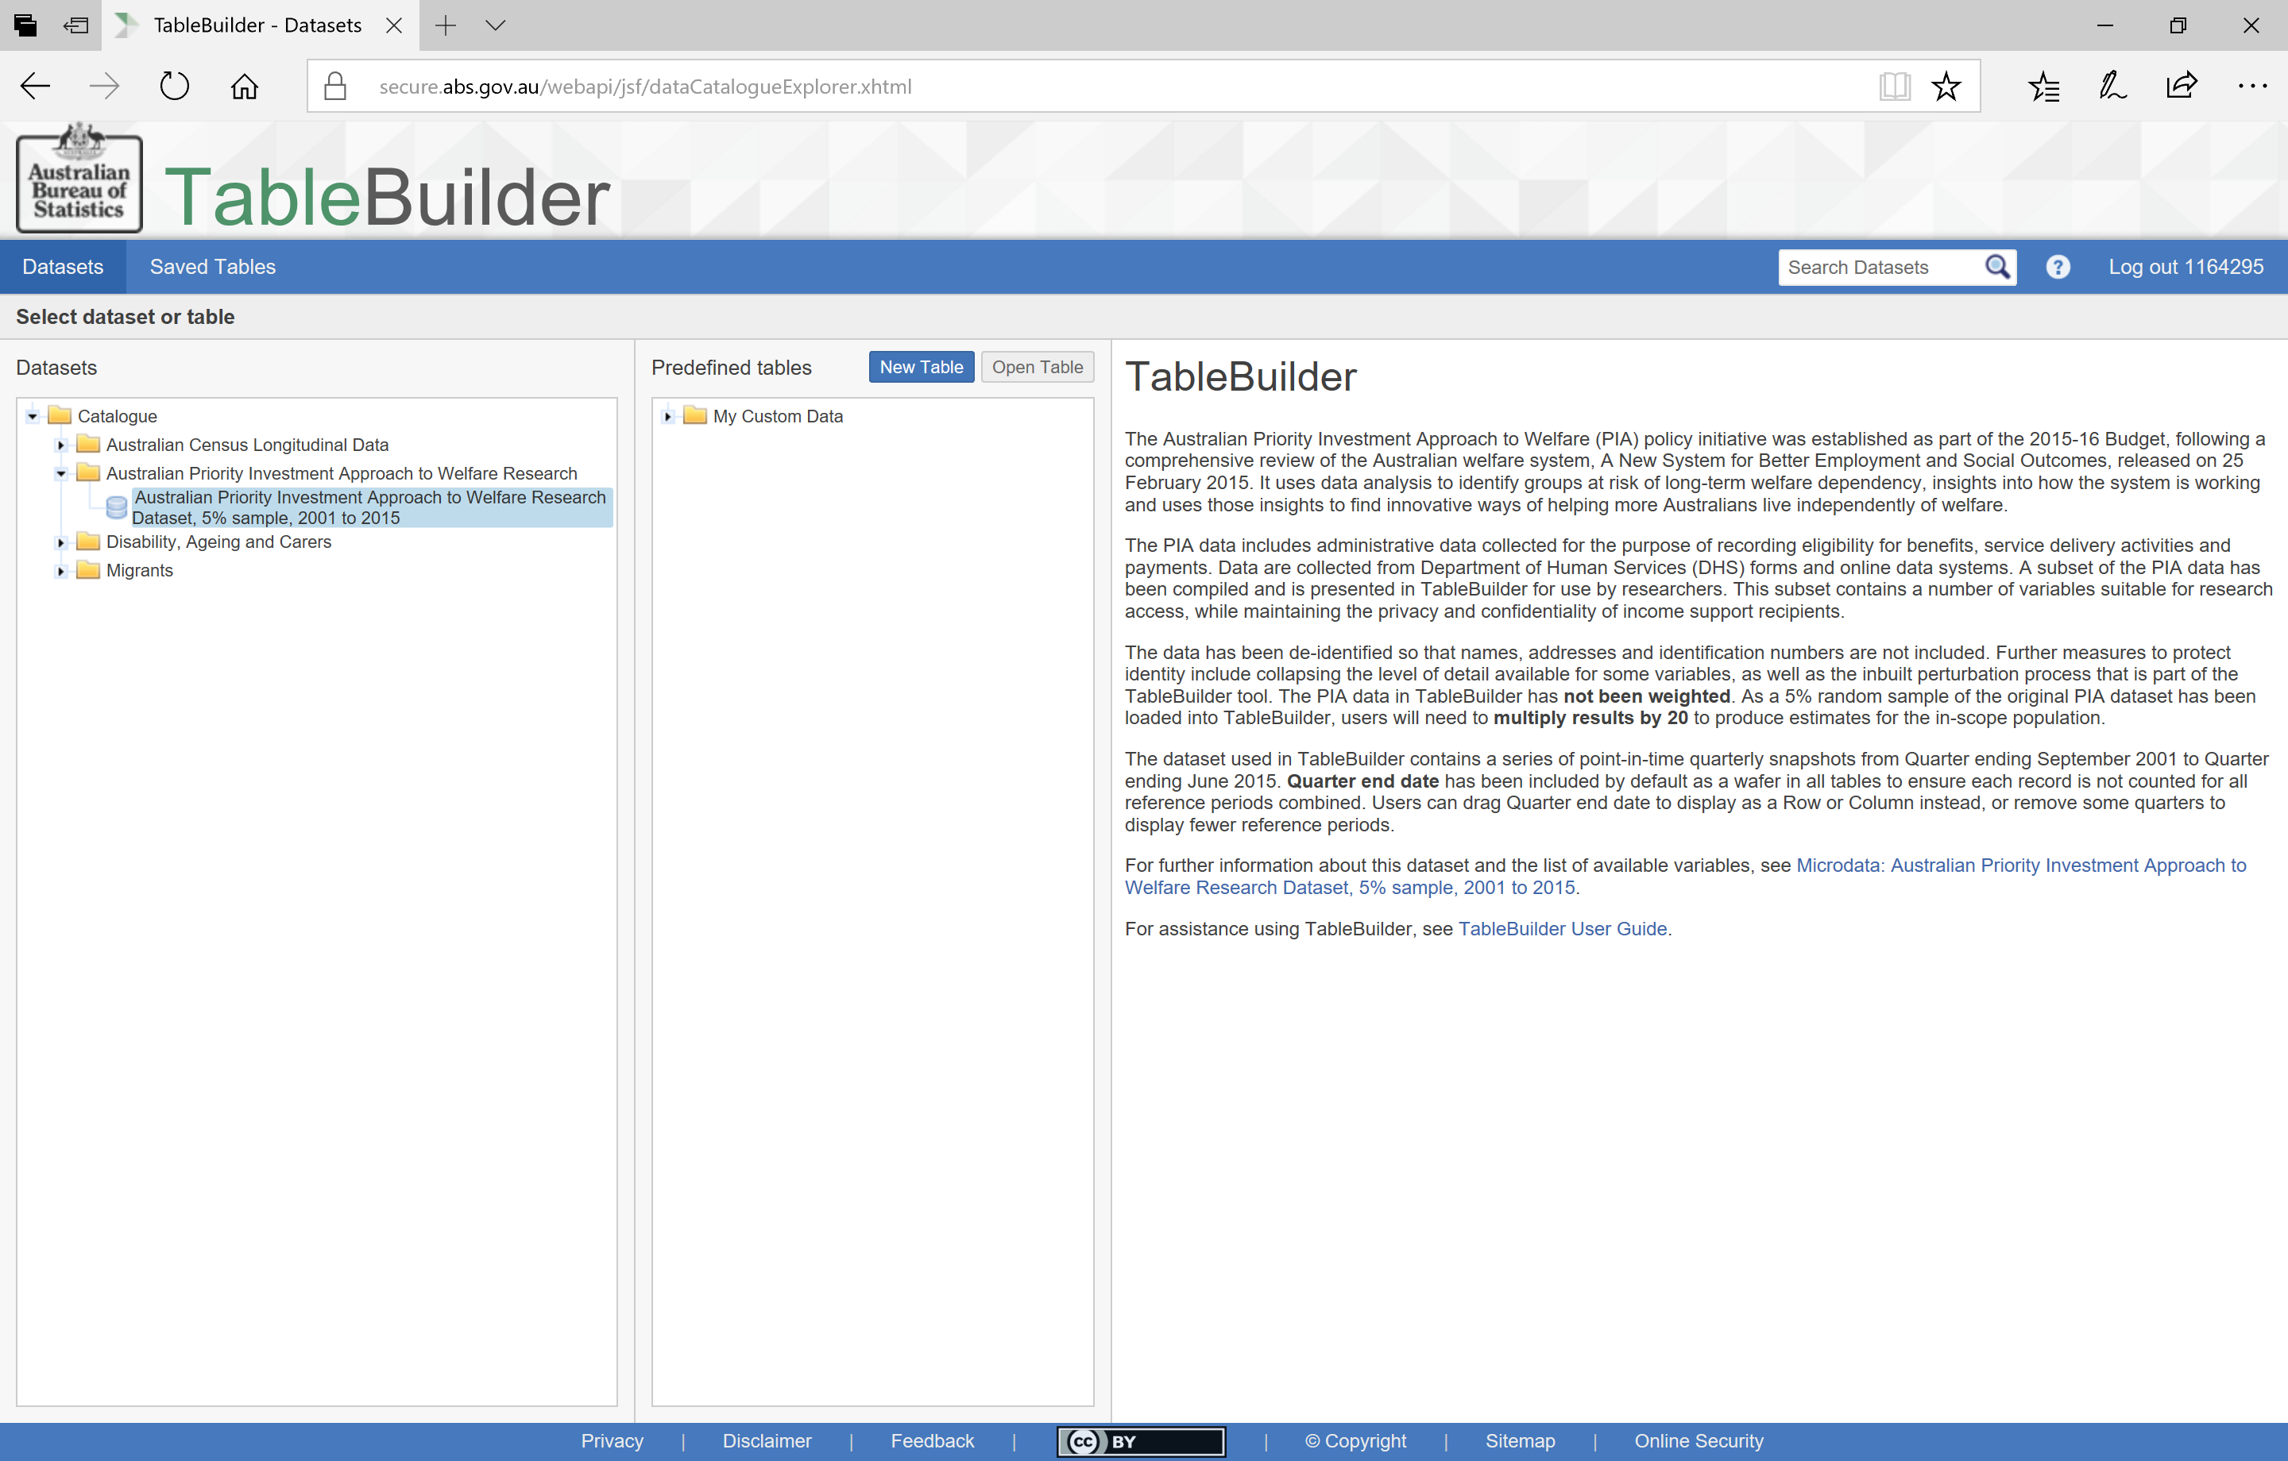
TableBuilder Front Page
Information about the PIA dataset
Notes:
Now that I have selected the PIA dataset on the left,
the information on the right now provides background information to this dataset and links to more detailed information.
To get started, you can select one of the existing tables and then ‘Open Table’
Or you can start a New Table. We will create a new table for this demonstration.

Slide 7
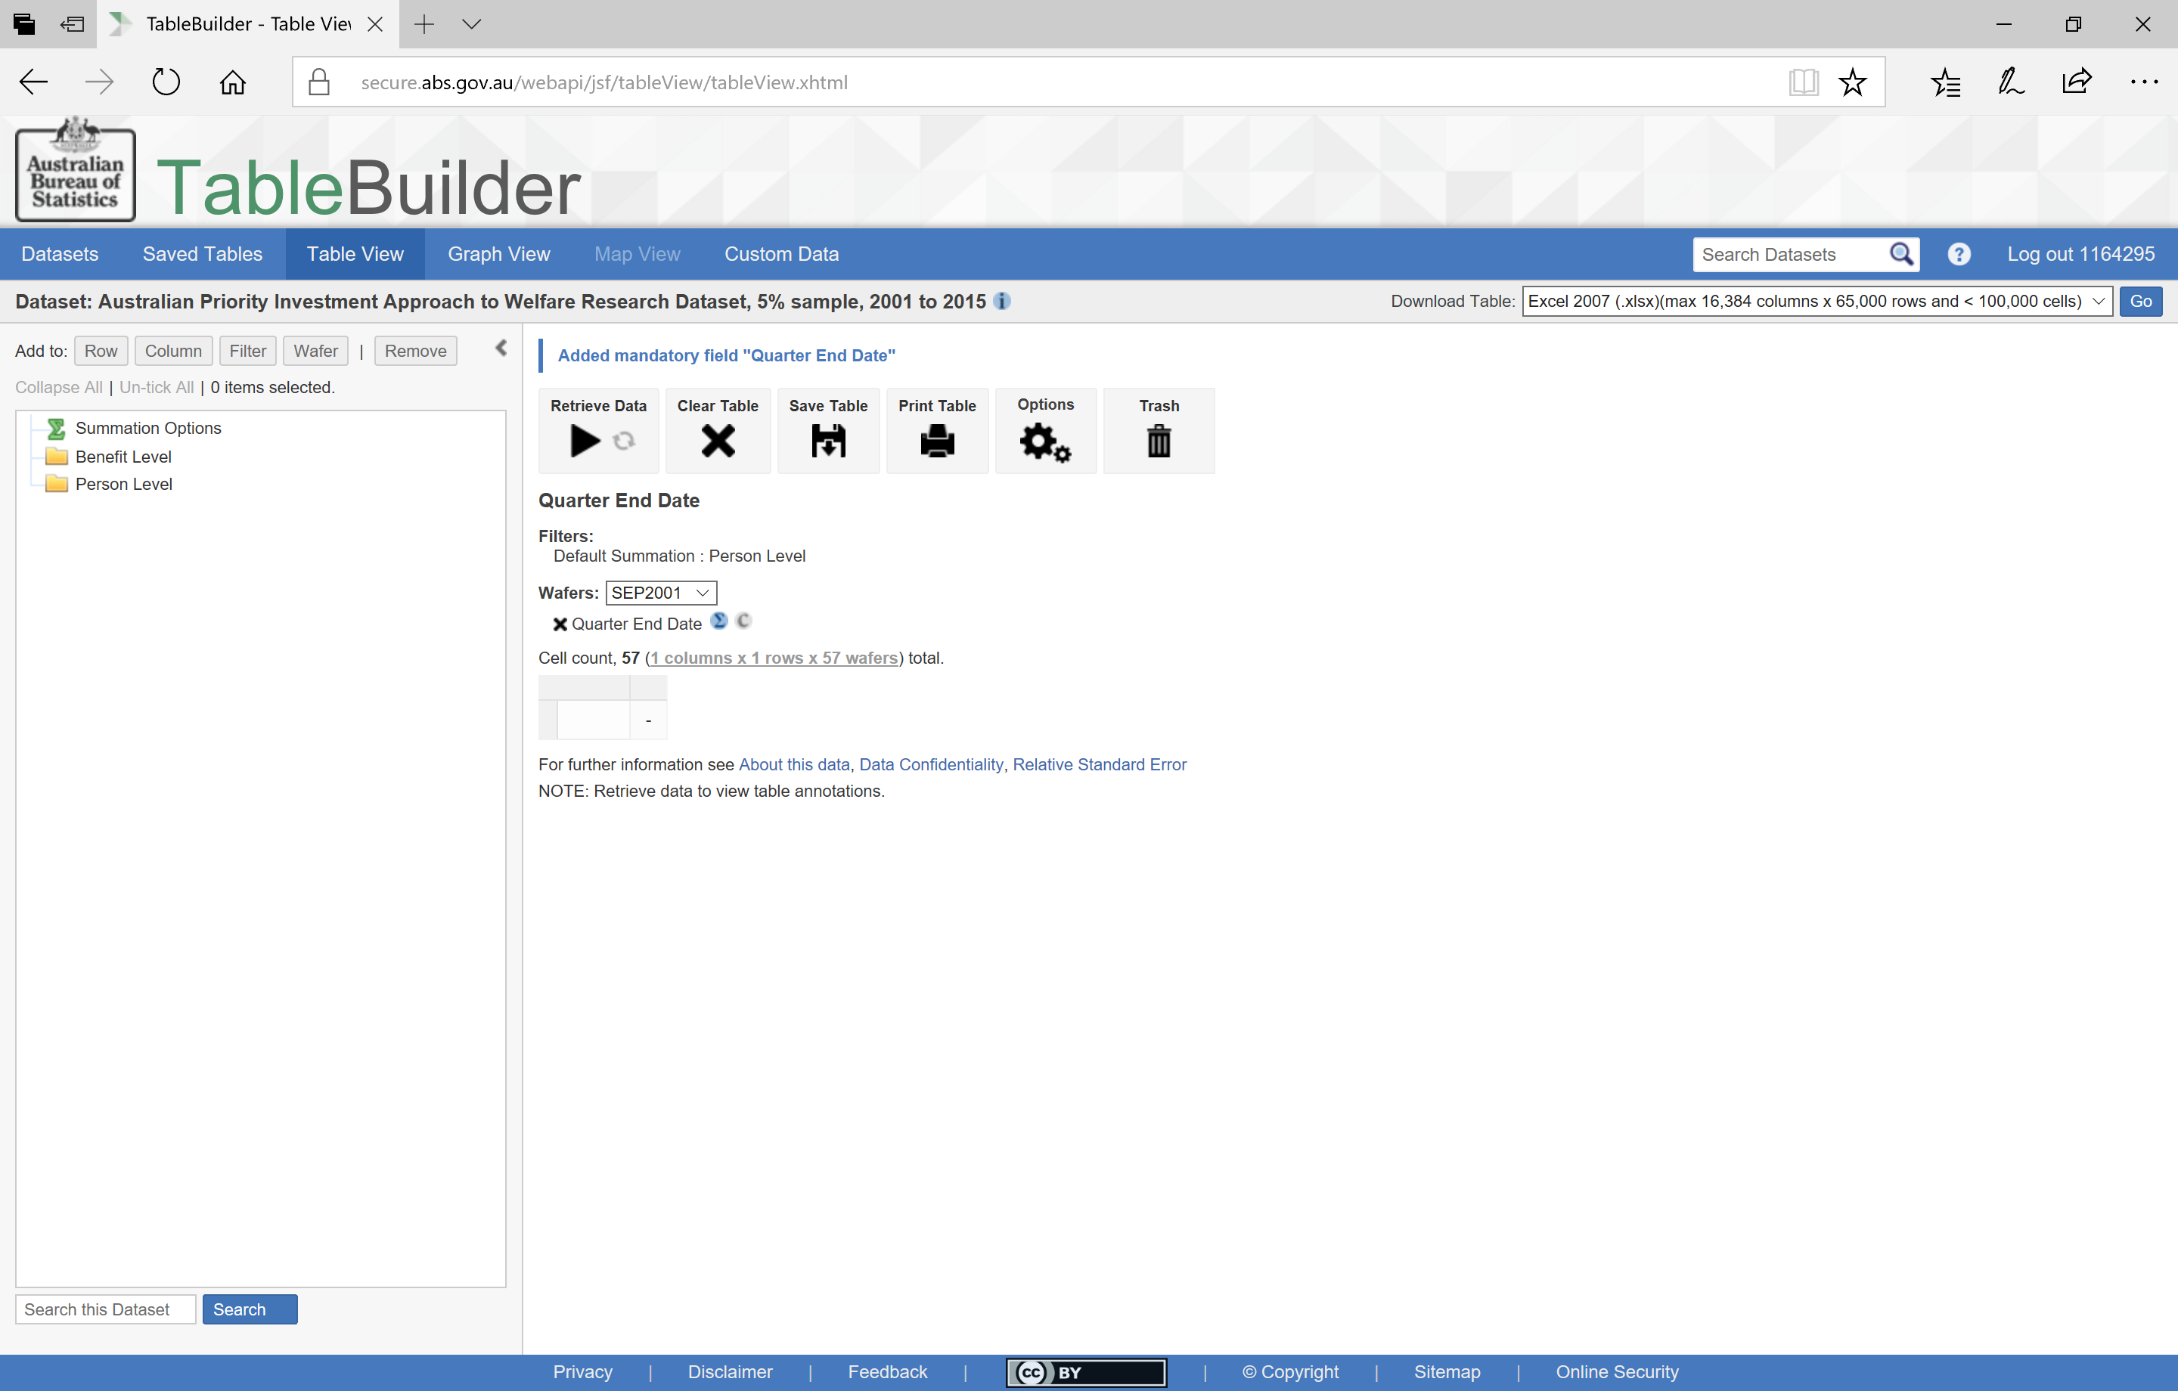
New Table
Notes:
When you go in to a new table you will see this screen.
At all times when using TableBuilder you are able to select either the ‘i’ icon at the right of the title or the ‘About this data’ link at the bottom of the main screen. These will both take you to the background information about the Priority Investment Approach data and how it has been applied to TableBuilder.
As described in the previous session, the PIA dataset includes 56 separate quarterly snapshots over 14 years. The table has been designed so that the variable that identifies which of these quarters you are looking at is
a mandatory field and must be included somewhere in your table. You can have it in the columns or rows of your table, but by default it is in the wafer. Adding any variable to the wafer will turn a 2D table (with rows and columns) into a 3D cube. That is, the categories you add to the Wafer become the layers of your table

Slide 8
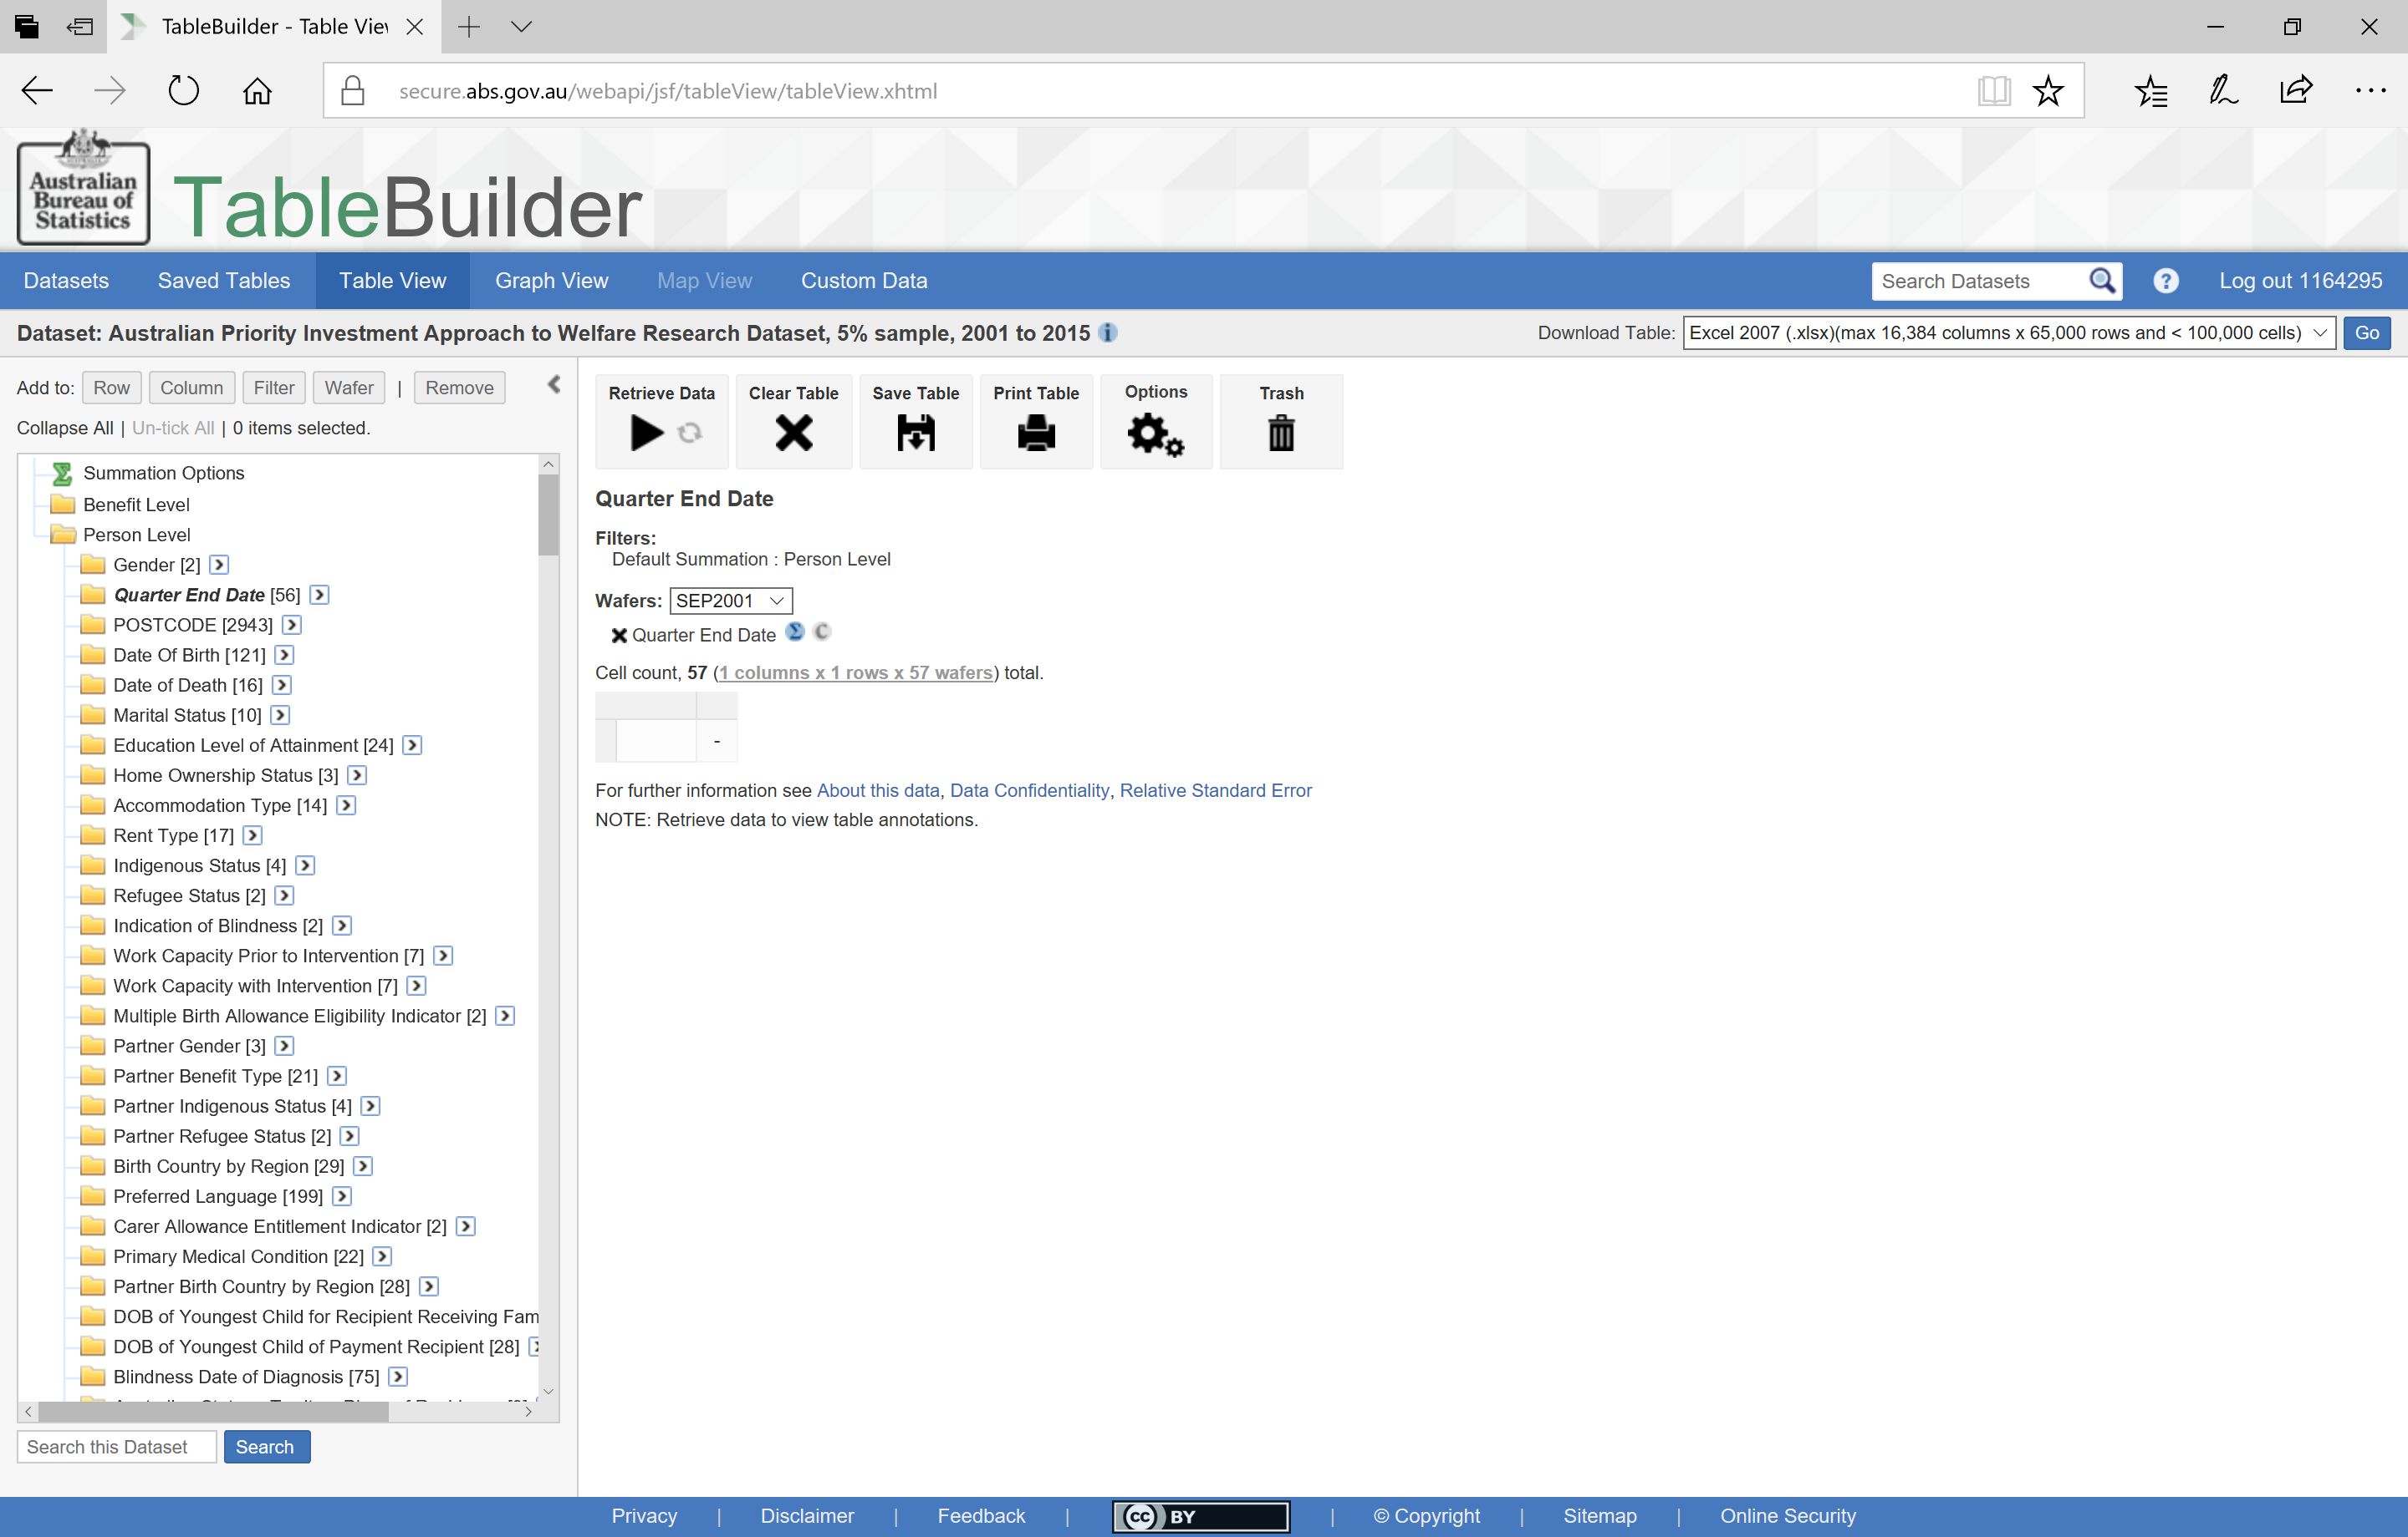
New Table
Notes:
By expanding the Benefit level and Person level folders, all 38 variables will be displayed. The number at the end of each variable title describes the number of categories available in that variable.
Here you can see there are 56 quarters in the Quarter End Date. By default, all 56 quarters are added to the wafer.
Having your table retrieve data for all 56 quarters for every table design you create, will increase the size of your table and slow down the time it takes to retrieve data. To make your table smaller and faster, you can remove those quarters that you are not interested in.

Slide 9
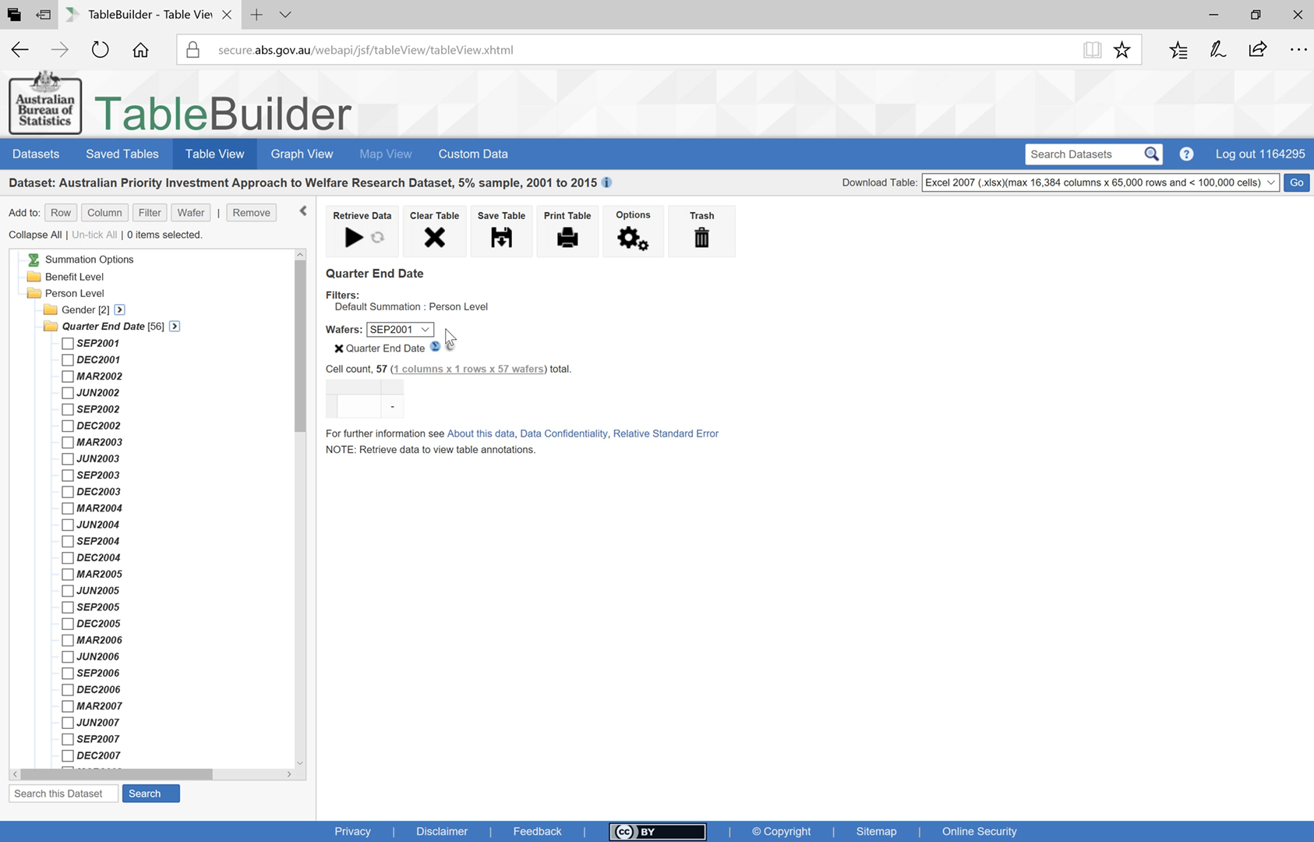
Removing quarters from the wafer
Notes:
Play: You can see all the quarters listed in the Wafer to start. To select many categories at a time, you can tick the first and then hold shift and tick the last, and it will include all categories in between. Here I have removed all quarters except for the latest one. Now my table will include only the data from the most recent time period.

Slide 10
How many Carers are in each age group?
Notes:
Let’s say I want to use TableBuilder to look at the age distribution of people who are receiving Carer Payment.

Slide 11
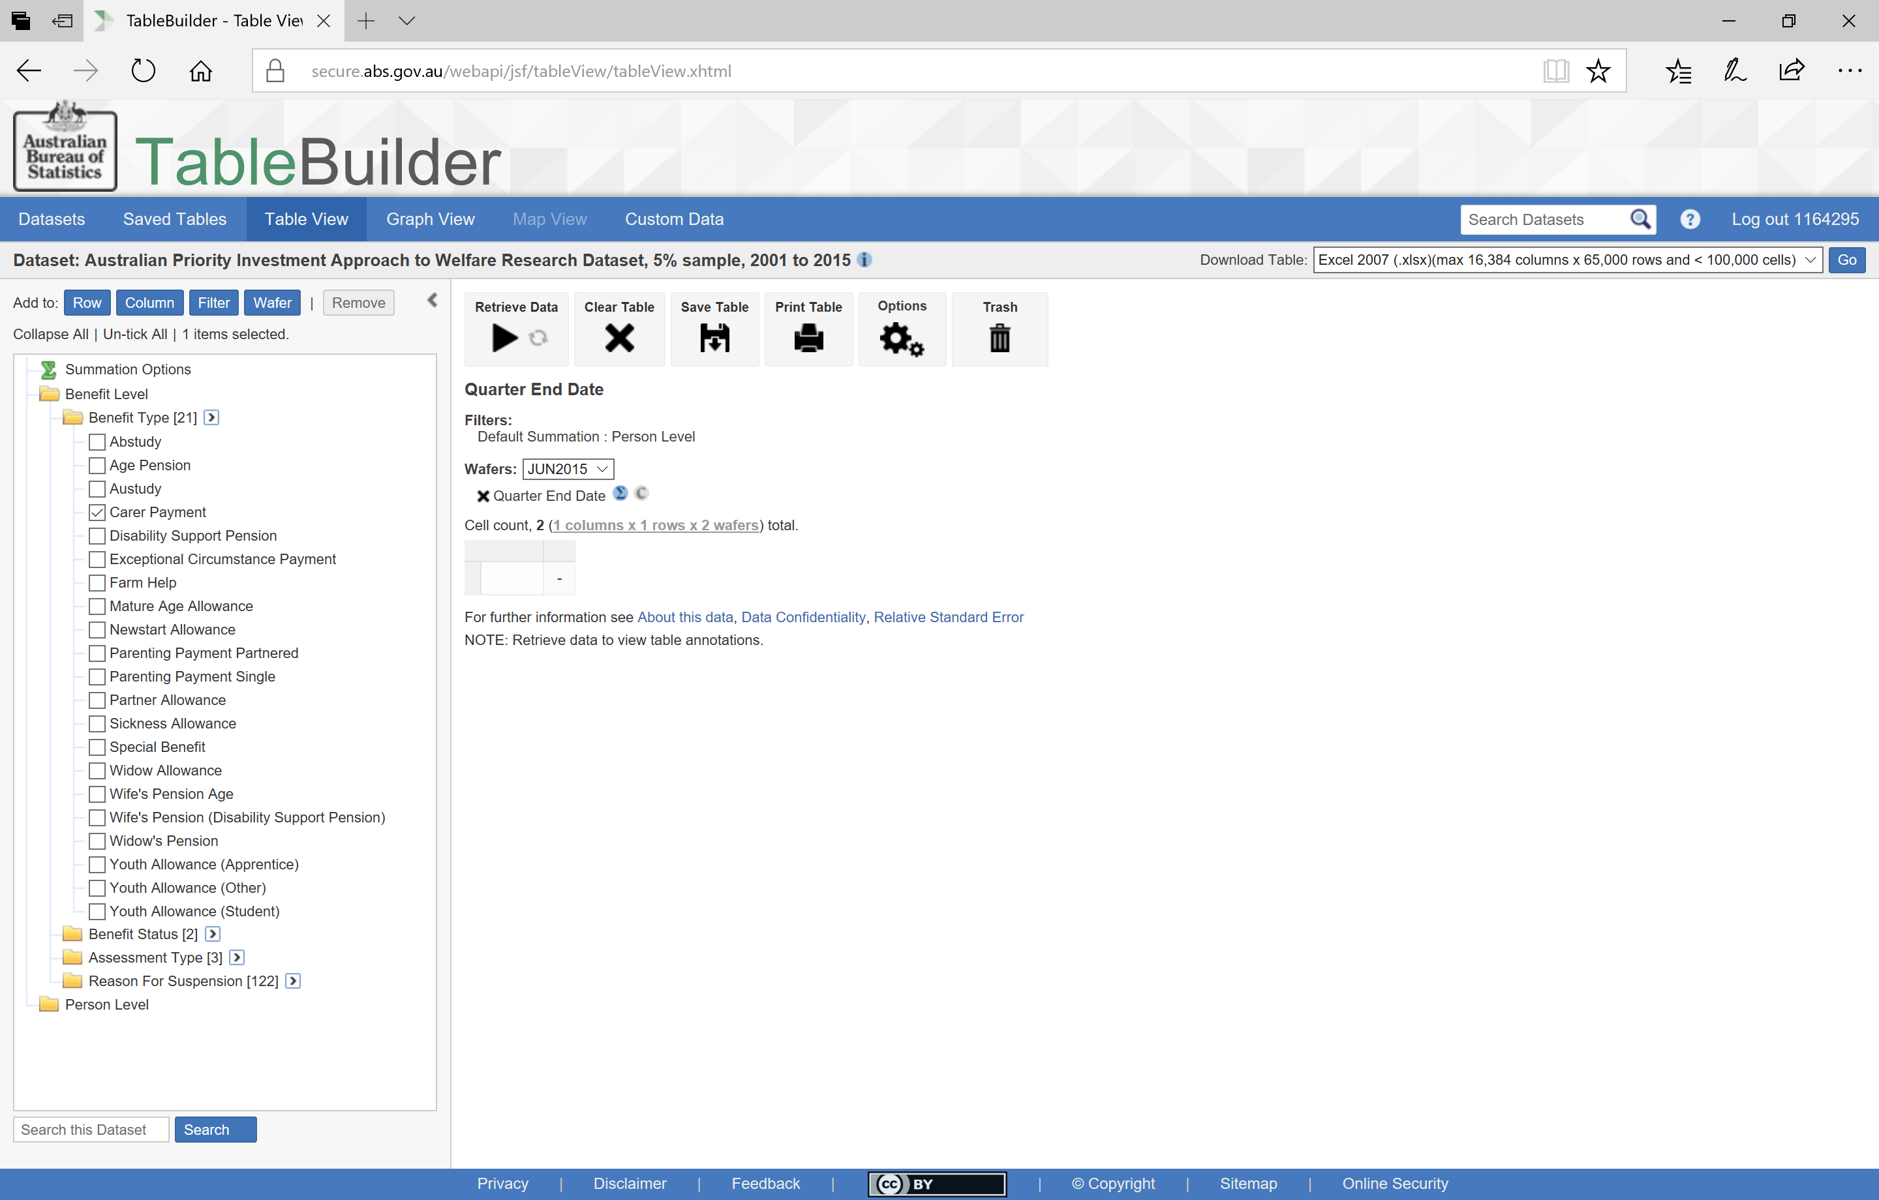
Adding a category to the filter
Notes:
By expanding the Benefit Type variable you can see all benefit types available.
Selecting the particular benefit you are interested in
allows you to use the buttons across the top. We will add Carer Payment as a Filter. Using the filter means that only those records (or people) who are on Carer Payment will be added to the table.

Slide 12
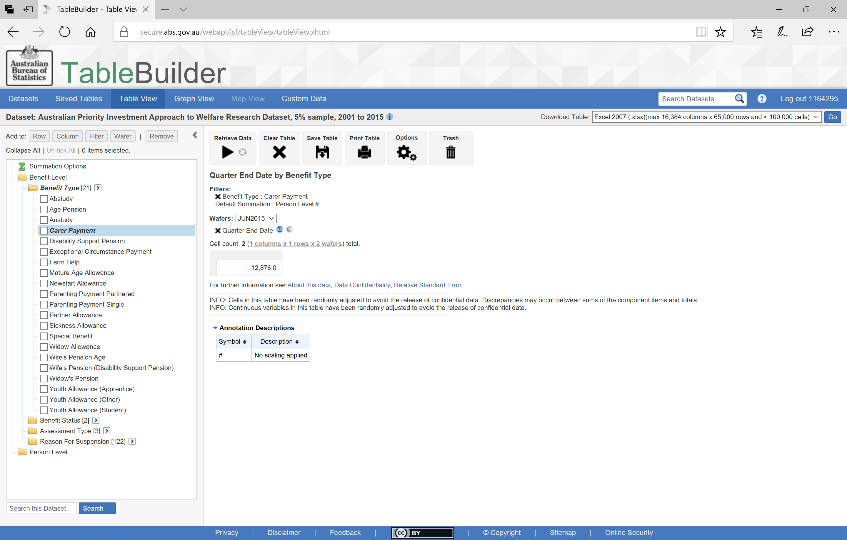
Reading the data
Notes:
So far we can see that
In June 2015,
there were 12,876 recipients of carer payment. Remember this is a 5% sample so for population estimates we would multiply this by 20.
To find out “How many Carers are in each age group?”, we can add all the age groups to the table.

Slide 13
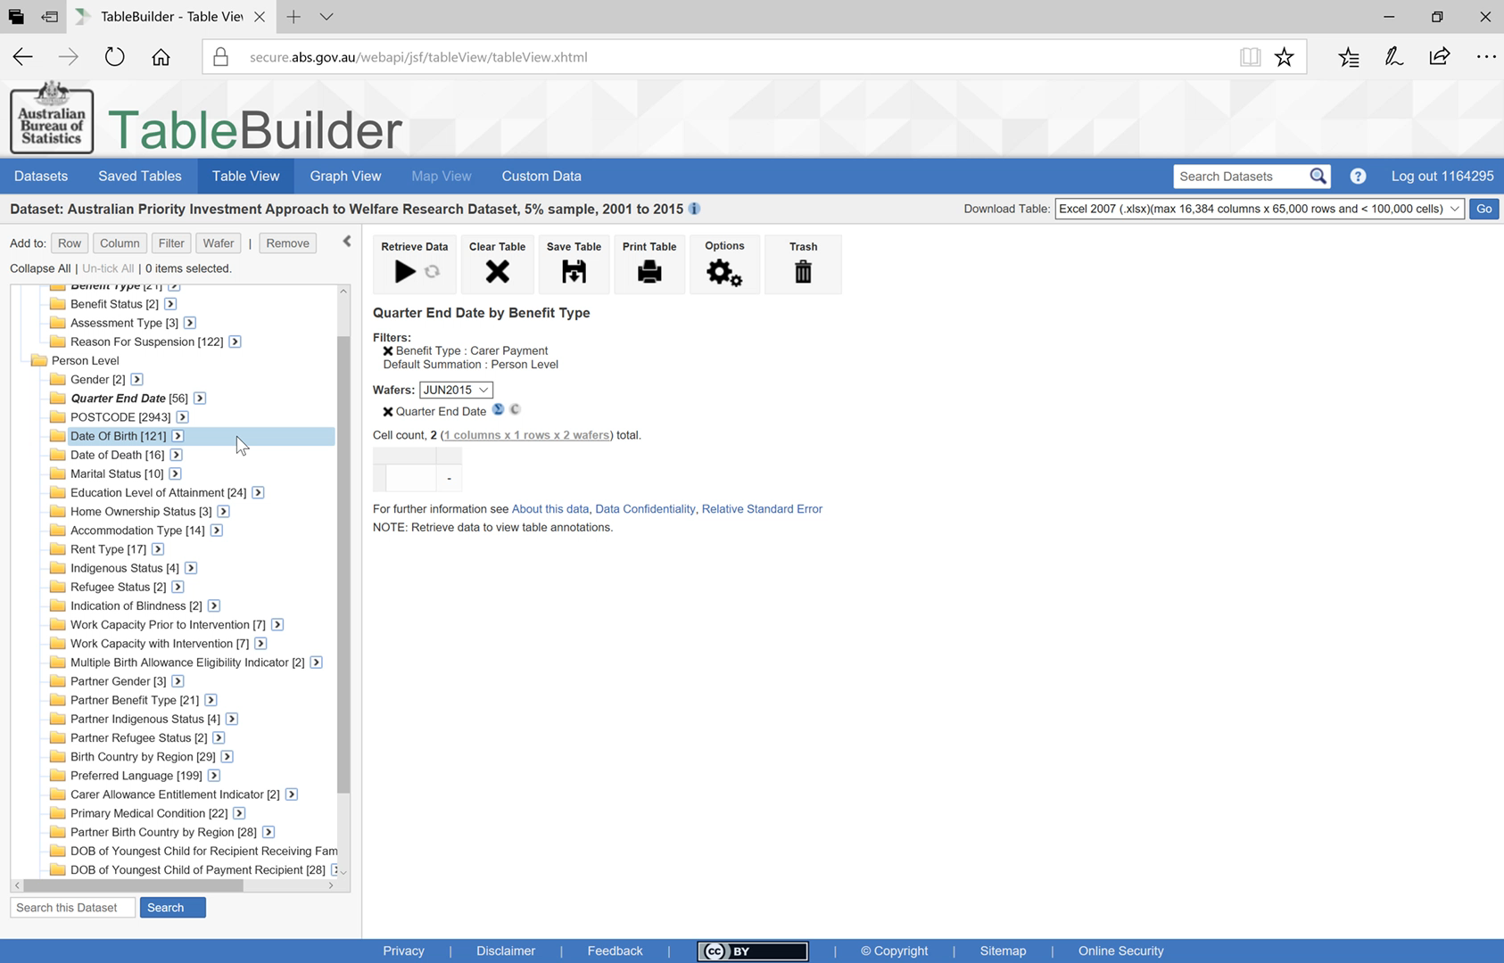
Adding a whole variable
Notes:
PLAY: When you click and hold a variable, the pop up menu of Row, column and Wafer appears. You can then drag and drop your variable into the one of these to have the whole variable added to the table. In this case we have added Date of Birth to Row to have the years listed vertically.

Slide 14
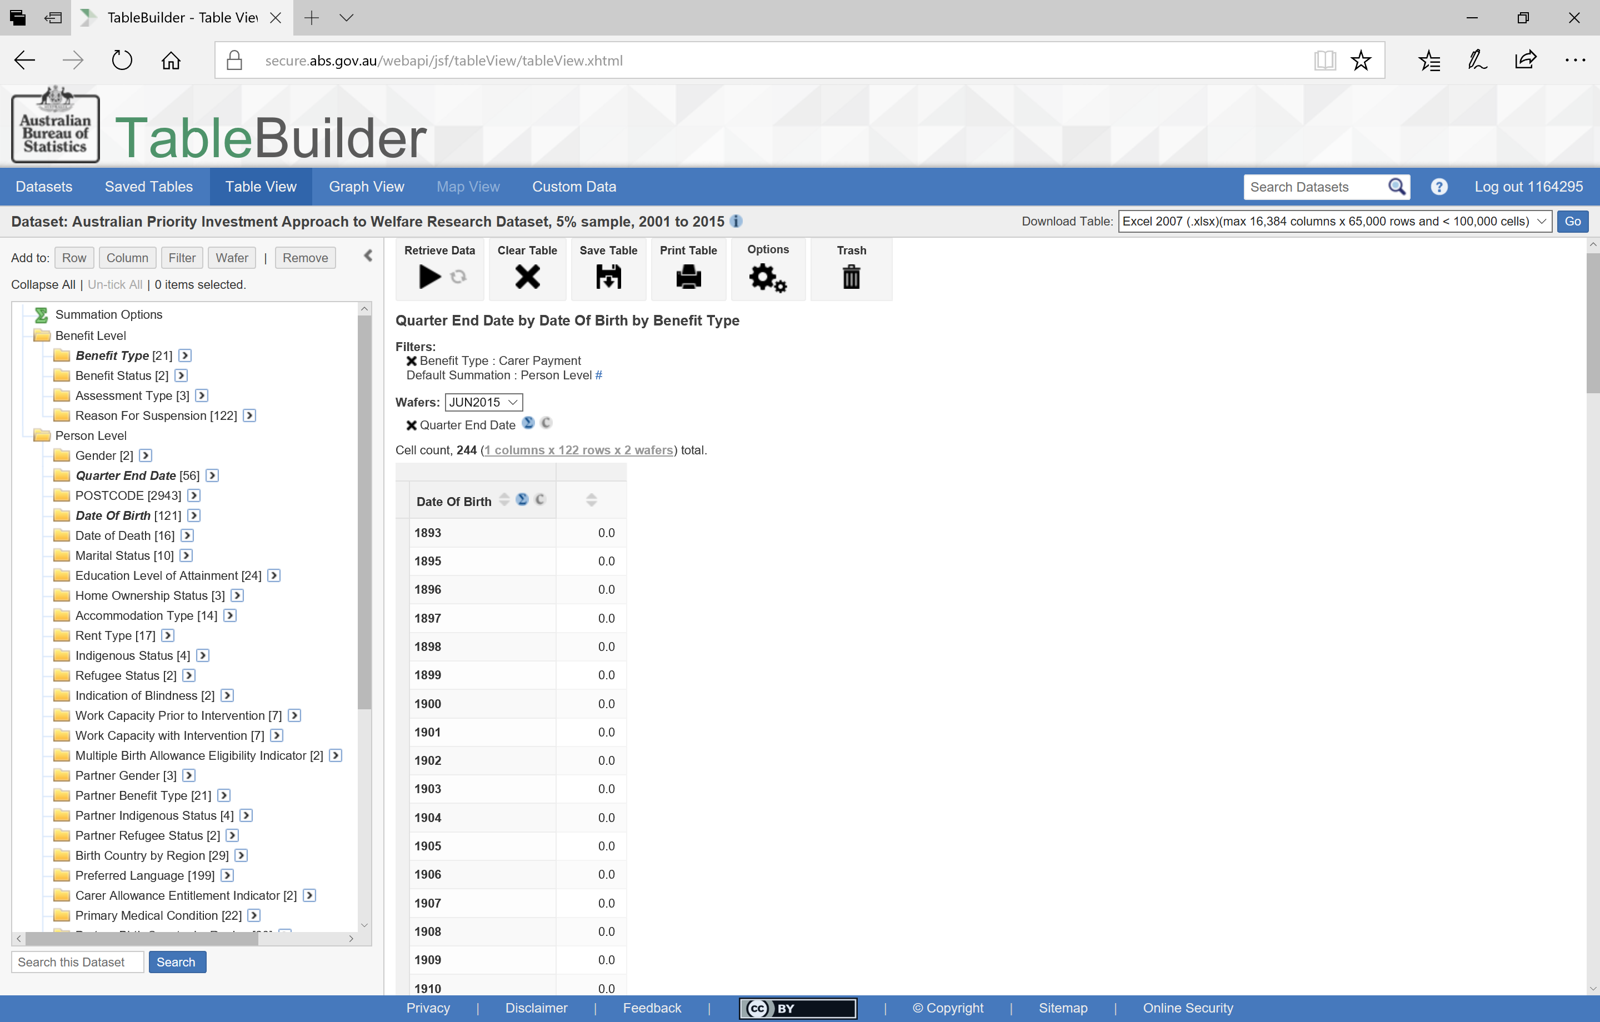
Finding parameters in the data
Notes:
By selecting ‘Retrieve Data’ we will see how many people who were receiving Carer Payments in June 2015 were born in each year of our data.
By scrolling up and down we see that the earliest date of birth is 1925 and the latest is 1997. That is, our oldest carer for that quarter (June 2015) was 90 years old and our youngest was 18.

Slide 15
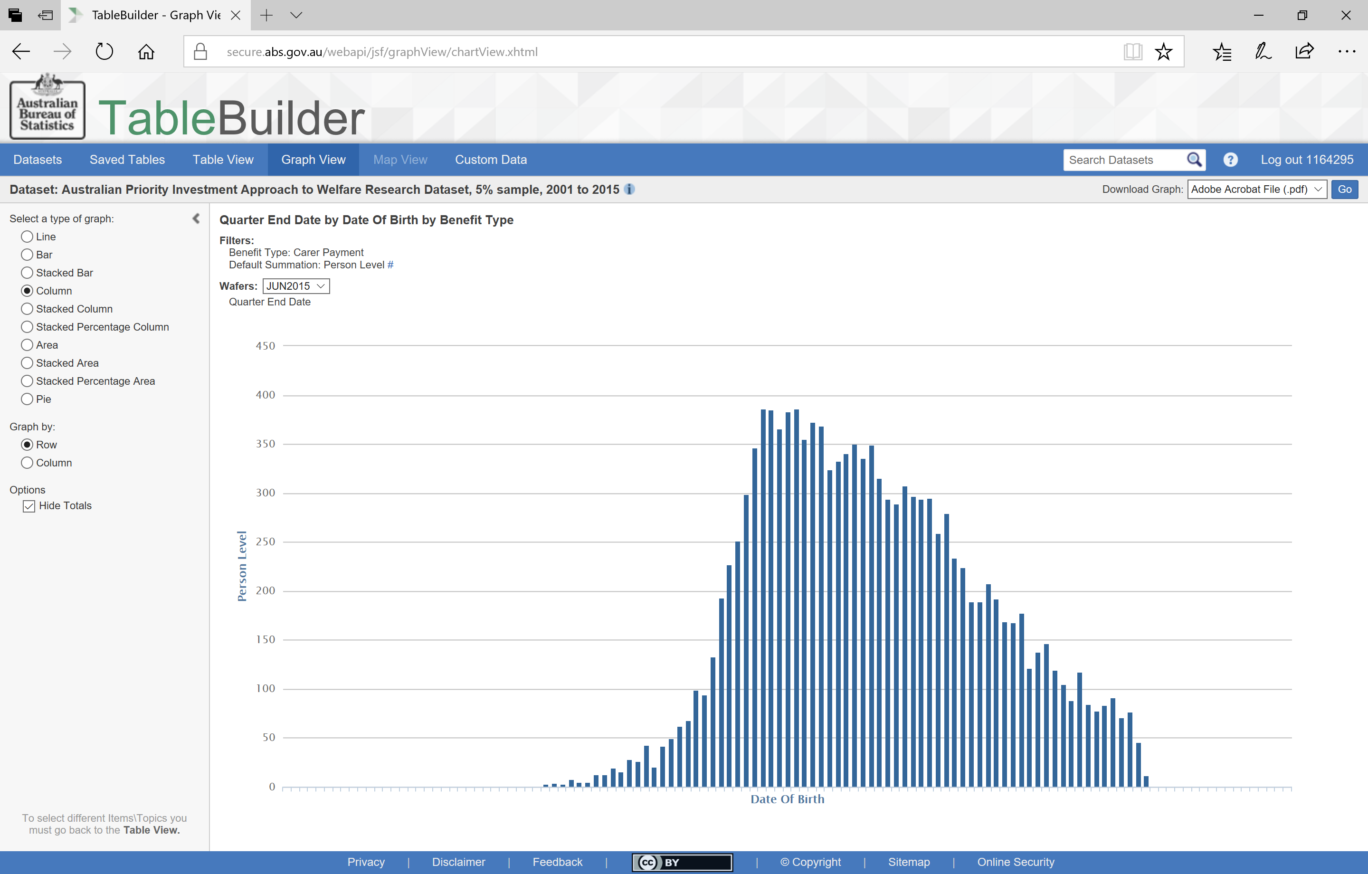
Viewing a graph
Notes:
To see a graphic representation of this data you simply select the
Graph View from the tabs across the top.
One thing to note is that everything you can see with TableBuilder is always group level or aggregate data. You will never see the individual unit level data that sits ‘behind’ the tables.

Slide 16
How many Carers are in each age group?
How does this change over time?
Notes:
Let’s see how the age of Carer Payment recipients has changed across time.

Slide 17
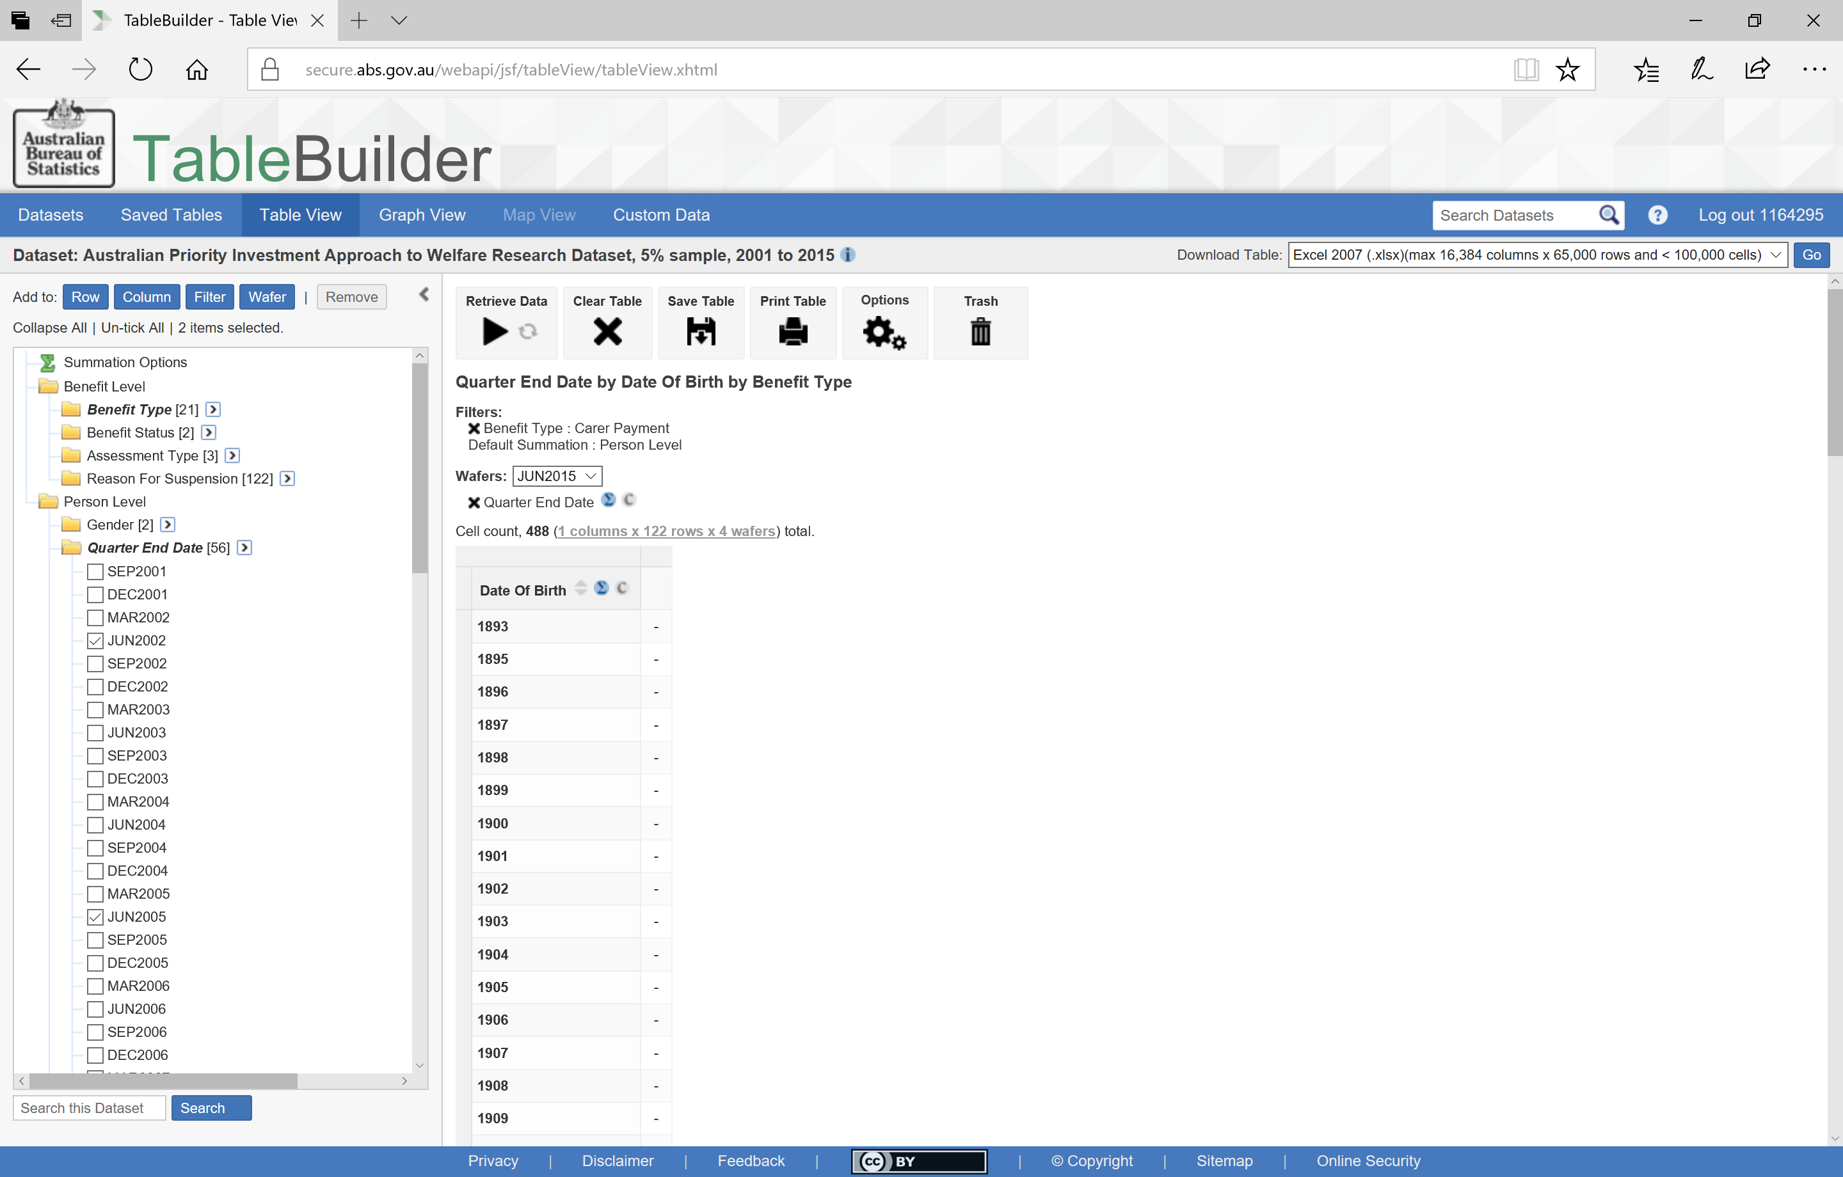
Adding a few categories
Notes:
I select ‘Table View’ from the tabs at the top to make changes to the table. To be able to look at age distributions over time,
I added four more quarters I was interested in by ticking the categories
And then adding them to the Wafer
To compare quarters alongside each other I have moved them from the Wafer to the Column. Because Quarter End Date is a mandatory field, it cannot be removed entirely from the table and can only be moved around between Wafer, Row and Column.

Slide 18
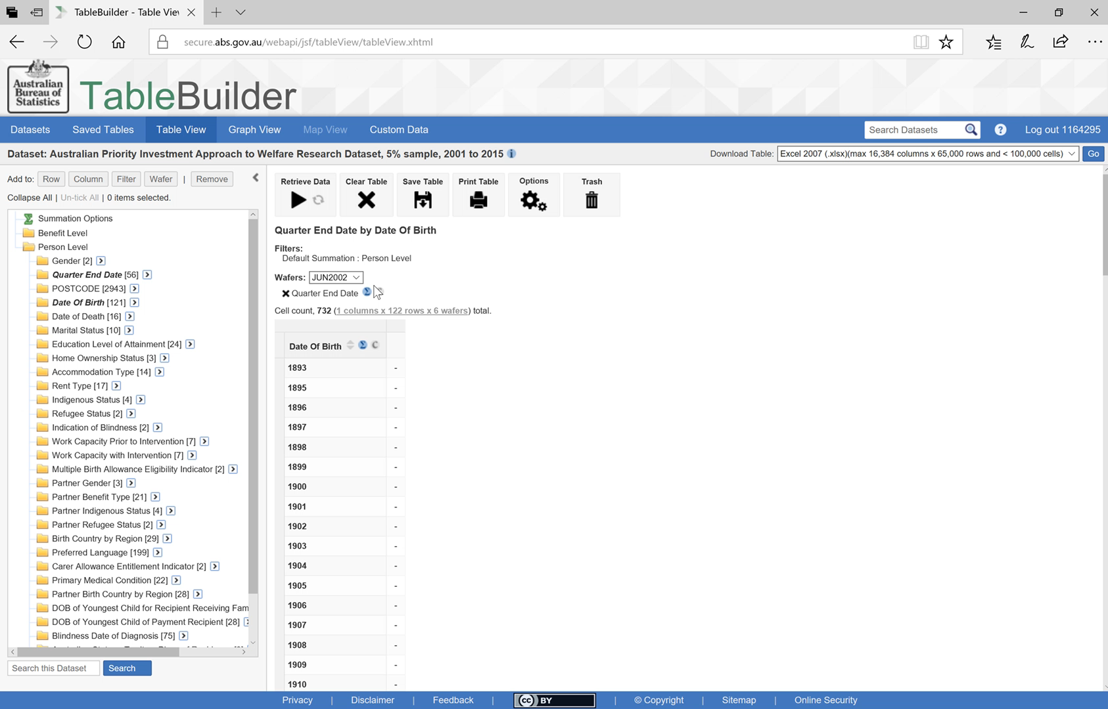
Moving a variable around
Notes:
PLAY: To do this you can simply click and drag the title and drop to the position in the table you’d like it to be.

Slide 19
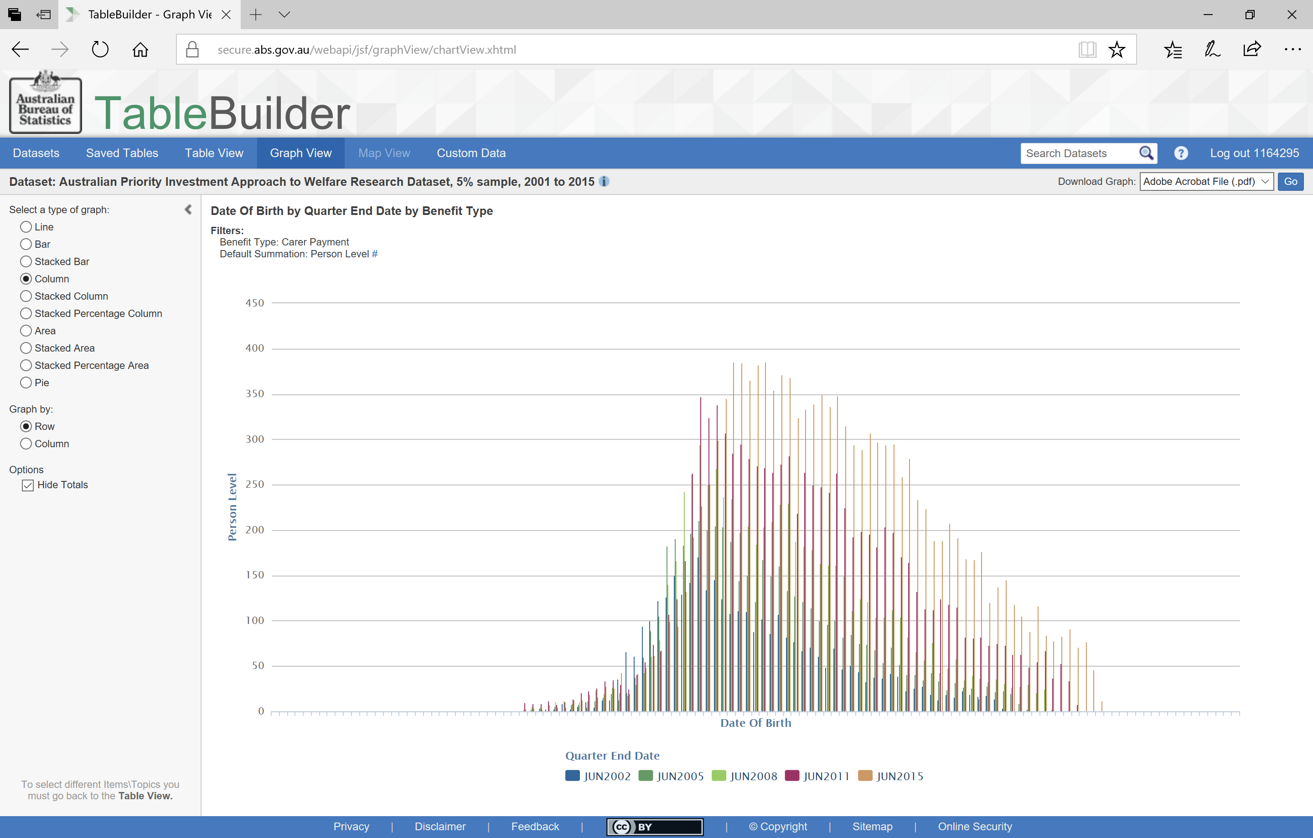
Viewing a graph with multiple categories
Notes:
By selecting
Graph View we can see the distribution of age groups for each of the four time periods.
In this display it is difficult to see the change in shape across time periods because they are displayed on top of each other.

Slide 20
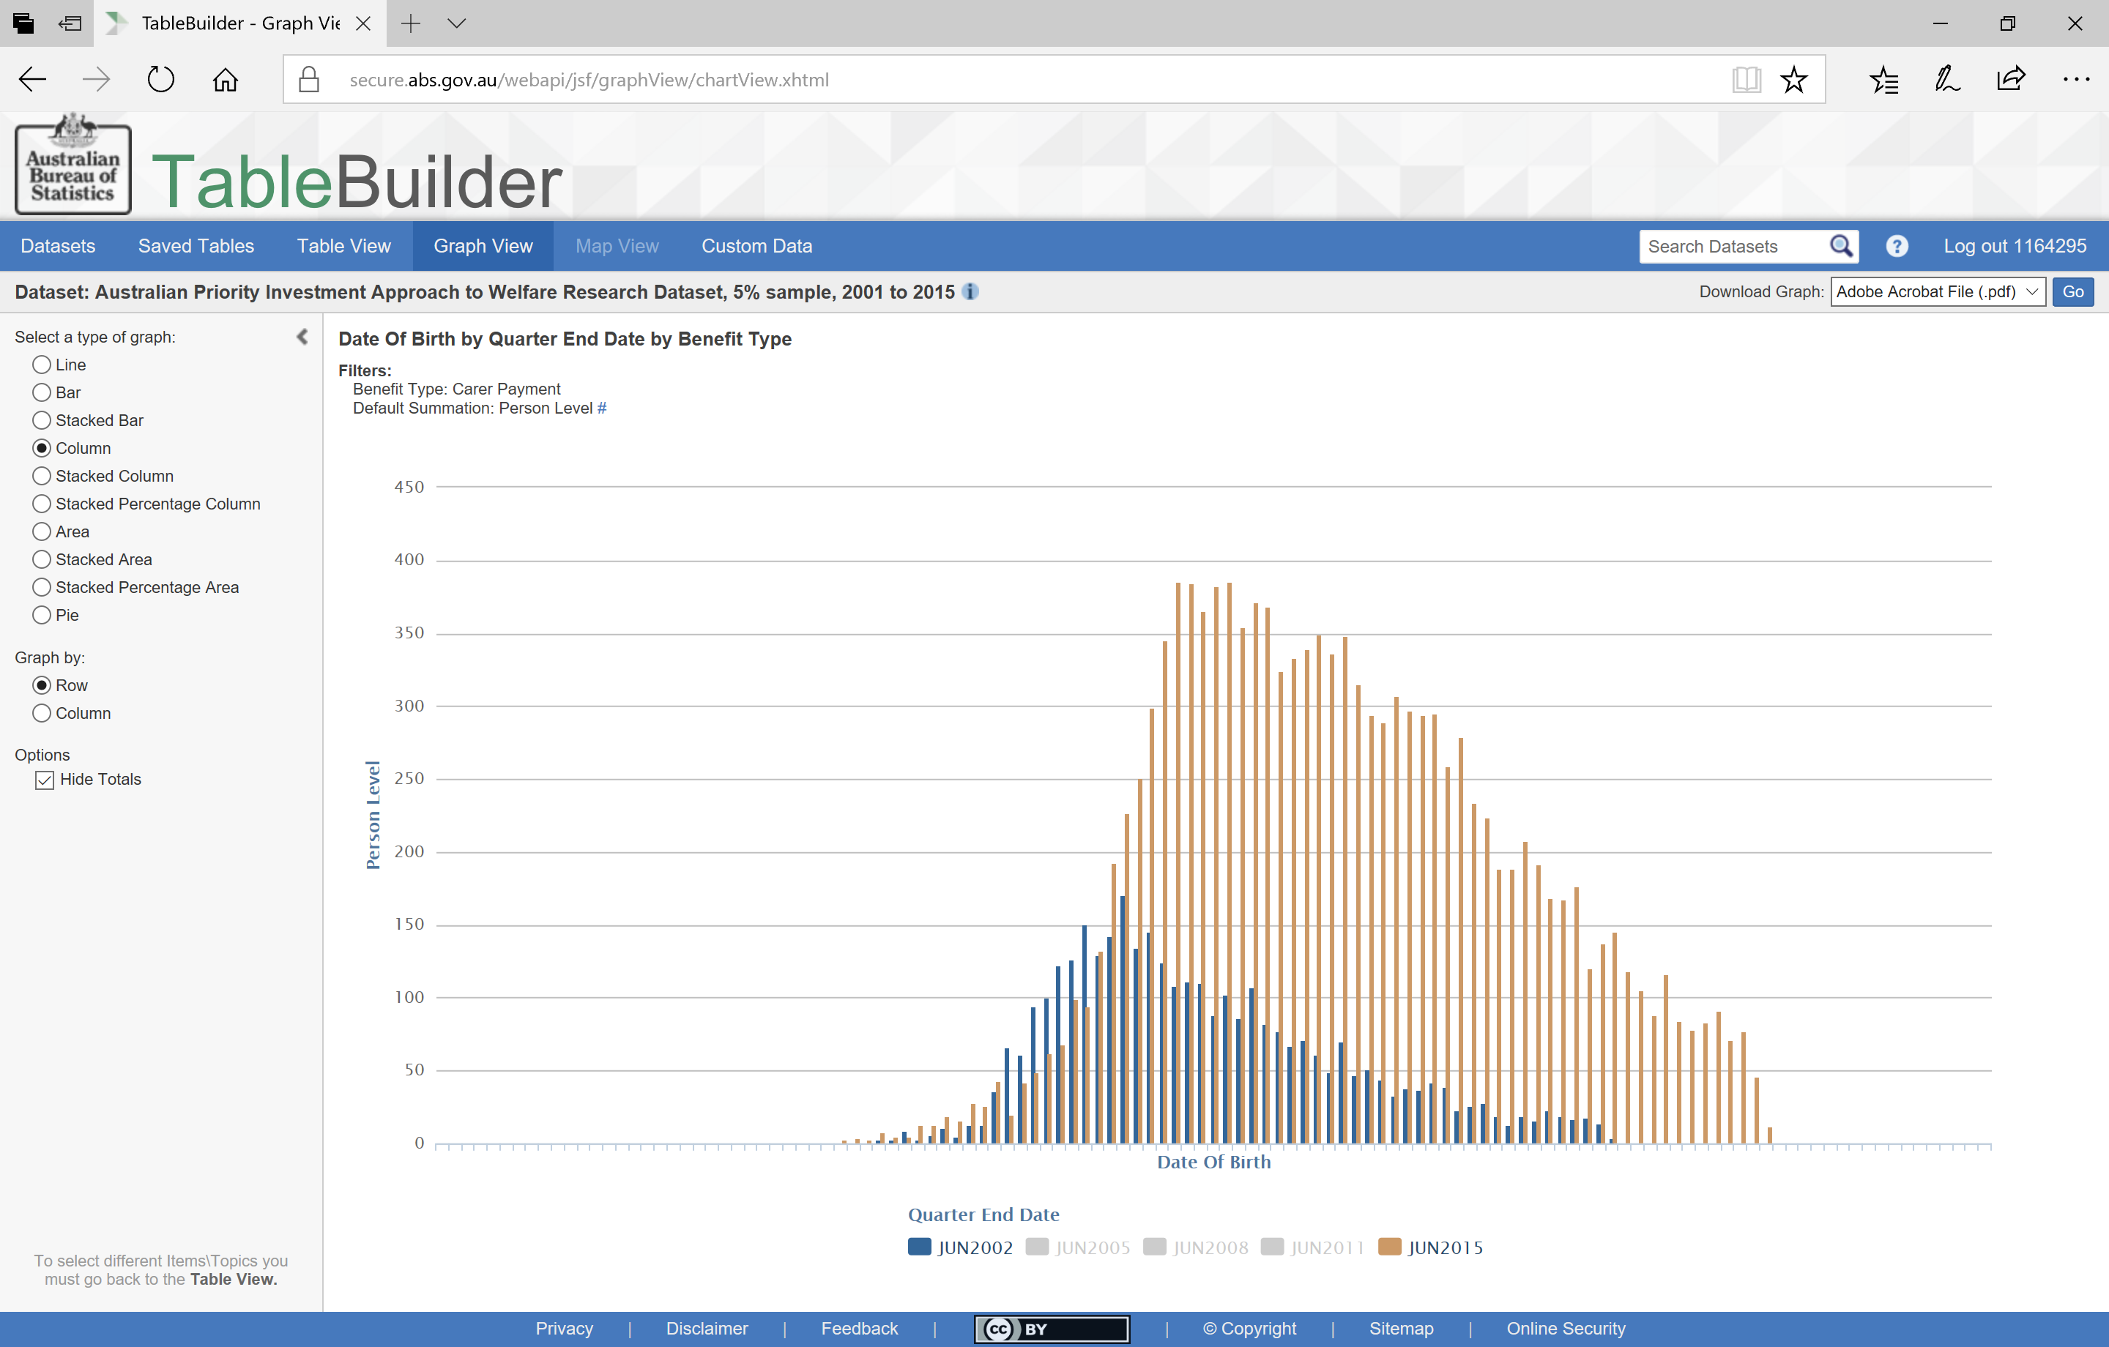
Hiding some categories
Notes:
You can hide parts of the graph by
clicking on the categories at the bottom

Slide 21
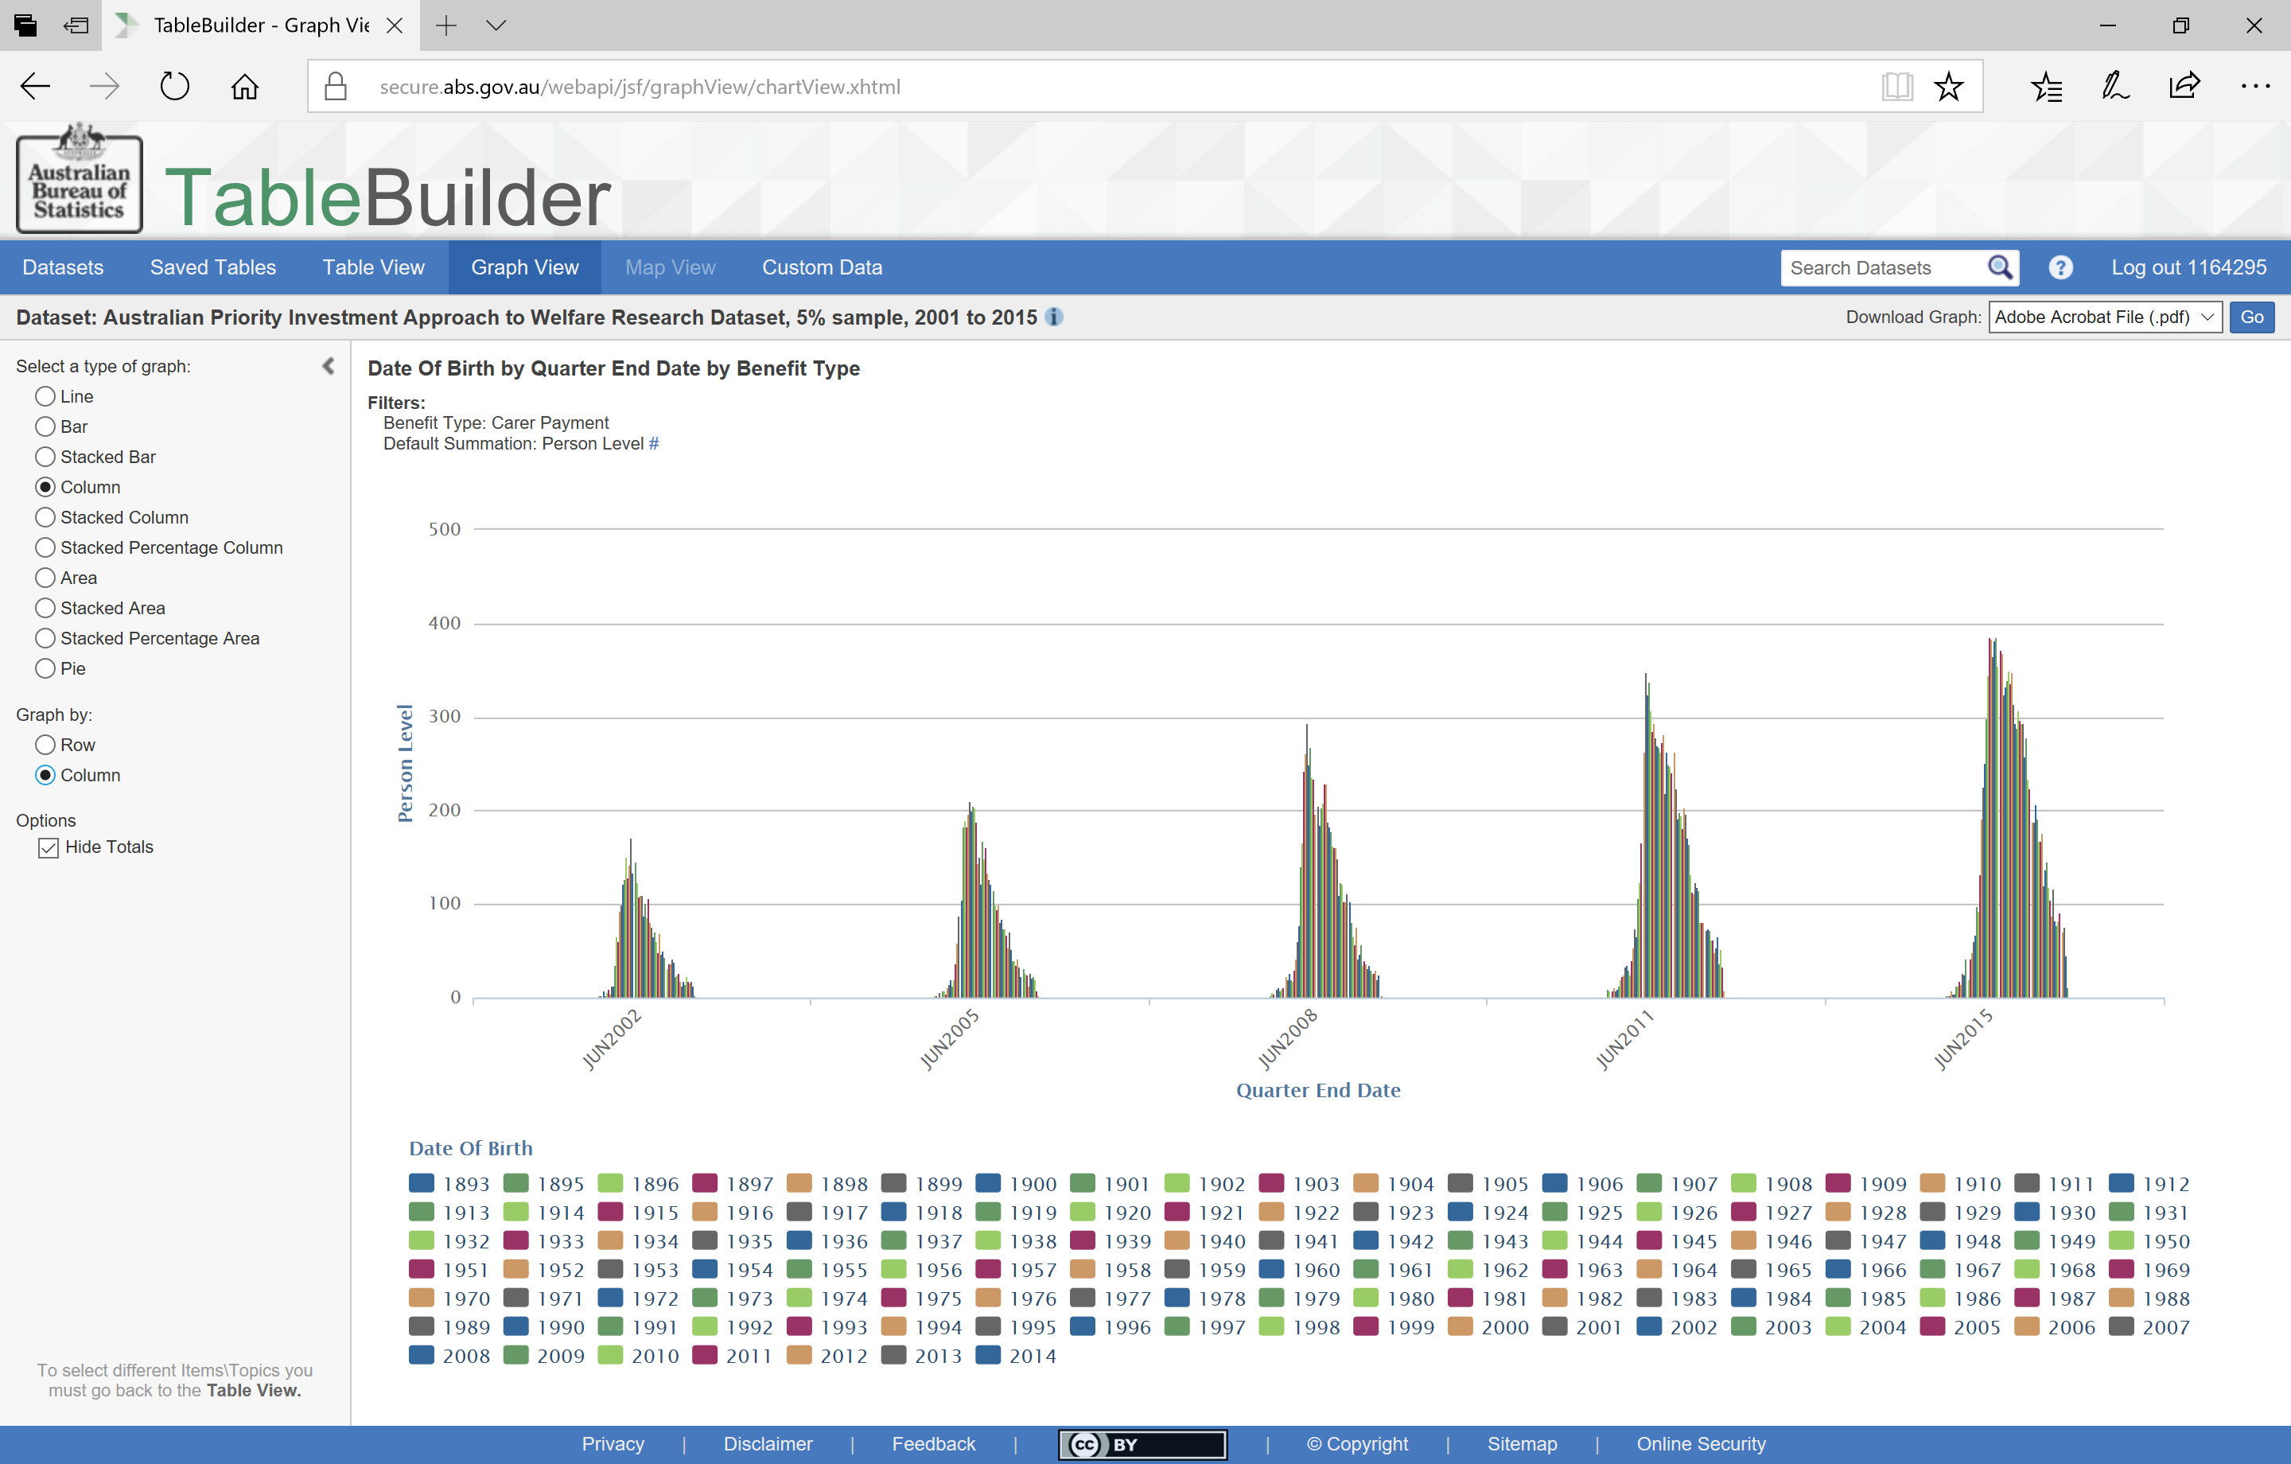
Using viewing options in graphs
Notes:
Alternatively you can display the results by
Column rather than Row. In our table we had the five time periods as the headings across the Columns and so now this is how the data is grouped here.
Now you can see not only the growth in numbers but also the change in shape across the time periods. In particular you can see that there are more young carers in the
2015 time period than there were in the
2002 time period. That is the shape of the 2002 distribution is leaning to the left (more older aged carers) whereas the shape of the 2014 distribution has a slight lean to the right (there are more younger aged carers).

Slide 22
How many Carers are in each age group?
How does this change over time?
How does this differ by geographic region?
Notes:
Let’s see how the age of the carers might be different across geographic regions.

Slide 23
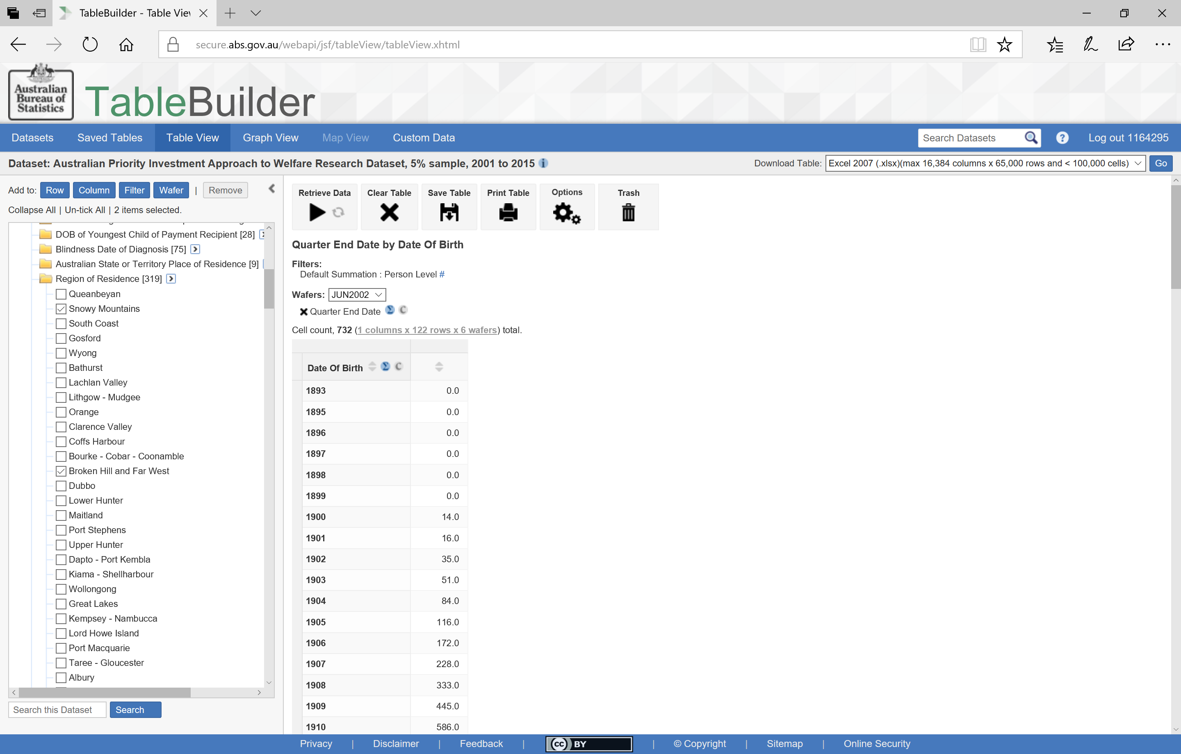
Using search bar
Notes:
Again, to change the table simply
select ‘Table View’ from the tabs at the top. To compare across geographic regions, I have put the quarter dates back into the Wafer. For geographic information we have three variables available: State, Postcode or region.
In this case we will use ‘Region of Residence’.
We will select the Snowy Mountains, Kiama – Shellharbour and Broken Hill. Let’s say we want to compare these areas to an Inner Sydney region.
There are 319 different regions so it might be quicker and easier
to use the Search bar. Simply type in ‘Sydney’ and the search will return all categories and variables that have that word in them. Tick the one you want and
use the buttons at the top to add these regions into the Columns of the table.

Slide 24

A suppressed table
Notes:
Now we have a table with the regions next to each other in the Column, the quarters in the Wafer and Date of Birth in the Rows

Slide 25
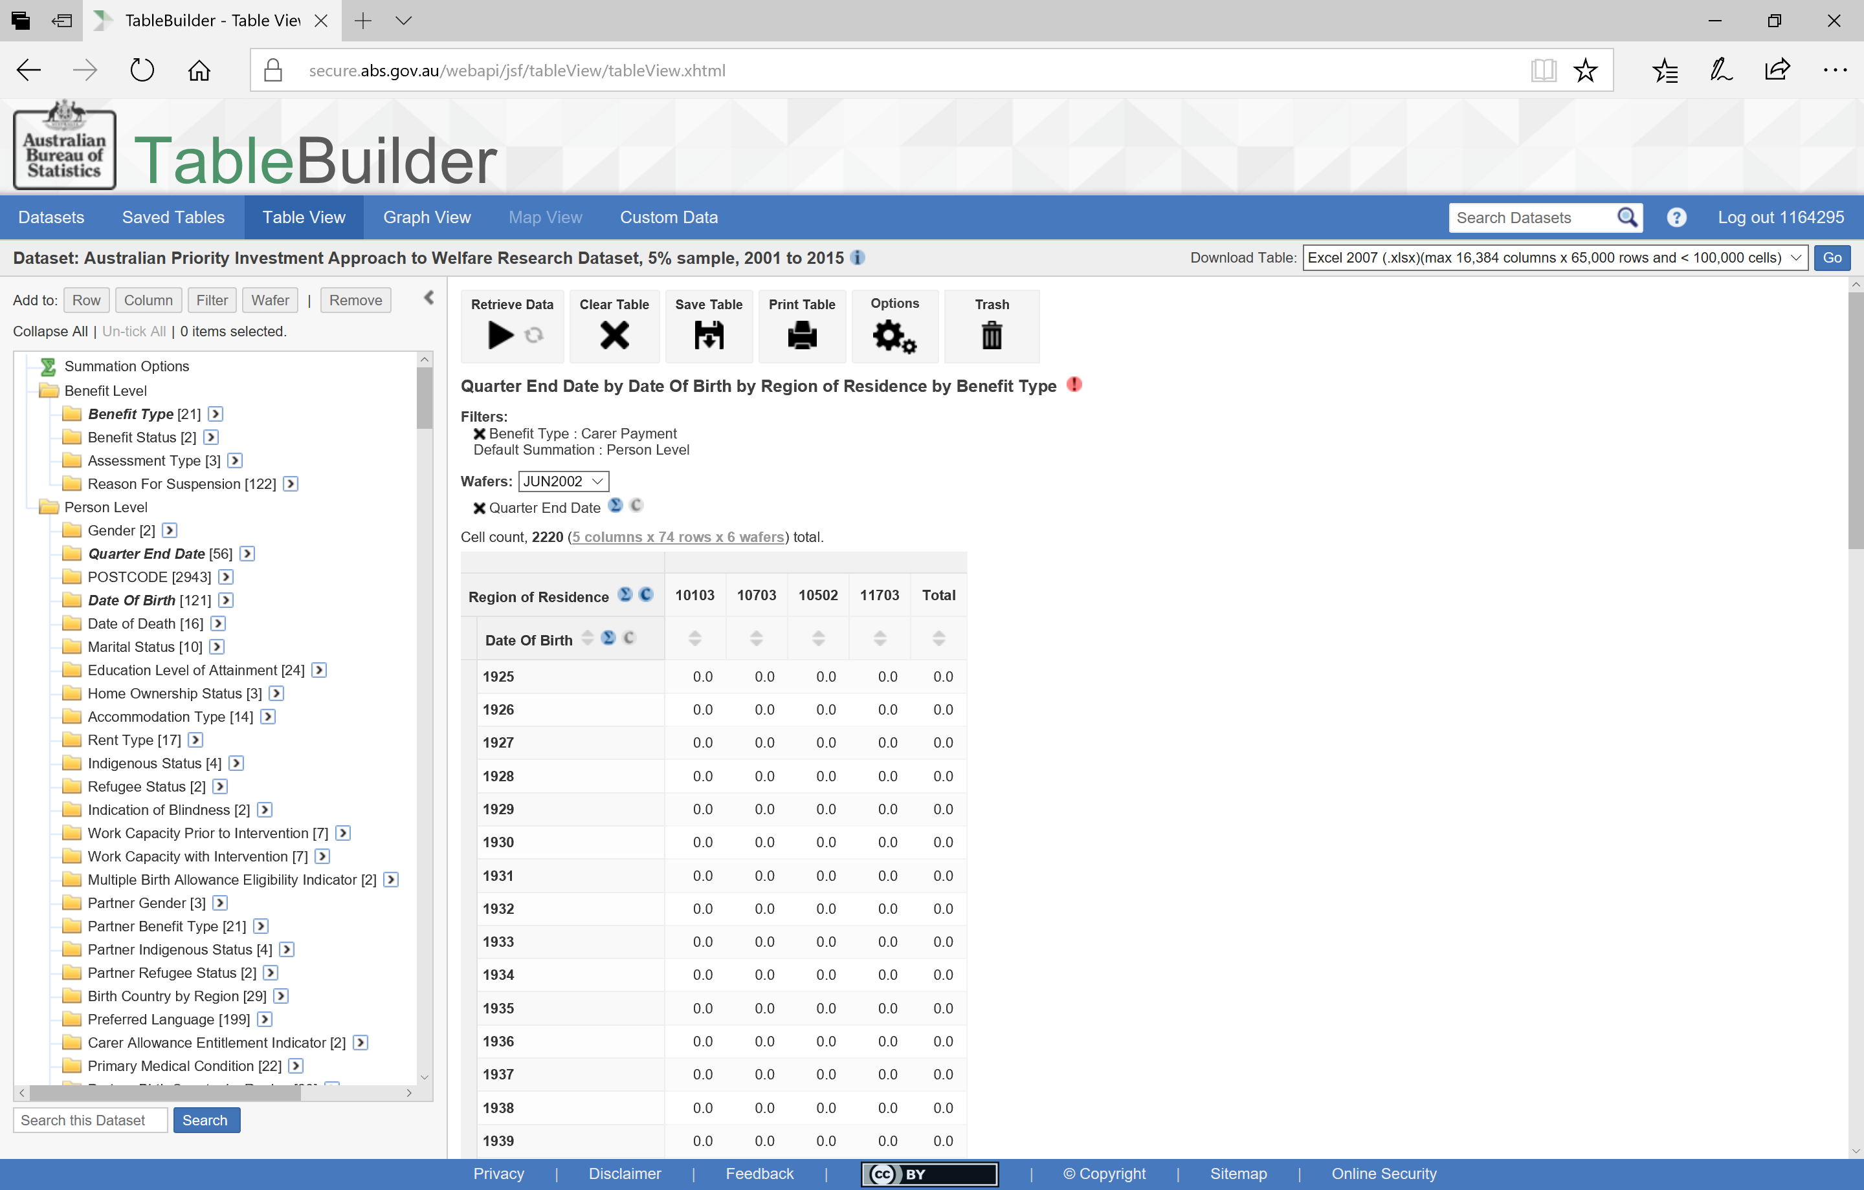
Toggle between codes and labels
Notes:
By selecting the
small ‘c’ next to any variable in a table, you will toggle between the codes and the label. You might want to see the codes used in variables to compare to other data or information sources. In this case you will see the SA3 region codes.
In this case the table has been suppressed. This is one of the privacy measures built into TableBuilder. That is, where there are low numbers in any cells and there is the possibility of people being identified, the information in the table is suppressed and zero values are returned.
Lets look at another way of defining by geographic region.

Slide 26
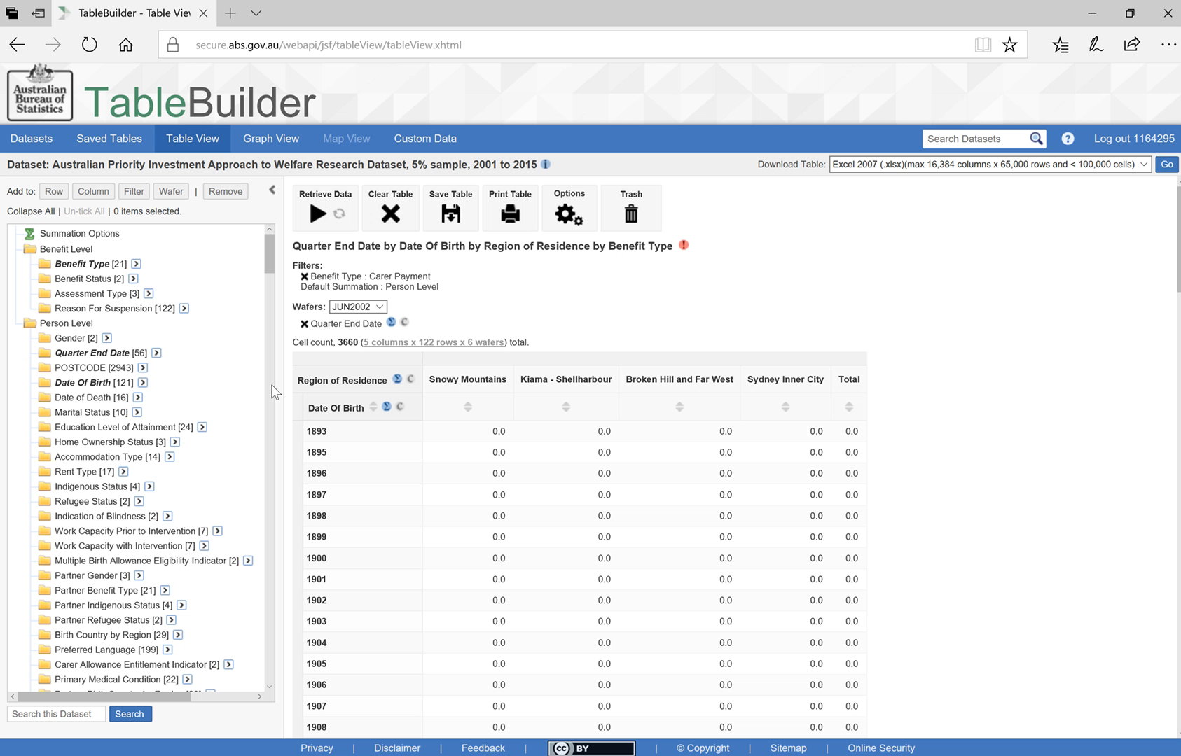
Trashing a variable
Notes:
PLAY: To remove a whole variable from the table simply grab the variable title and drag and drop over the Trash icon

Slide 27
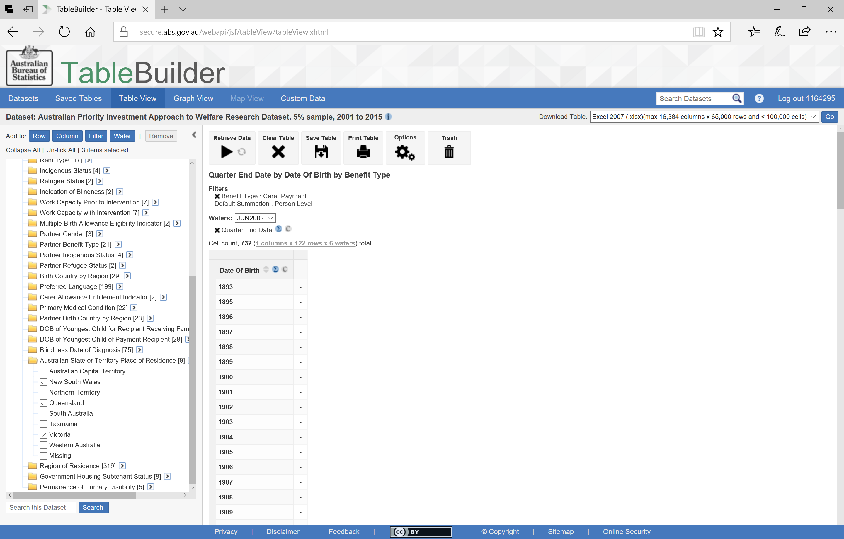
Adding a few variables
Notes:
We might look at the age distribution of Carers by State. In this case I have selected only NSW, Victoria and Queensland. I will select these states by
ticking the box and then using the
Column button at the top.

Slide 28
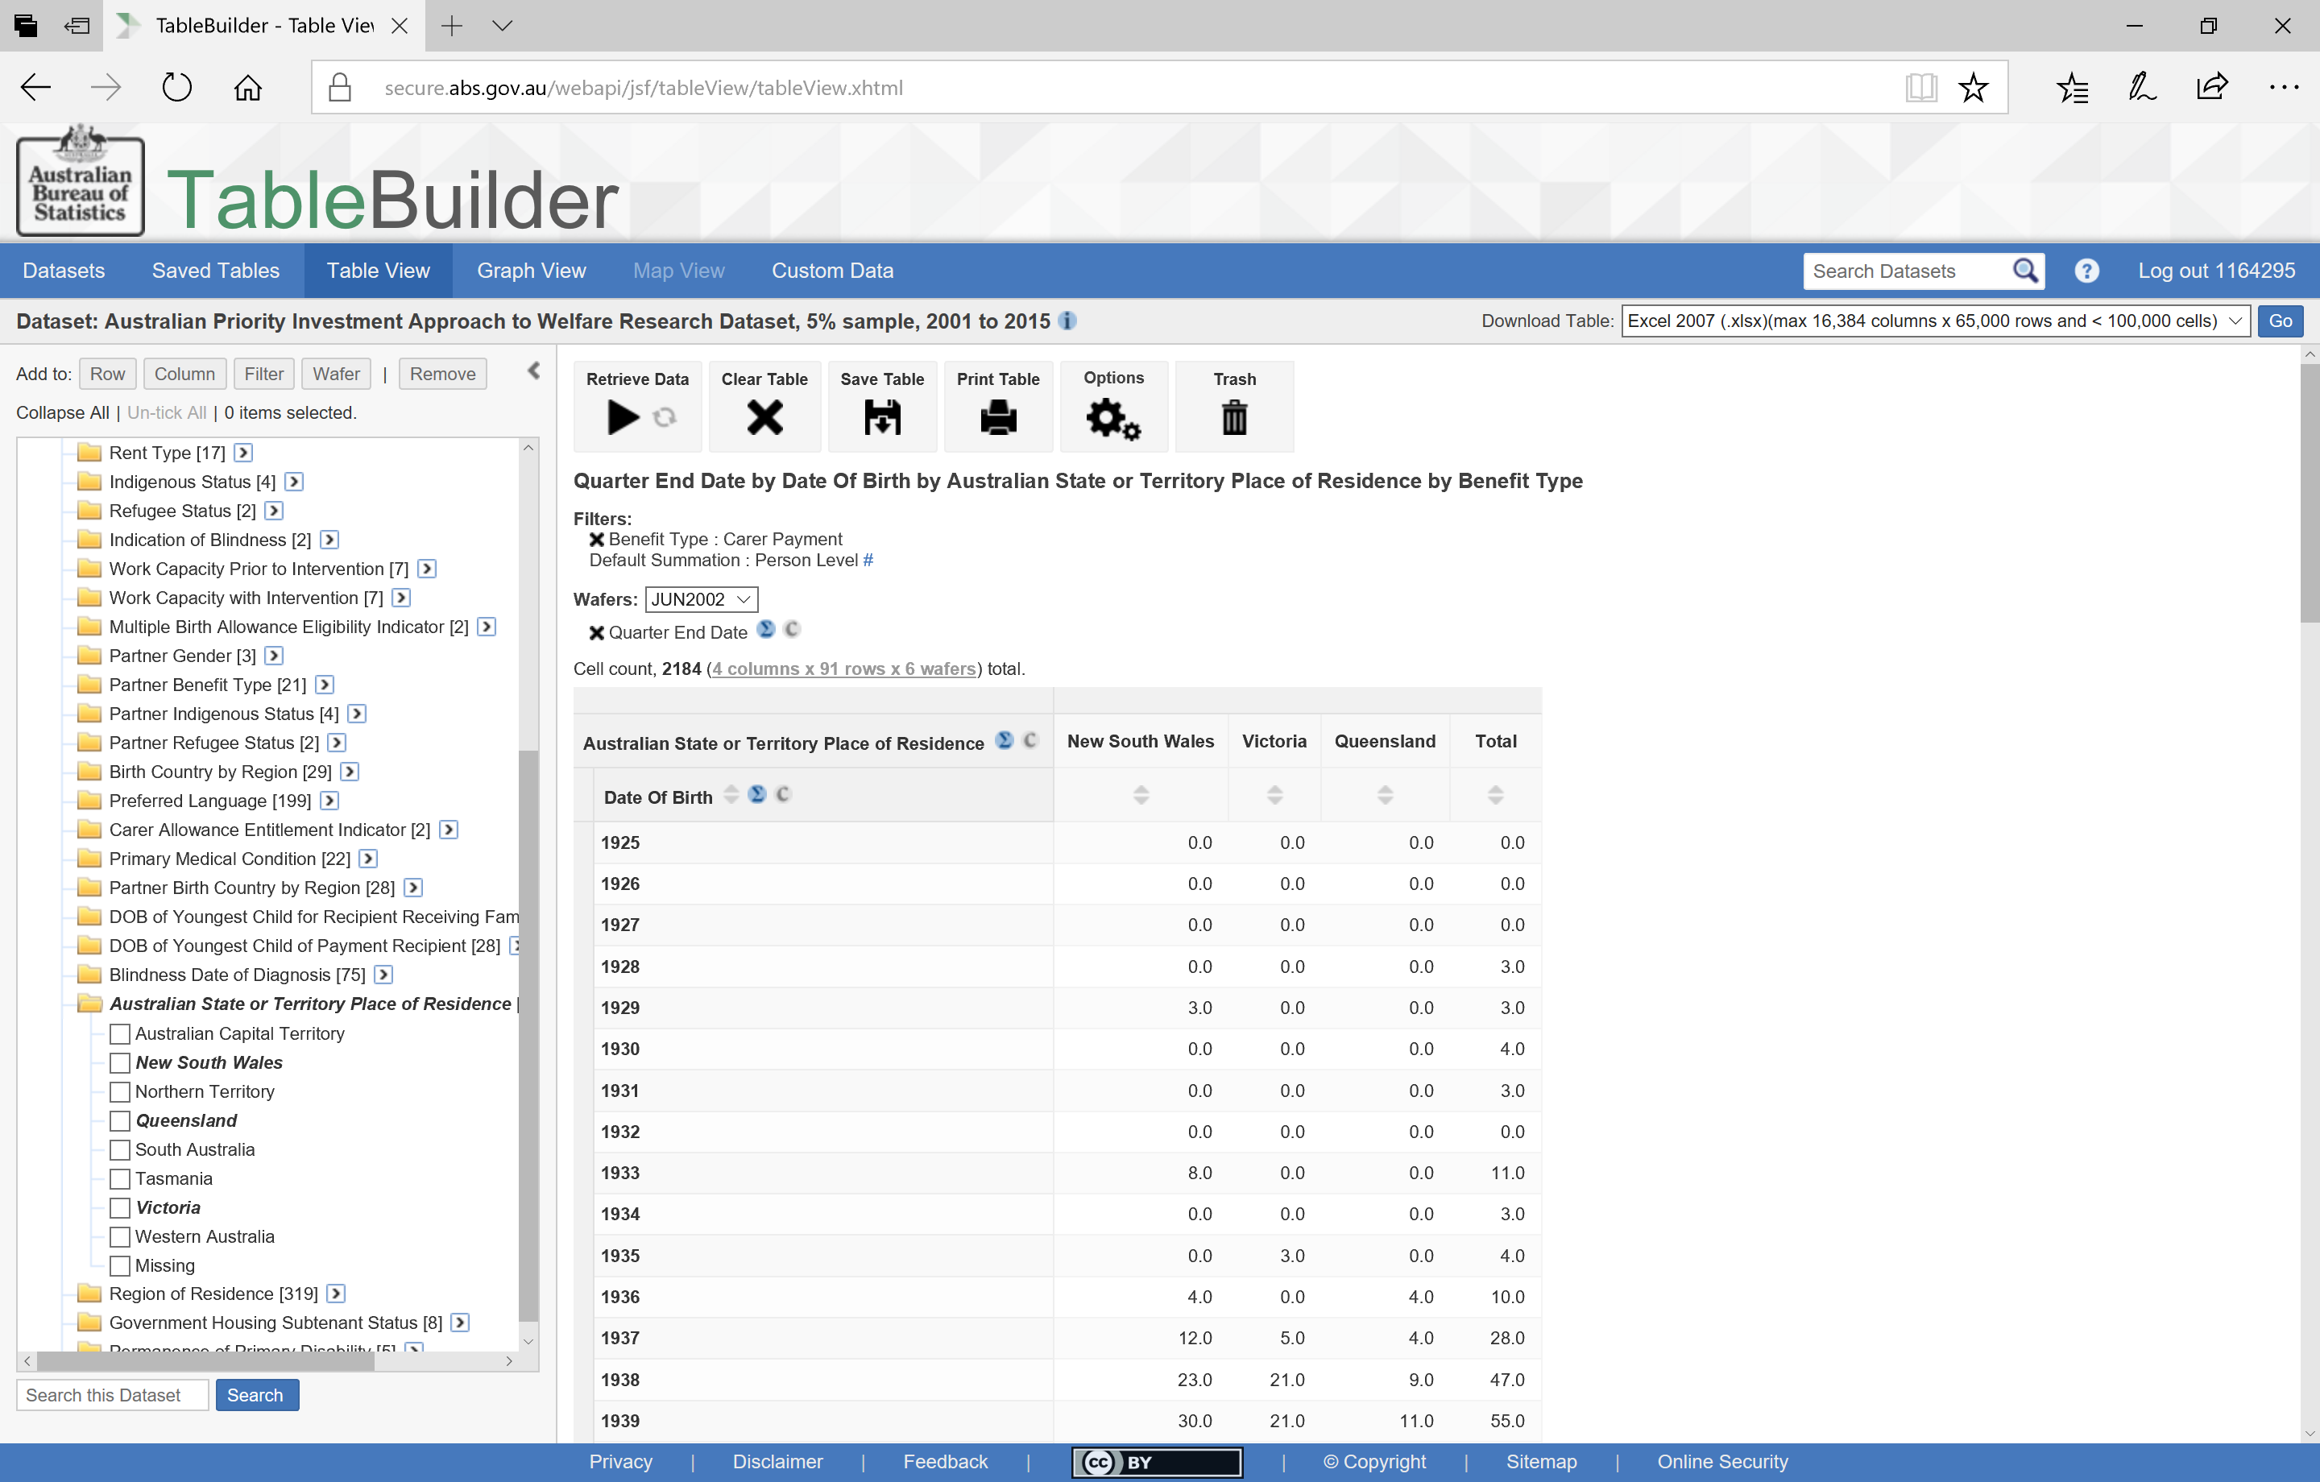
The order of selection determines the order of display
Notes:
Due to the larger geographic regions, we now have data in our table
Please note that the order the categories are displayed in is determined by the order that they are ticked. In this case I selected
Victoria before I selected
Queensland. And as such,
Victoria is listed before
Queensland in the table.

Slide 29
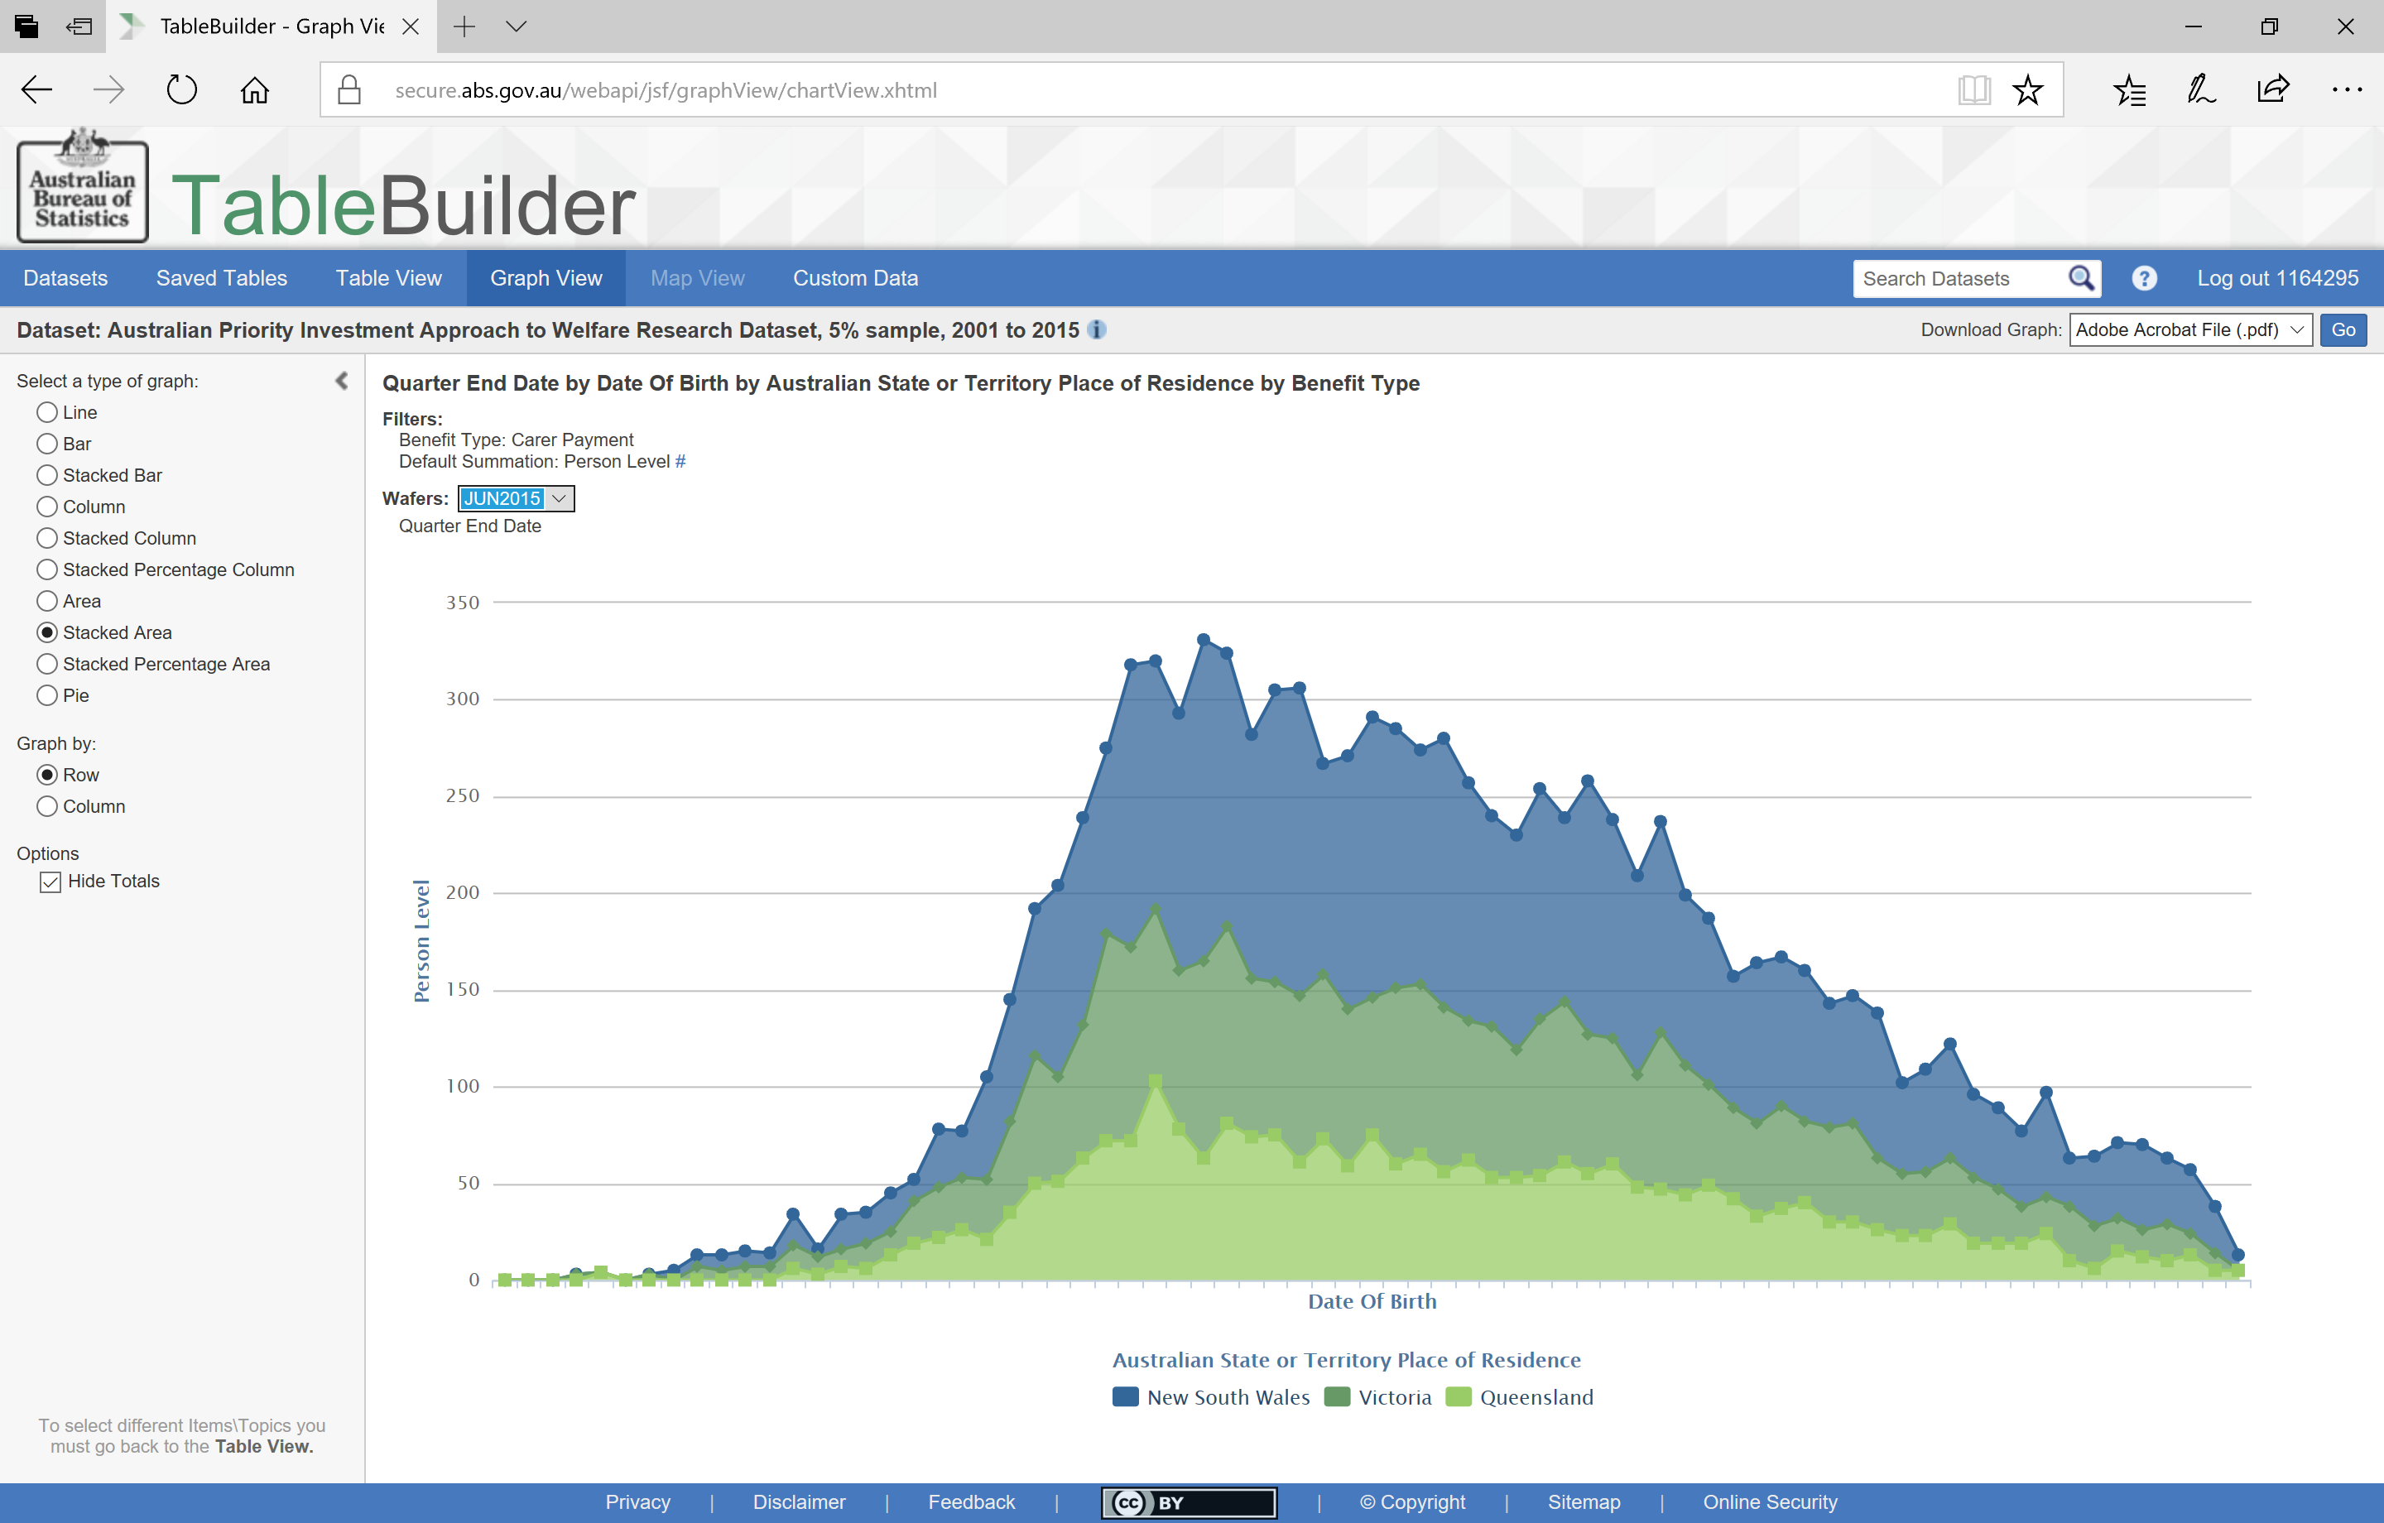
A Stacked Area graph
Notes:
By selecting Graph View we can see the distribution of age groups for each state.

Slide 30
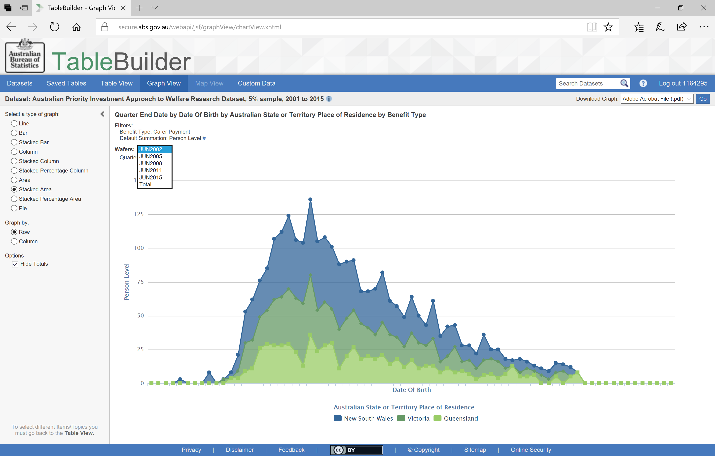
Using Wafer in graphs
Notes:
And we can easily switch between graphs of the different quarters that we have in the Wafer by using the
drop down box

Slide 31
How many people aged 50 and over are receiving Newstart?
Notes:
Now let’s look at a different question. Say we would like to know information about people who are 50 years or older and receiving Newstart Allowance.

Slide 32
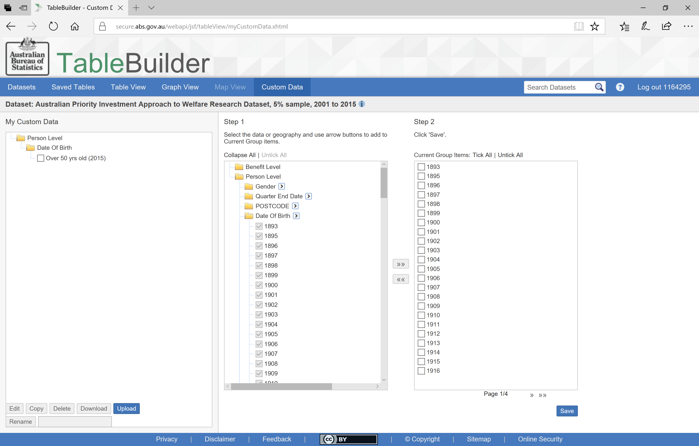
Using Custom Data
Notes:
You can’t add multiple categories (or years) as a filter to a table. To create a table that only includes information about people who are 50 years and over, I will use Custom Data to create an age group category. This method can also be used if you were looking to select ‘young people’ defined by a certain age range or to combine a number of postcodes or geographic regions to create your own geographic category.
Details on how to use Custom Data are available in the TableBuilder User Guide however briefly,
go into Custom Data using the tabs at the top
Select the categories you want to include. In this case, I only interested in the latest information which is the June 2015 quarter. As I want everyone aged 50 and over, I am interested in all Date of Birth years from the earliest up to 1965.
Move these years over to the right column
Tick all of these and then
Select Save

Slide 33
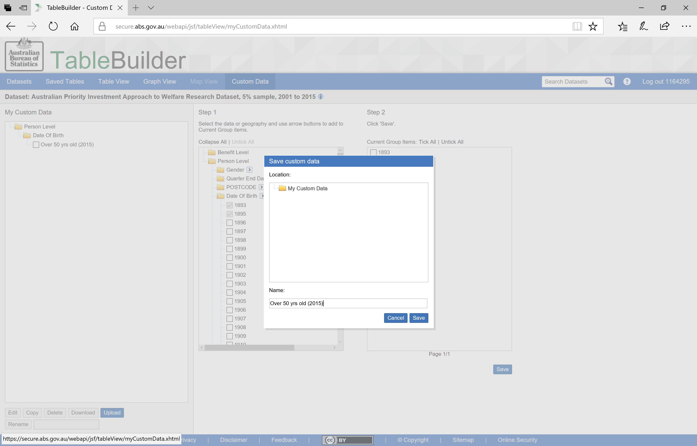
Saving a new category
Notes:
You will need to give a name to your new category.
Then Save again.

Slide 34
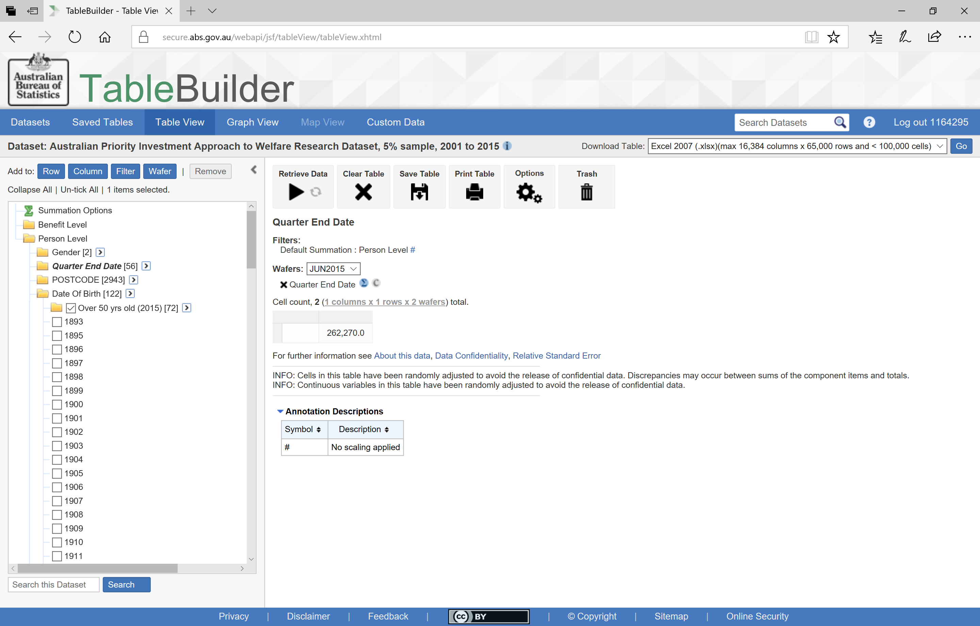
Using a new category
Notes:
This new category will be added under the variable in your TableBuilder.
To add this age group as your filter select the new category
And select Filter
I have June 2015 in the Wafer so only information from this quarter will be displayed.

Slide 35
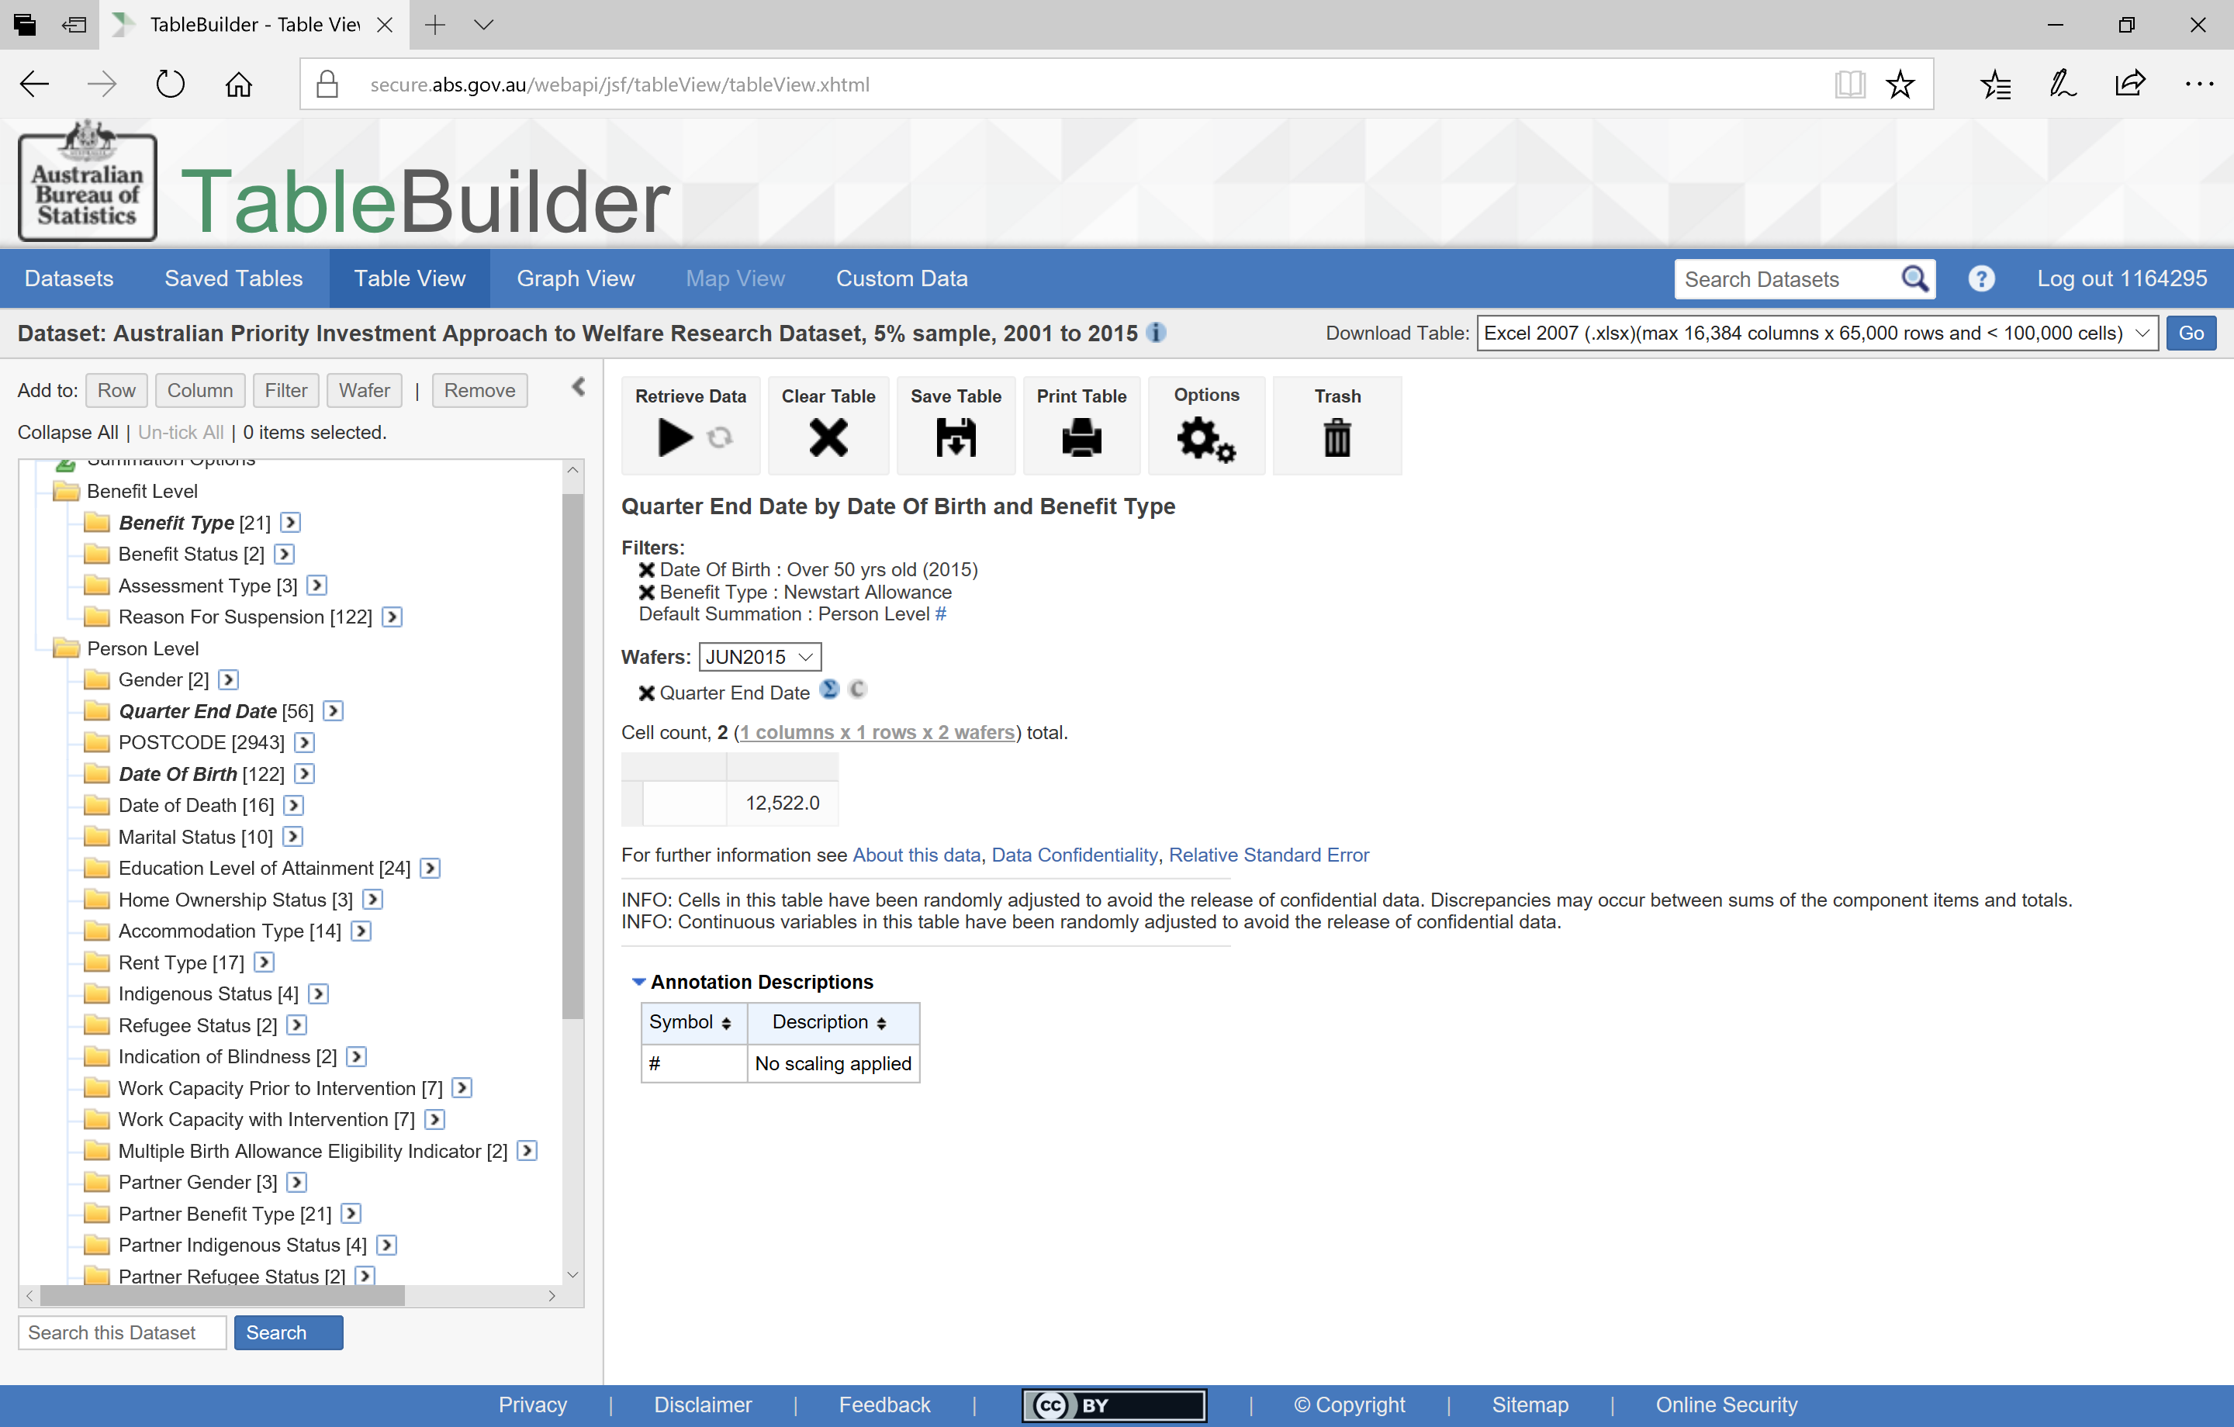
Reviewing the information in a table
Notes:
I am also only looking at those receiving Newstart allowance so I need to add this Benefit Type to the filter. Now, the table will only present the count of those people who were aged 50 and over and were receiving Newstart Allowance in June 2015.
In this case, there were 12,522 recipients (again, multiply by 20 for a population estimate)

Slide 36
How many people aged 50 and over are receiving Newstart?
What is their highest level of education? How is this different by Gender?
Notes:
Let’s look at what we know about these recipients regarding their level of education and gender.

Slide 37
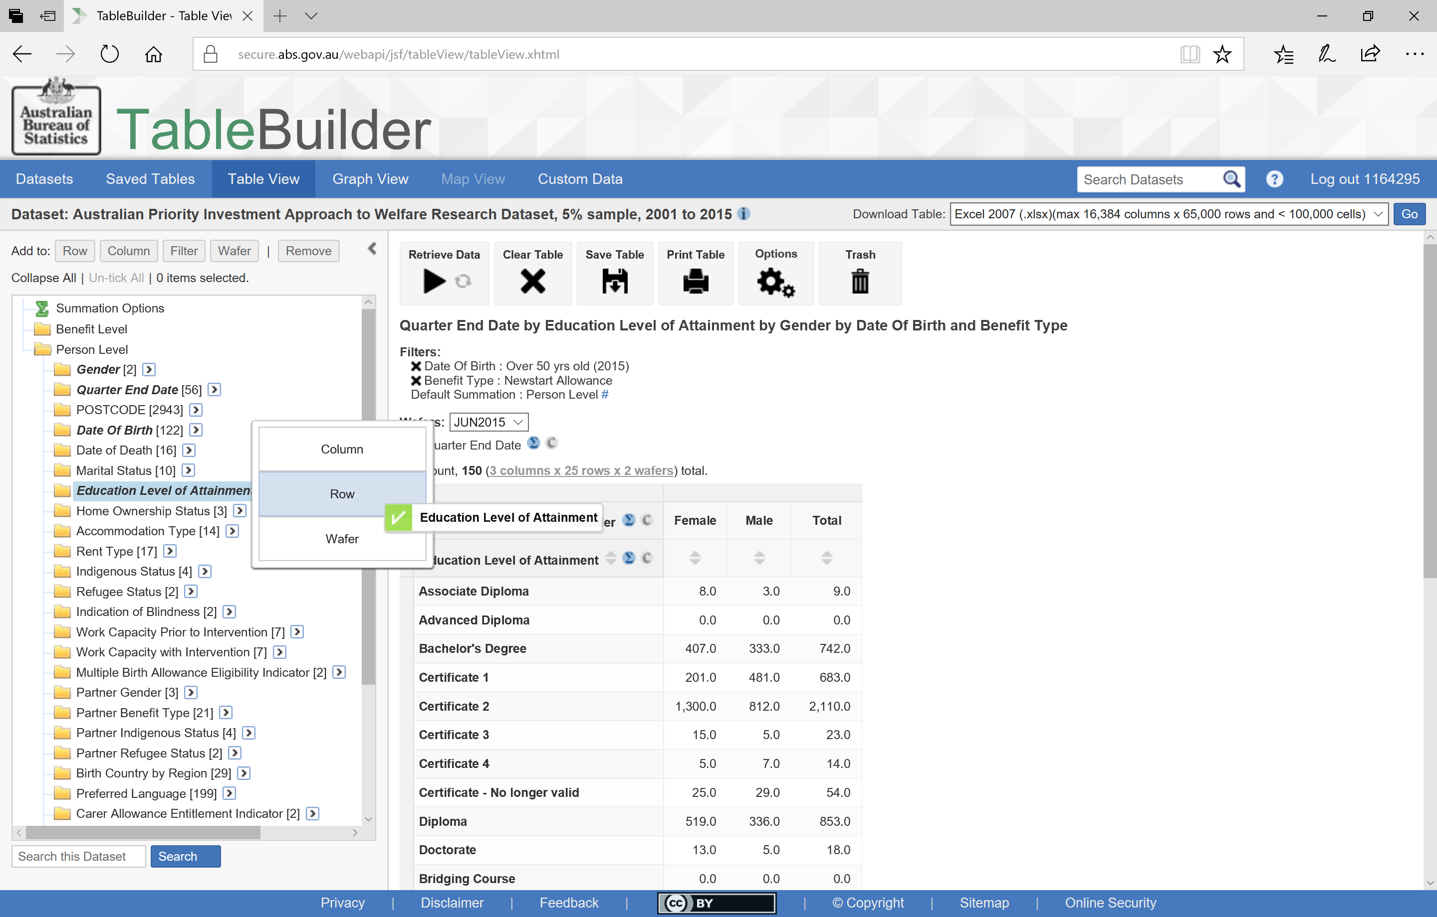
Adding a whole variable
Notes:
To look at this question I have added ‘Education Level of Attainment’ to the Row and
Gender to the Column by dragging the variable title.

Slide 38
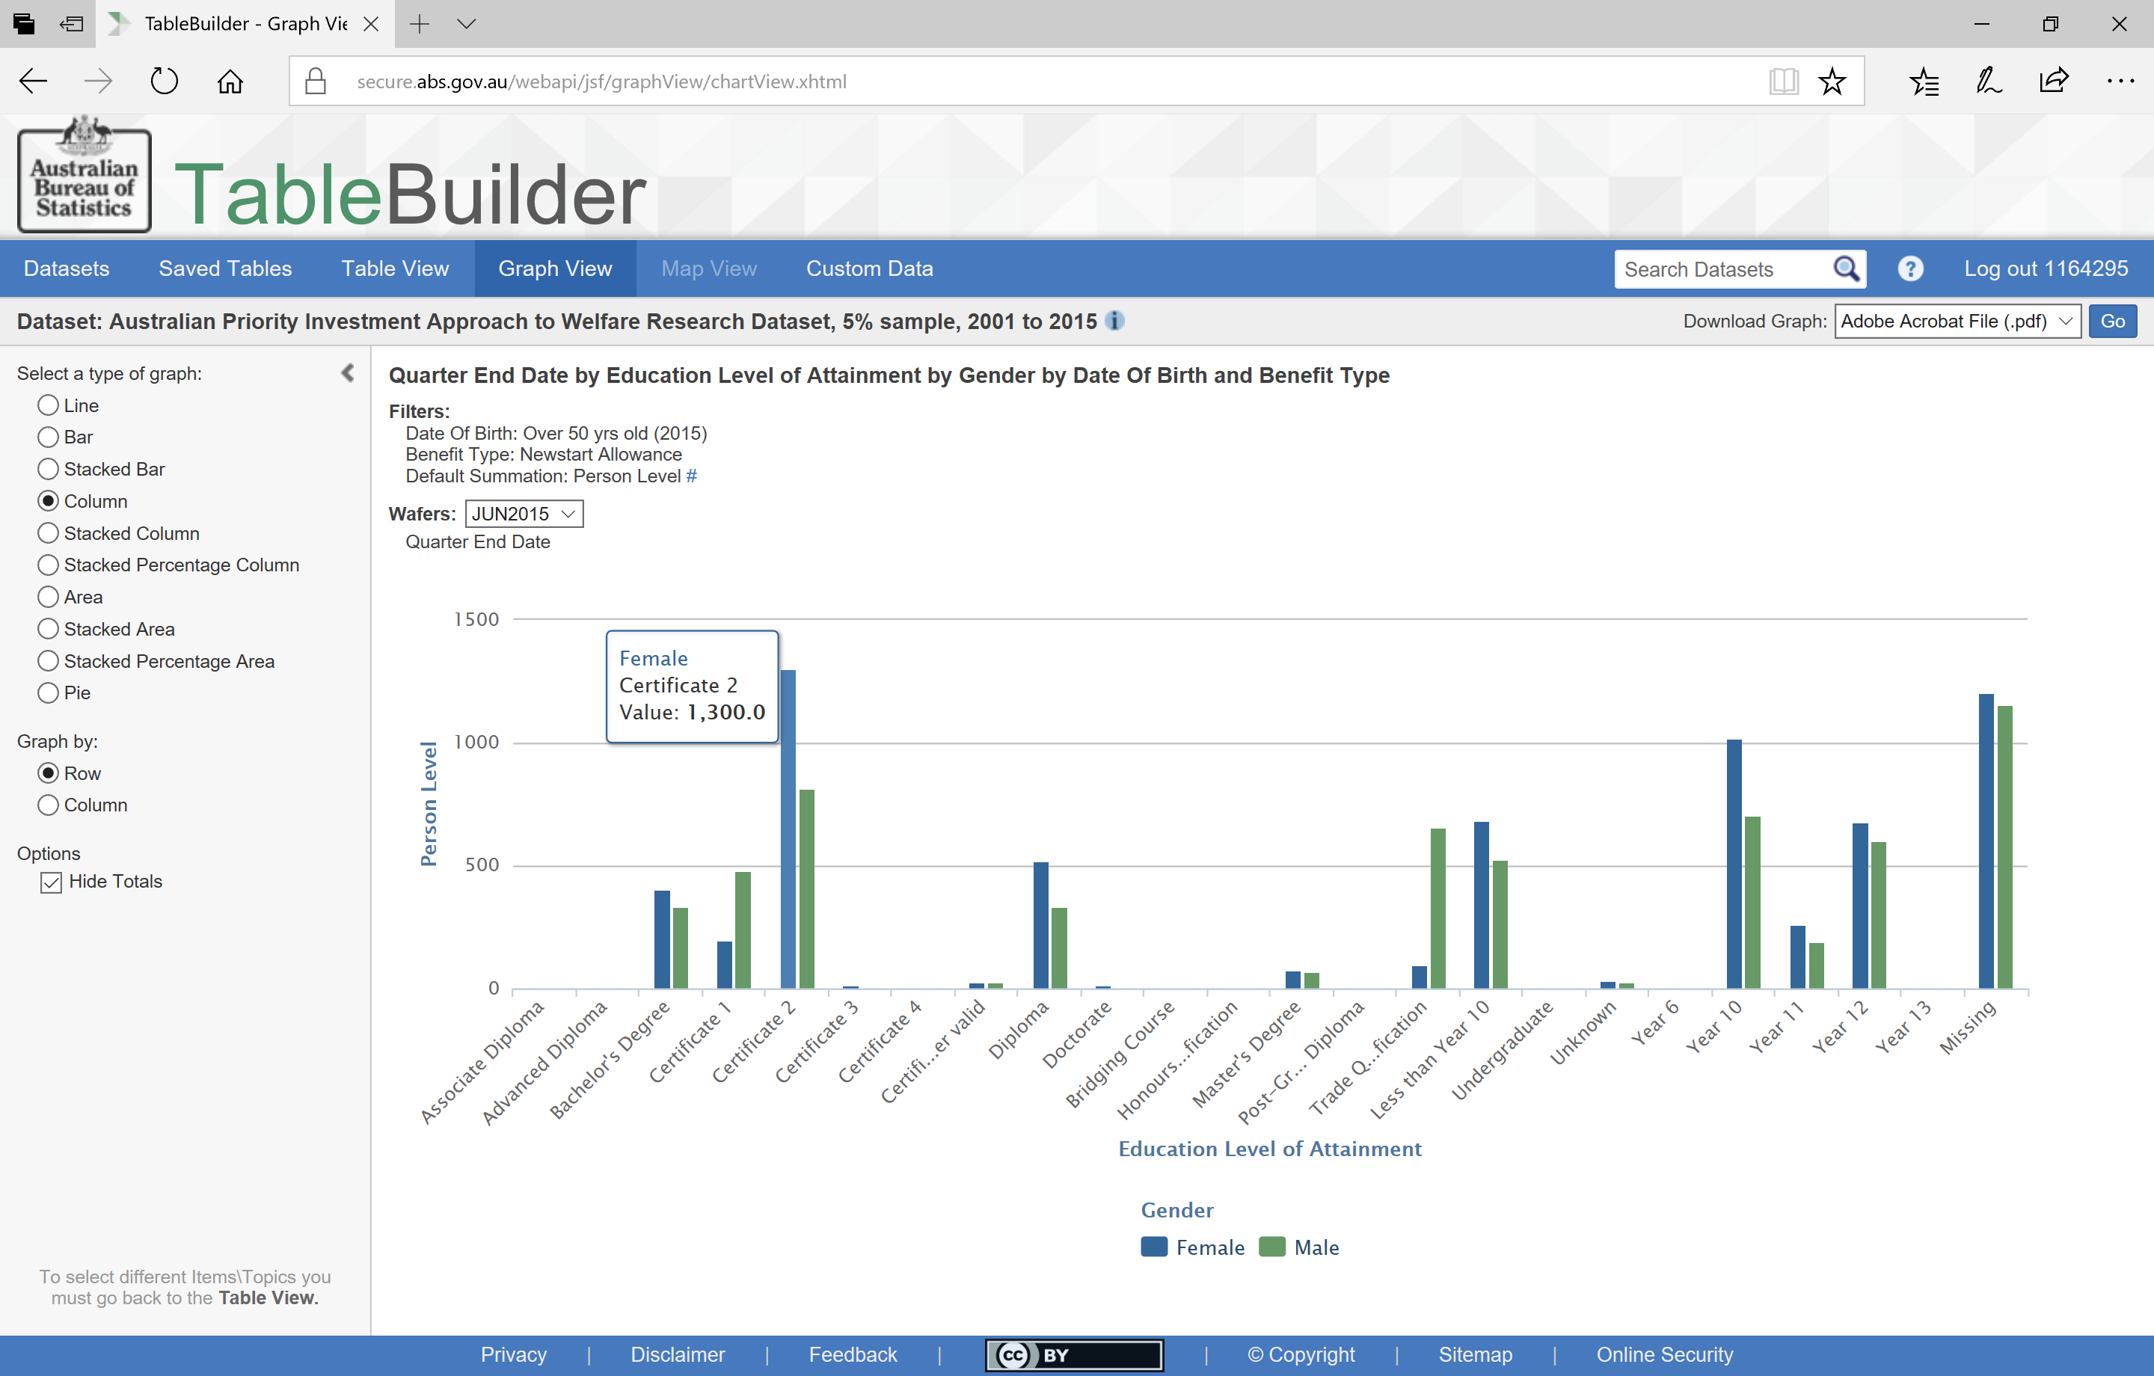
Viewing details in a graph
Notes:
Using the Graph View I can look at the distribution of the Newstart Recipients by their highest level of education.
To see more detailed information, I can hover over any of the graph elements
You can see the information is quite spread out here and is not in any sensible order.

Slide 39
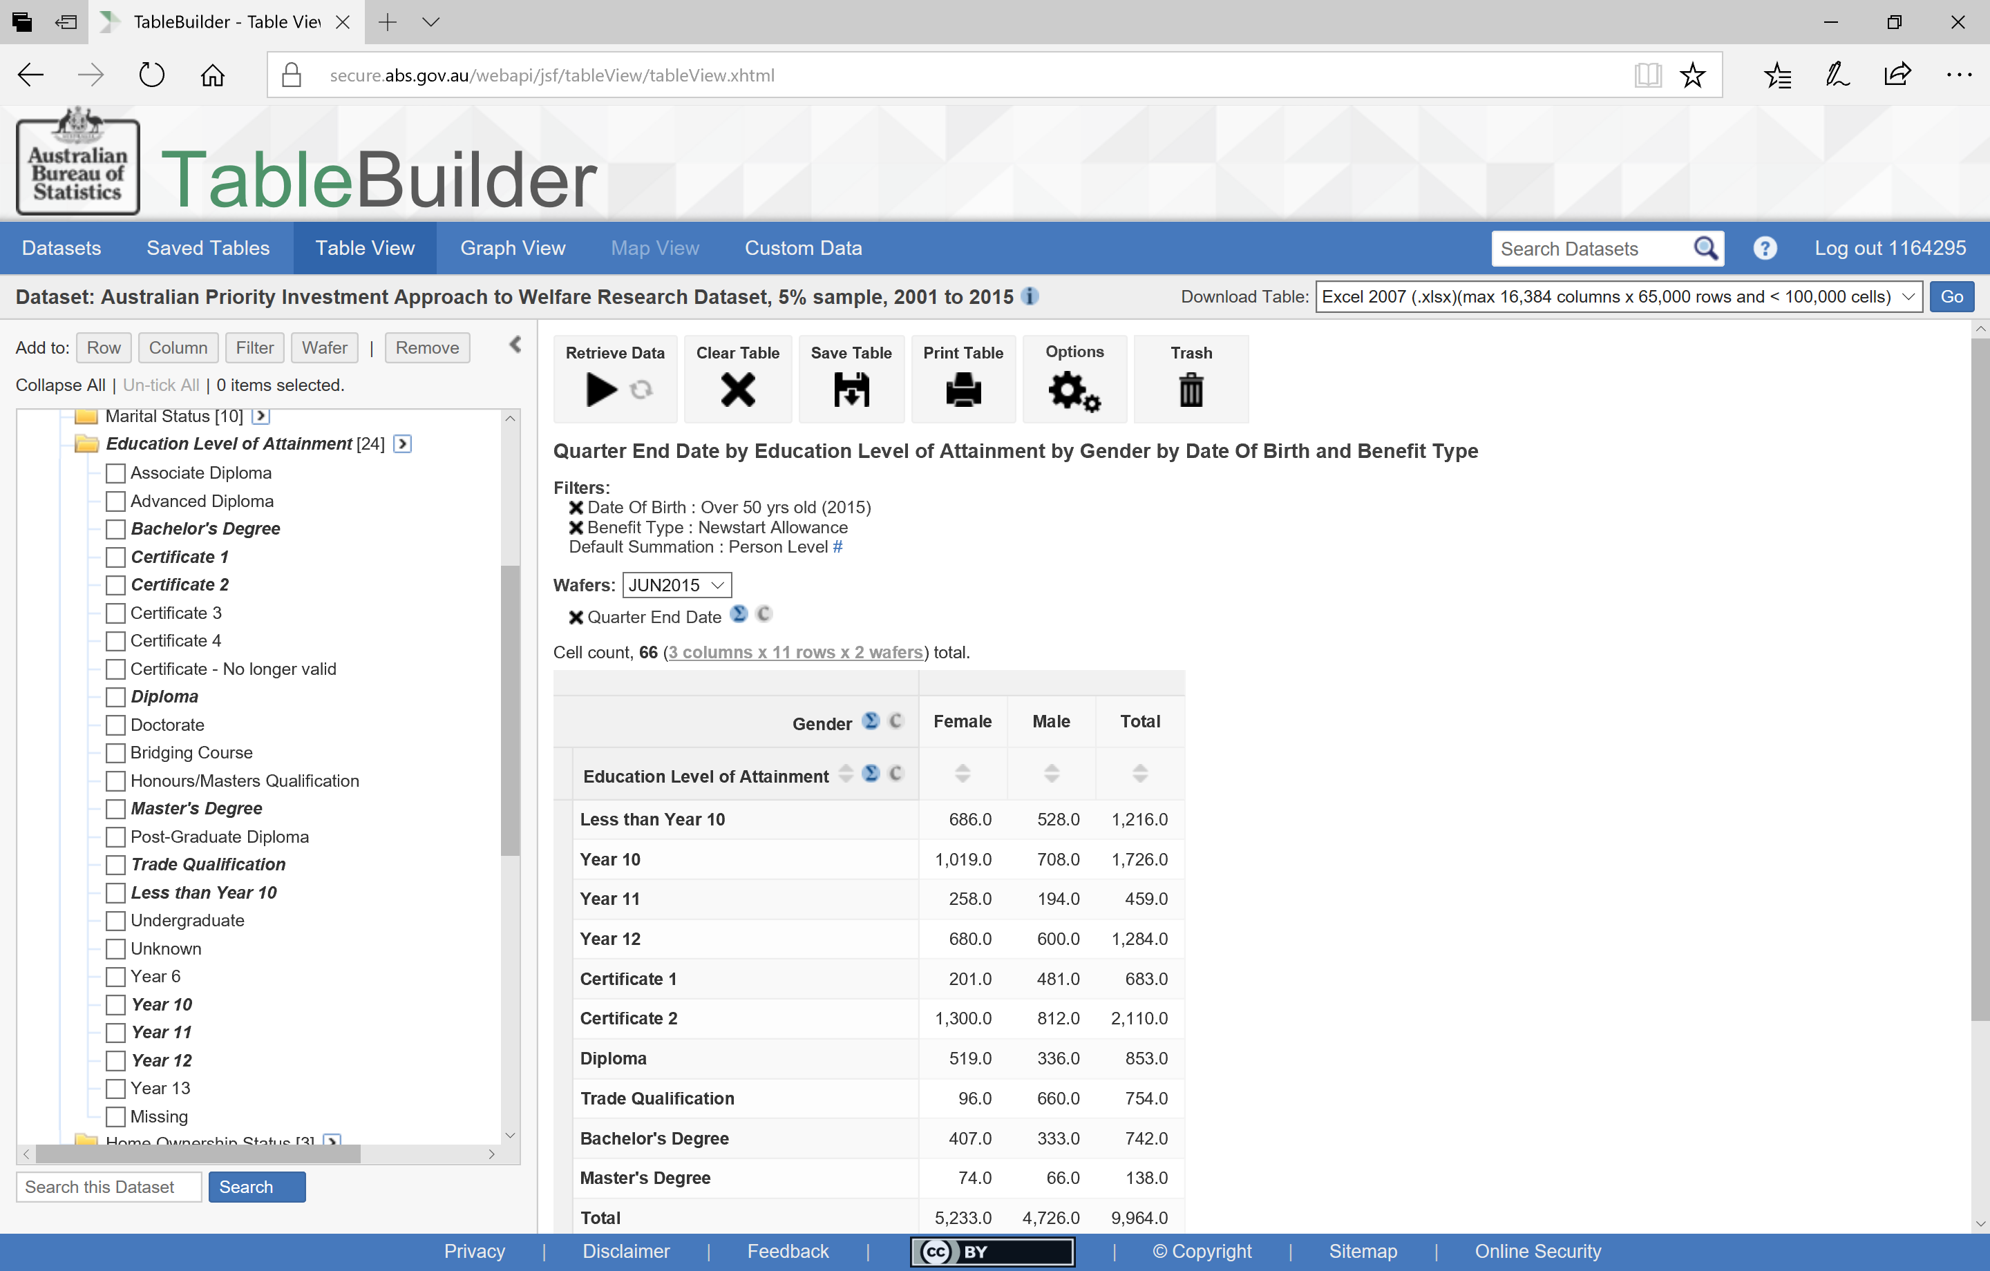
Adding categories in a particular order
Notes:
To make this table (and graph) make a little more sense, I have removed the Education variable and then selected only the categories I am interested in, in an order that makes sense.
You can see education is now listed from “Less than Year 10” through to “Master’s Degree”.

Slide 40
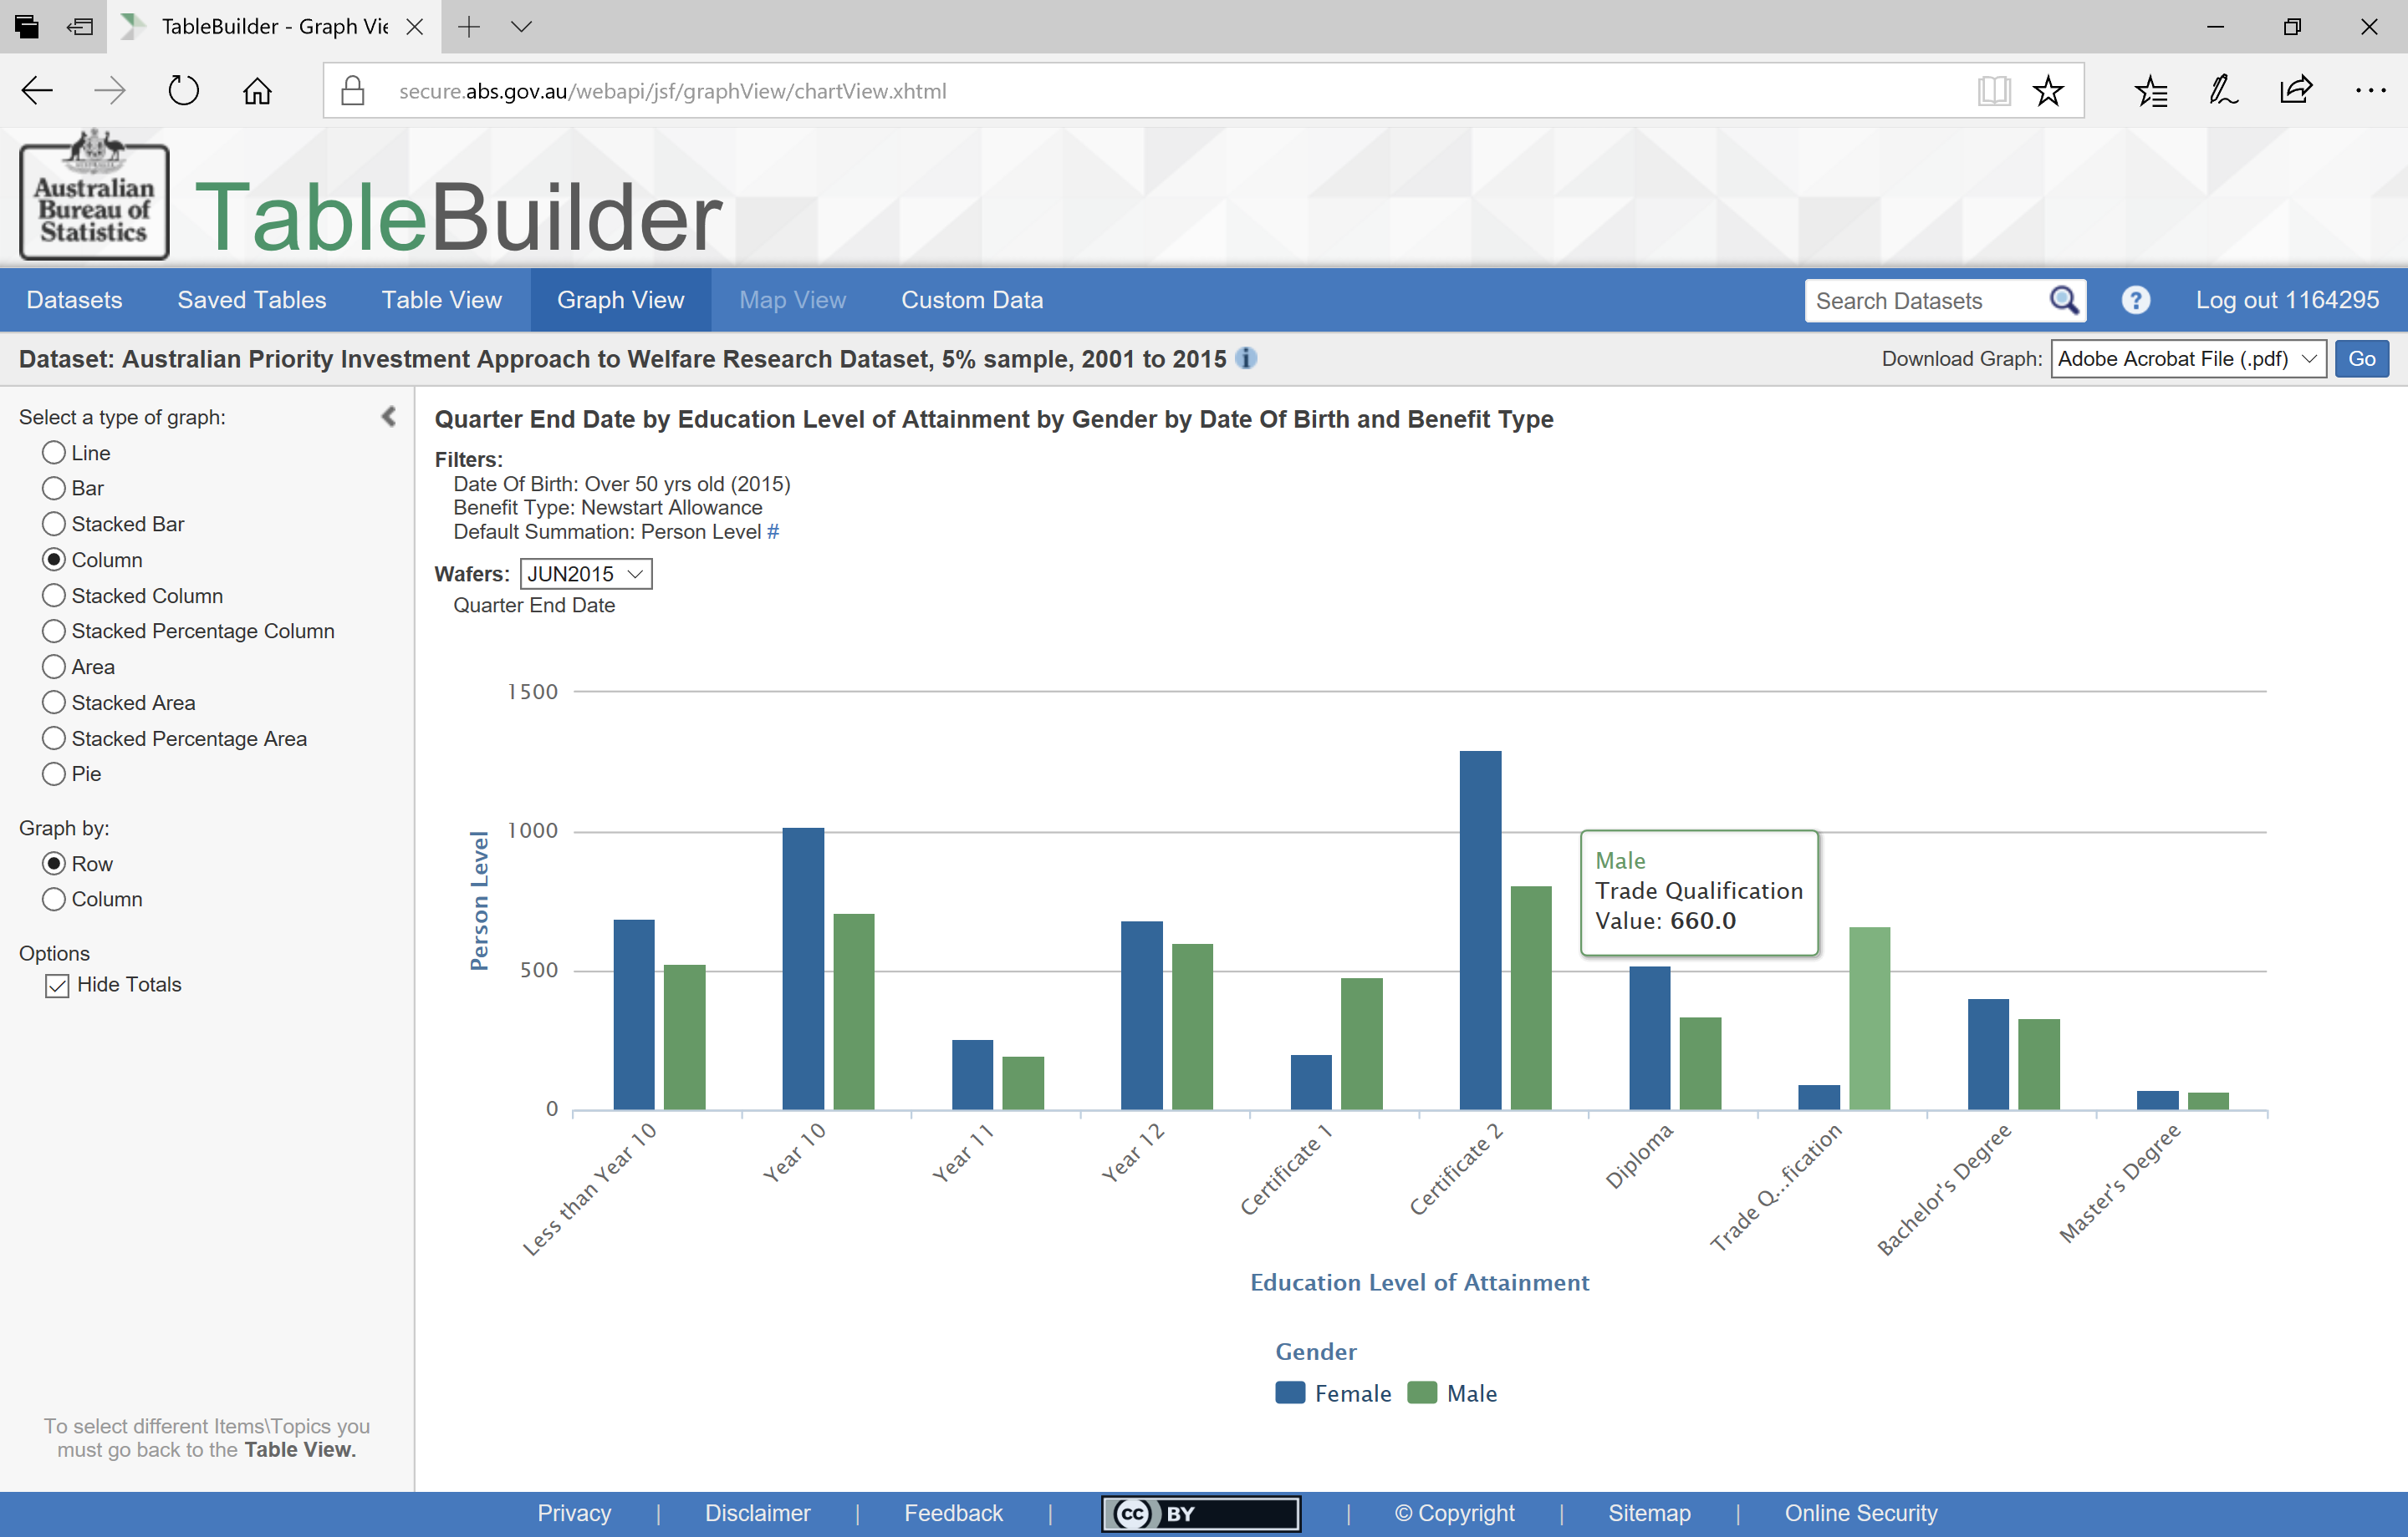
Viewing a graph
Notes:
Now the graph also presents the information in this same order and as such is easier to read.

Slide 41
How many people aged 50 and over are receiving Newstart?
What is their highest level of education? How is this different by Gender?
How is this different by Indigenous Status?
Notes:
Let’s look at how this is different for indigenous and non-indigenous recipients.

Slide 42
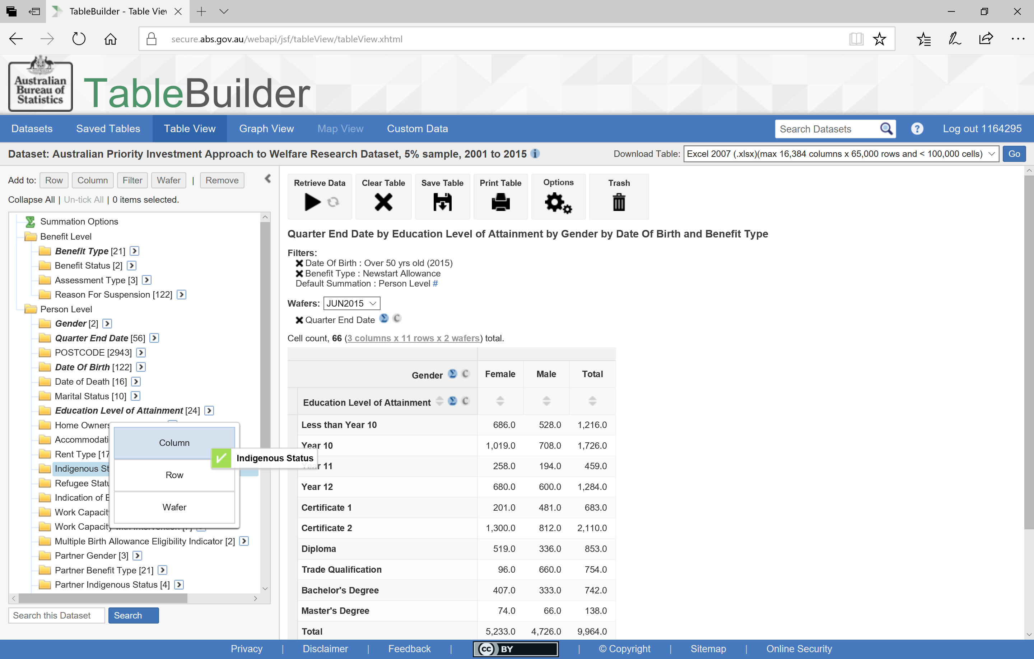
Adding a second variable to a column
Notes:
To add Indigenous Status we simply pull the ‘Indigenous Status’ Variable across to add it to the Column information.

Slide 43
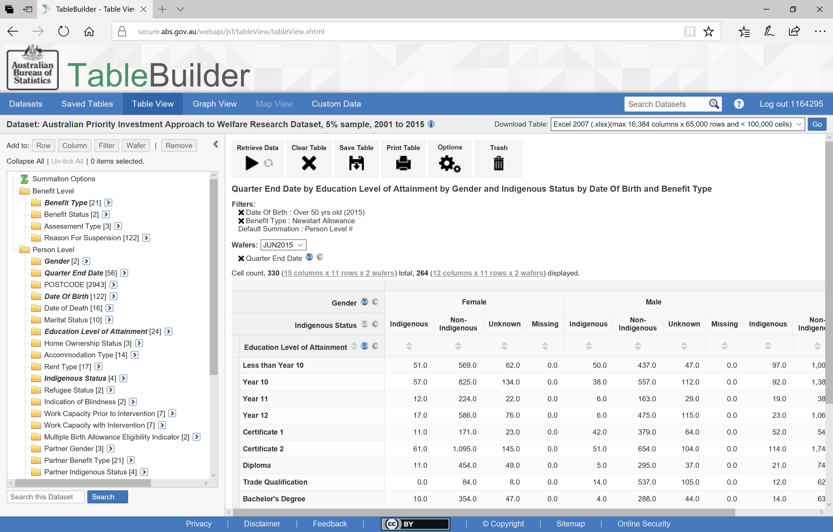
A nested table
Notes:
This will display the information for Gender by Indigenous Status.

Slide 44
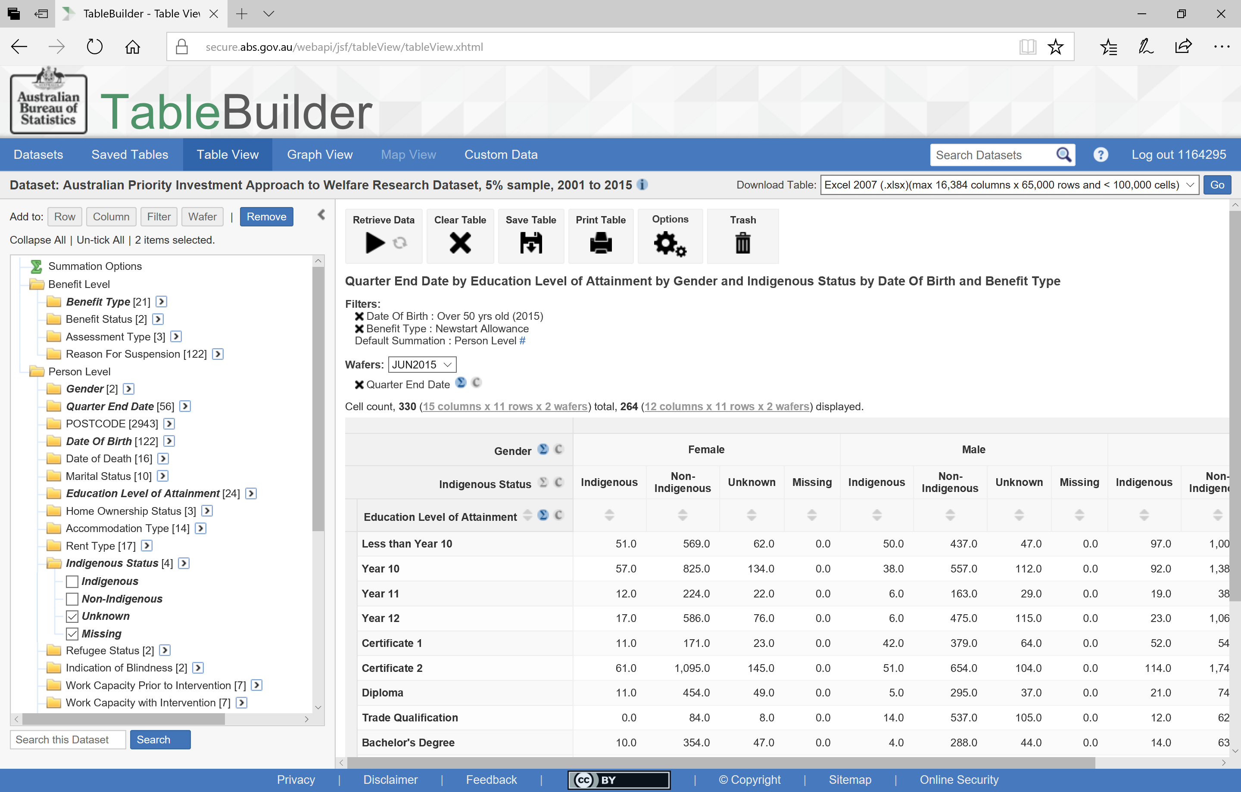
Removing some categories
Notes:
We might decide that we don’t want to include ‘Unknown’ and ‘Missing’.
To change this we tick these categories, and then
Select ‘Remove’

Slide 45
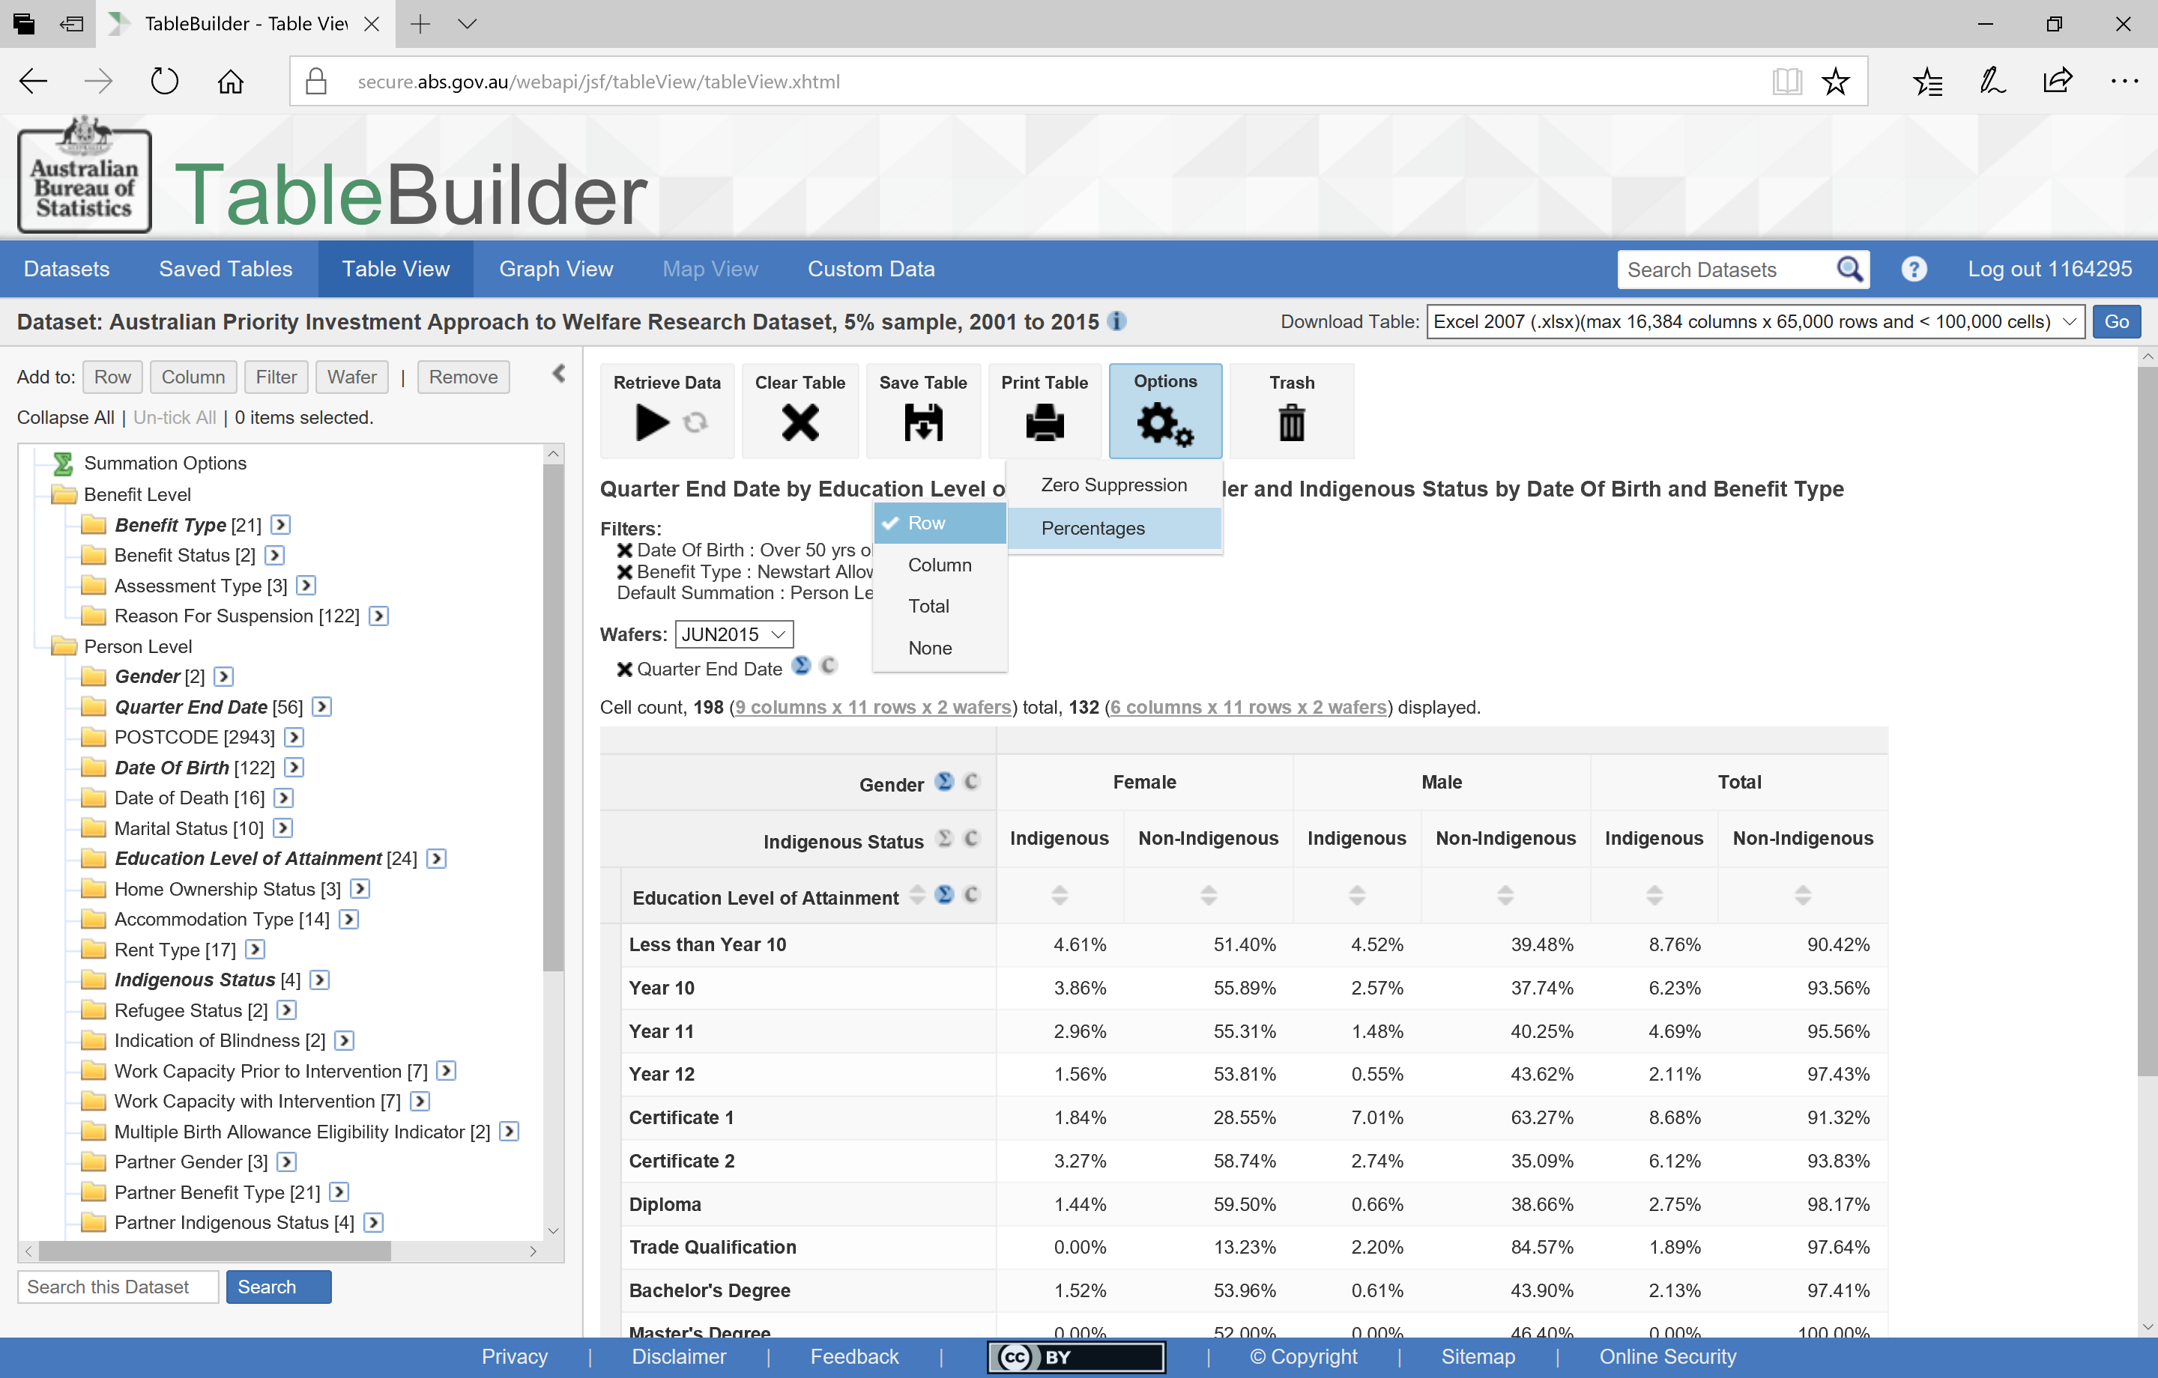
Displaying the data by percentage
Notes:
The table is now more easily read with only the two categories for Indigenous Status.
We can also display the results by percentage. We can choose between percentage by Row or percentage by Column. Here we have selected by Row and as such see the distribution across the groups for each education level.
Here we can see that 8.76% of this group who had not completed Year 10, were indigenous.
Over 80% who had a Trade Qualification were non-indigenous men.

Slide 46
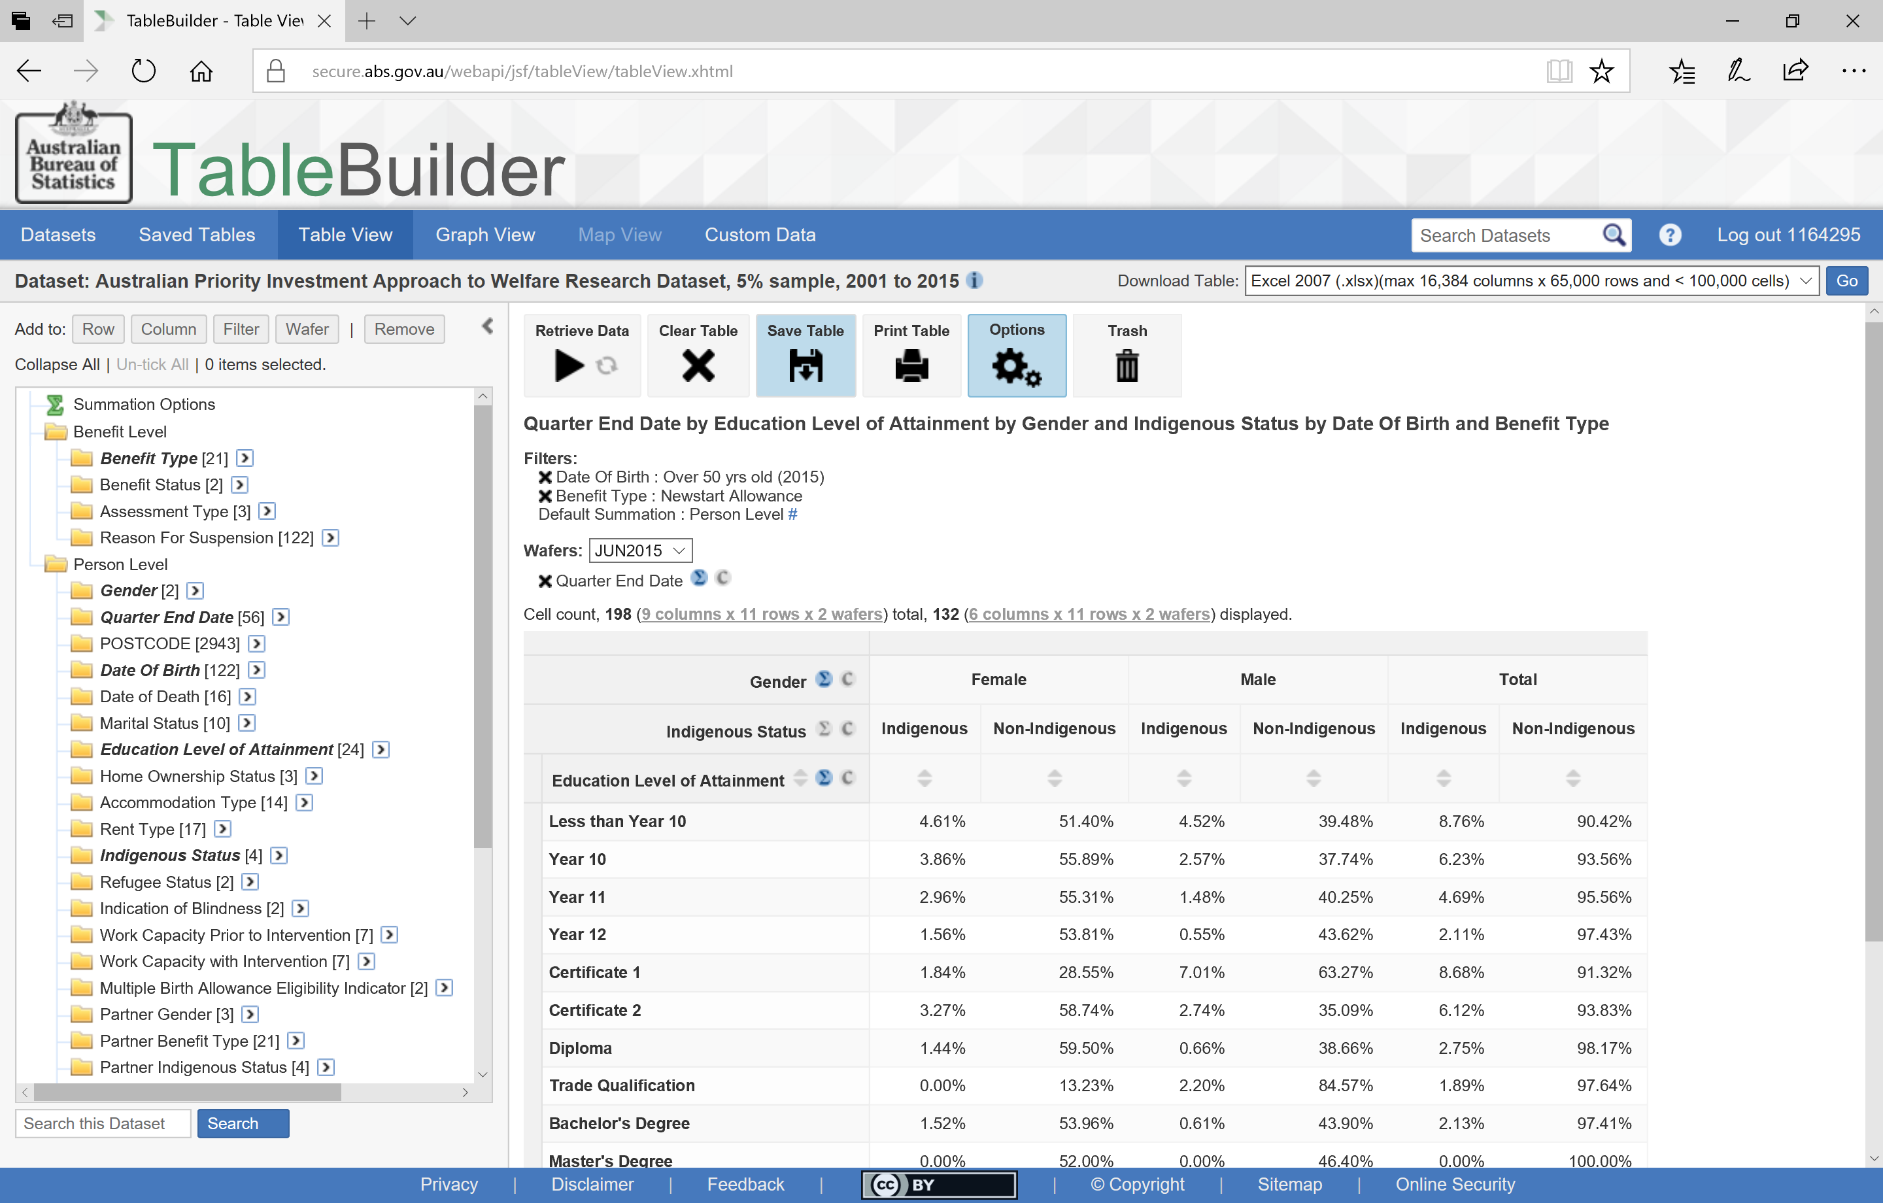
Saving a table
Notes:
If you want to be able to come back to this table in a different session, you will need to Save the Table.

Slide 47
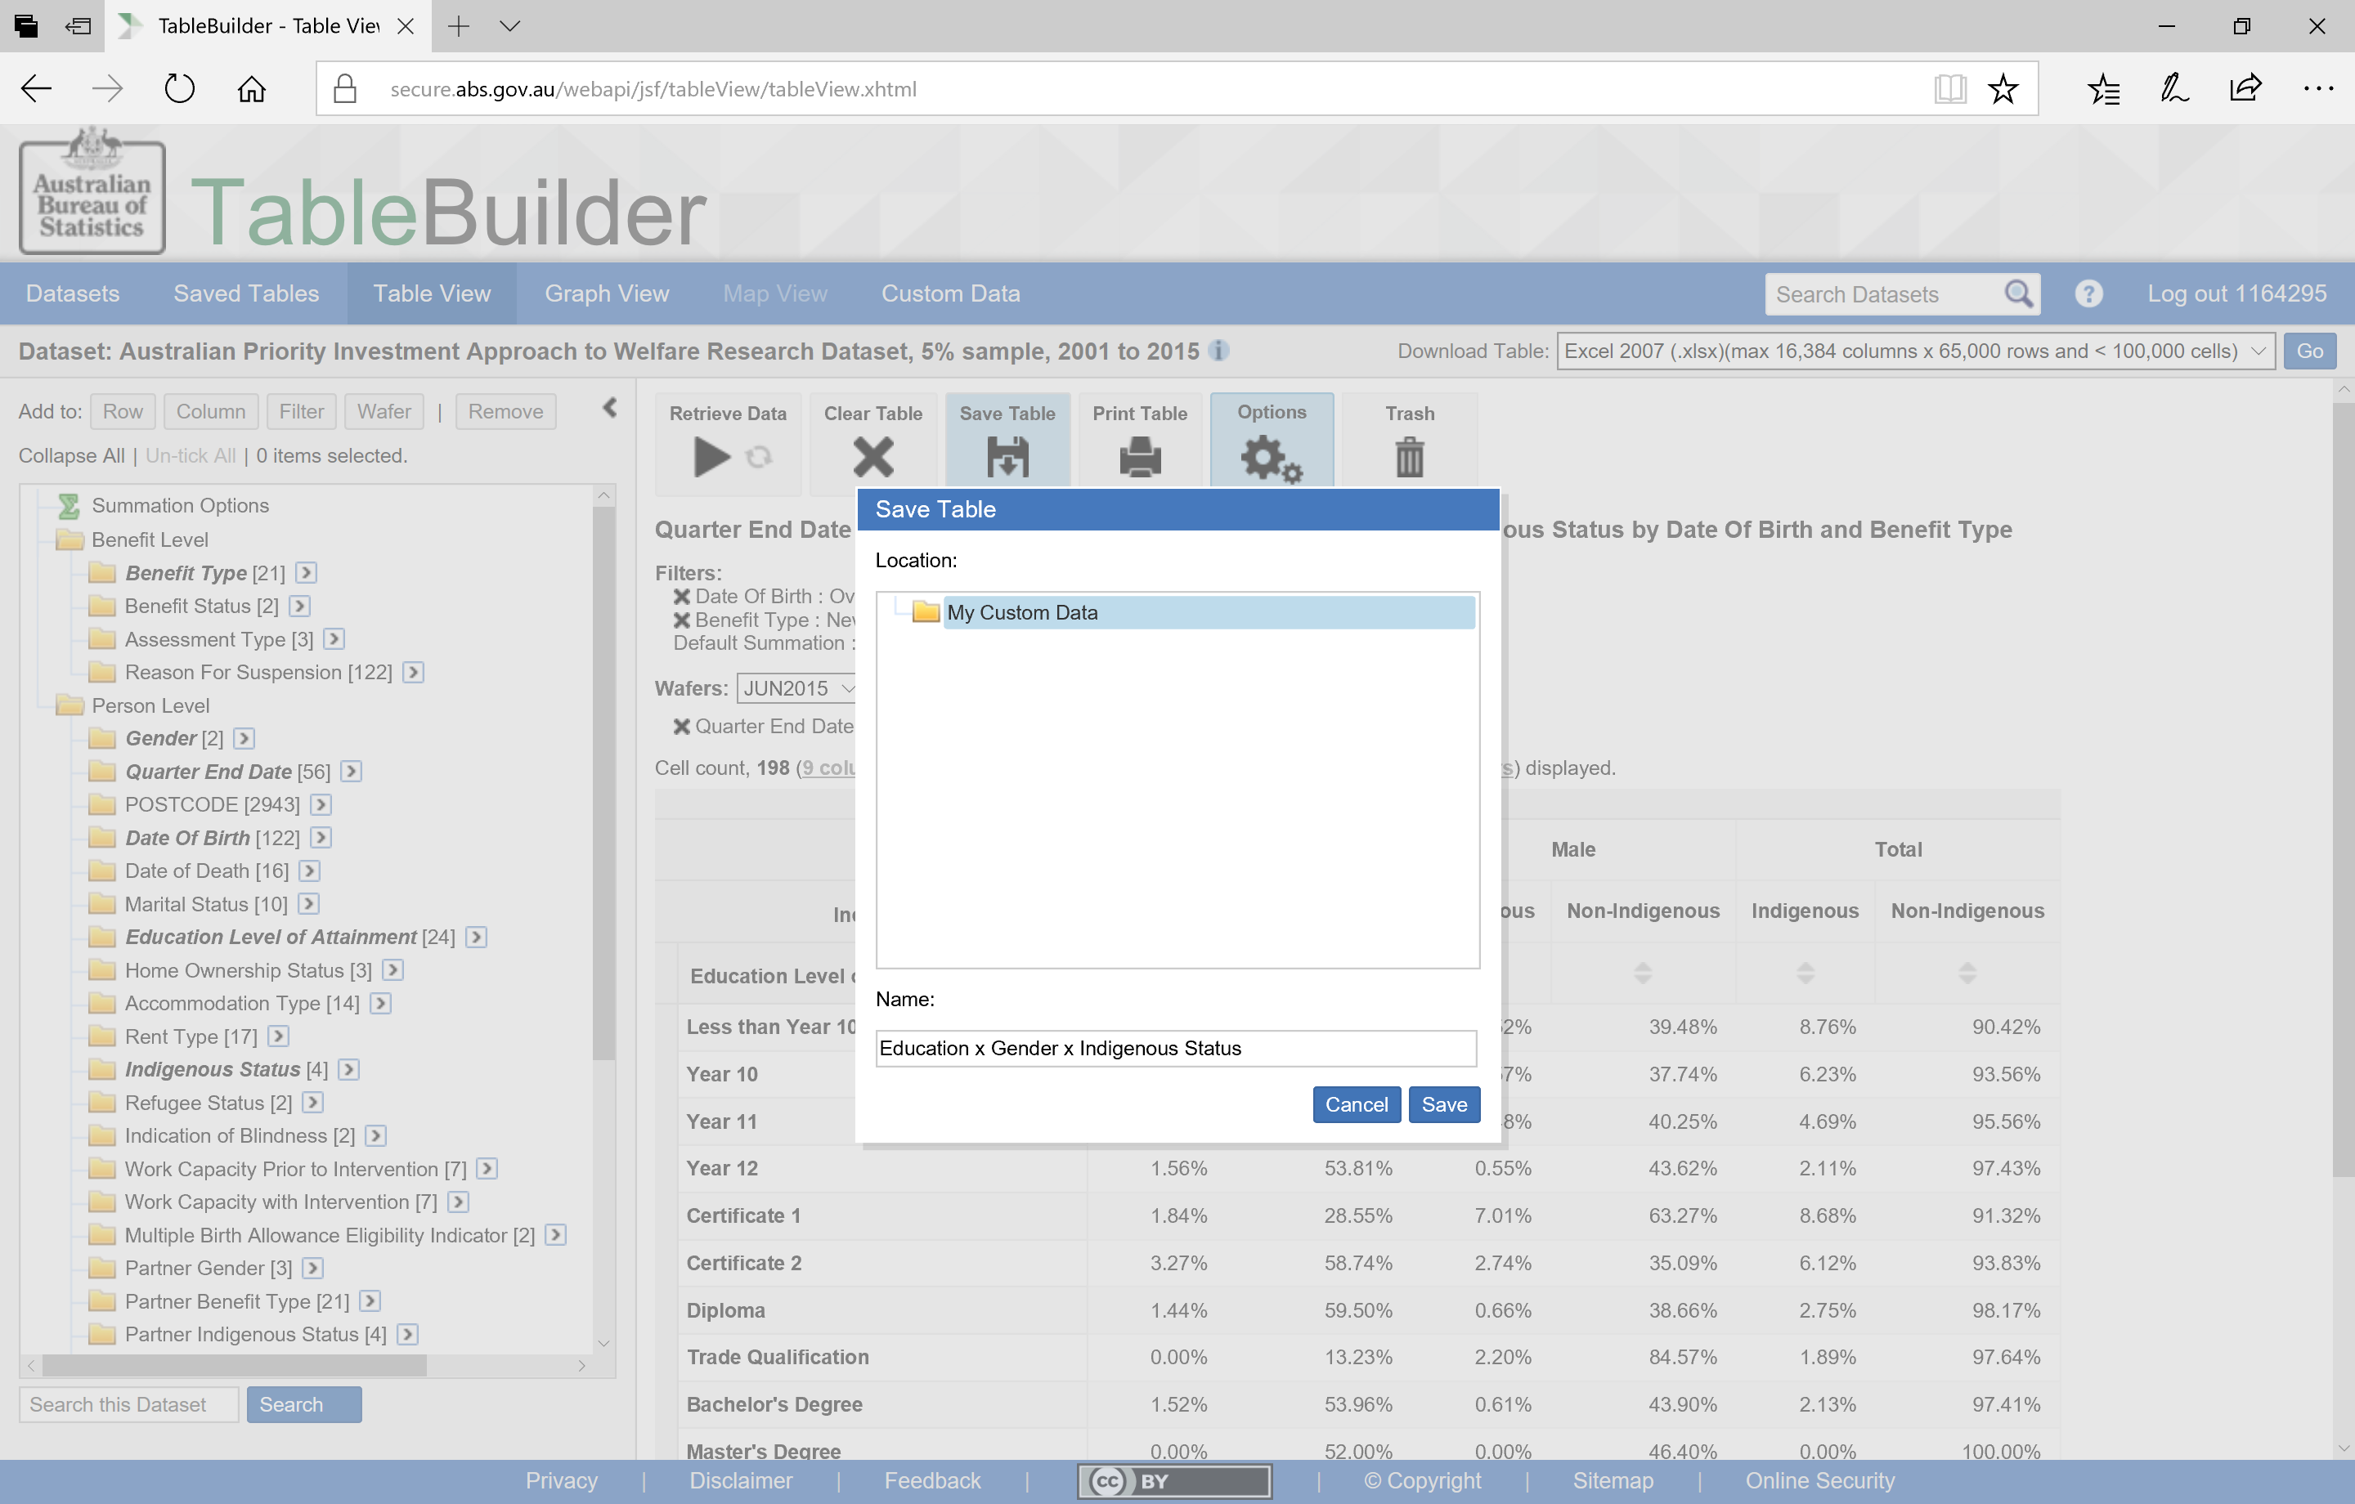
Naming a saved table
Notes:
By selecting the ‘Save Table’ button, you will be asked to name the table. Here I have called it ‘Education x Gender x Indigenous Status’

Slide 48
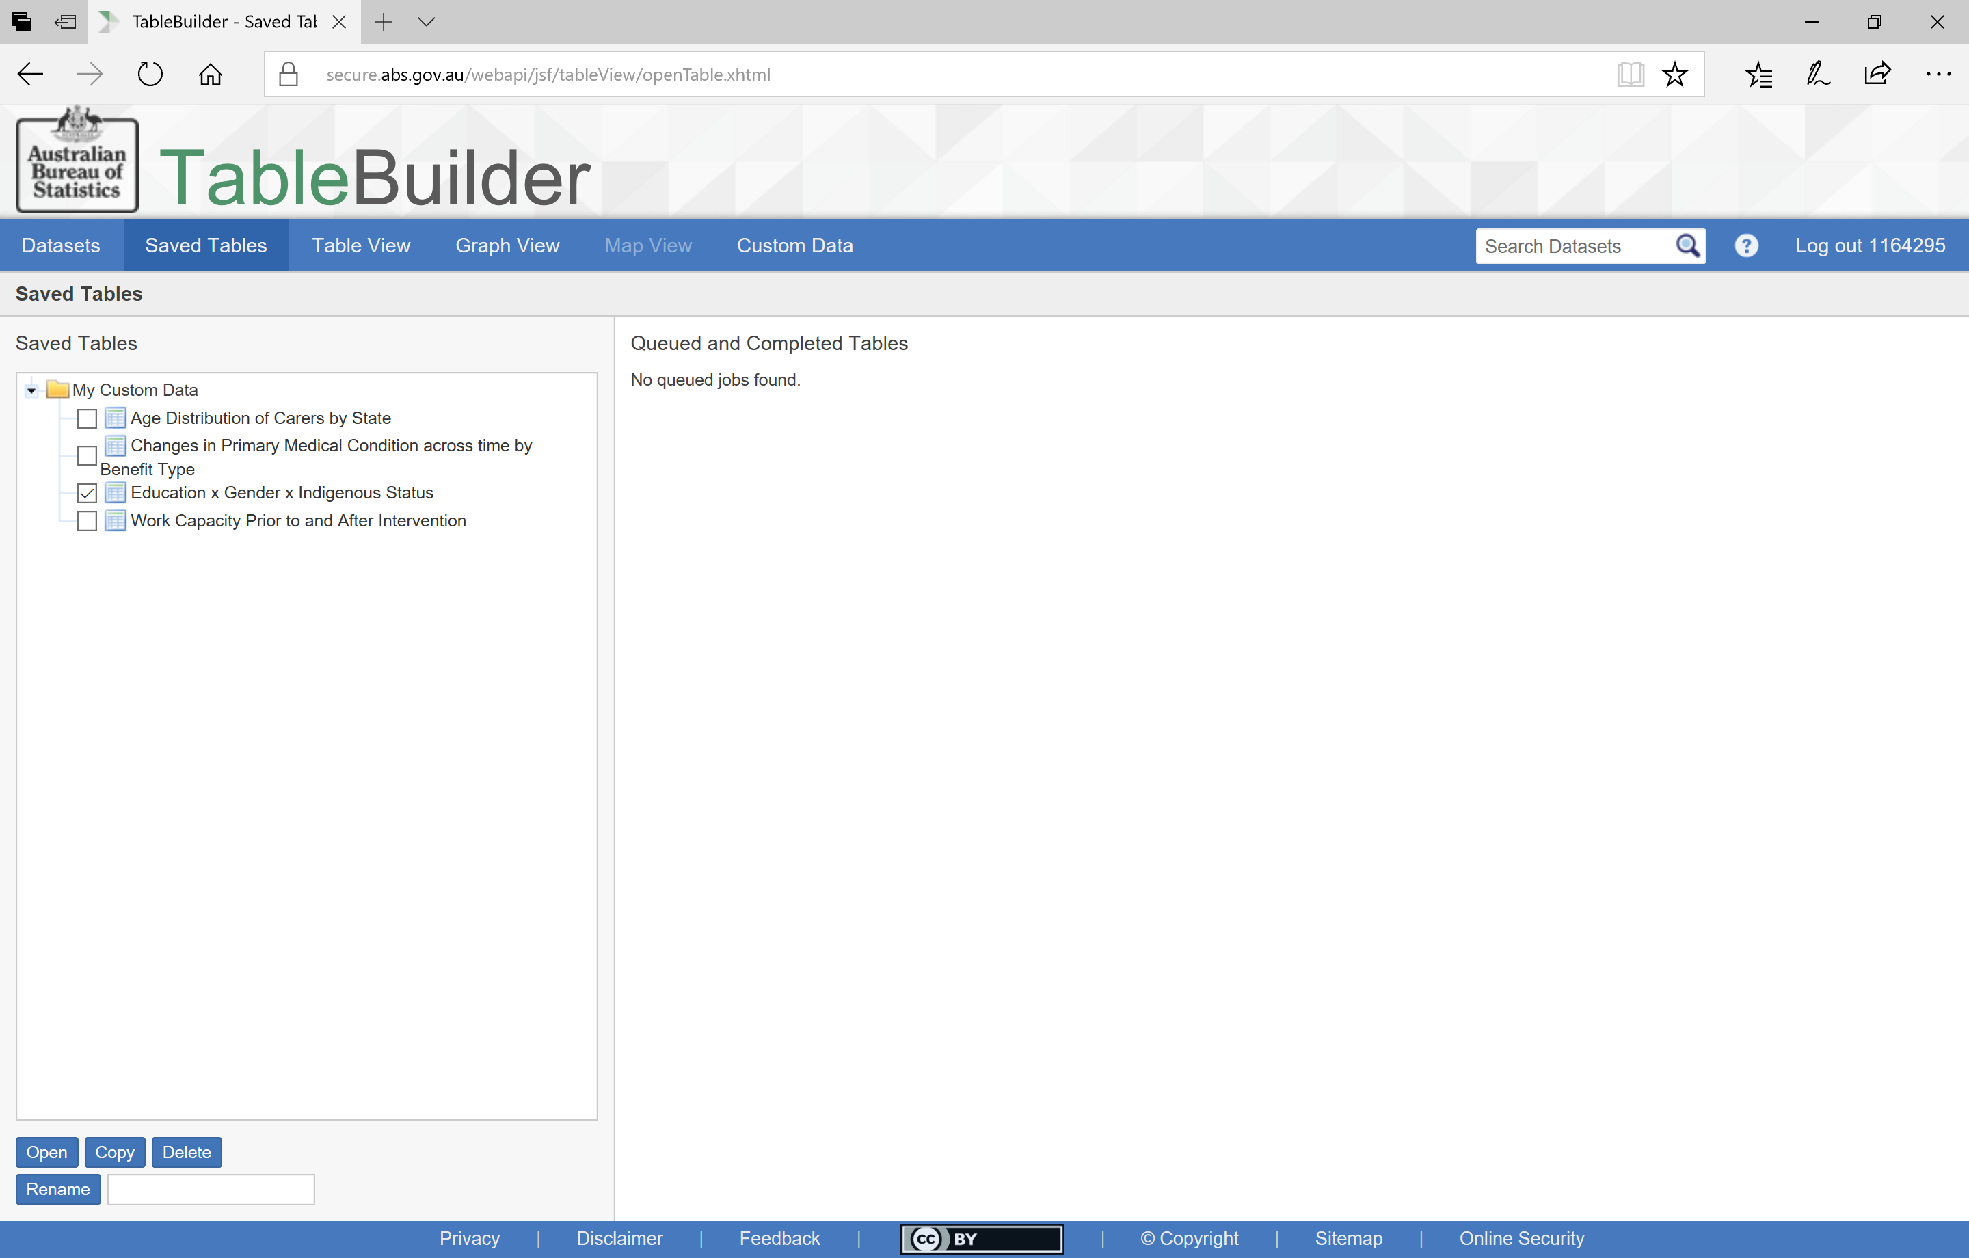
Finding your saved tables
Notes:
You will now see your table in the Datasets tab (in the middle column) as well as the Saved Tables tab.
In the Saved Tables tab you can Open, Copy, Delete and Rename your table.
As a side note, if you design a table that has too many cells, it will be converted to a Large Table. There is information about this in the TableBuilder User Guide but put simply this means that you won’t be able to view your table in the TableBuilder tool but it will be available for download
here in your ‘Queued jobs’.

Slide 49
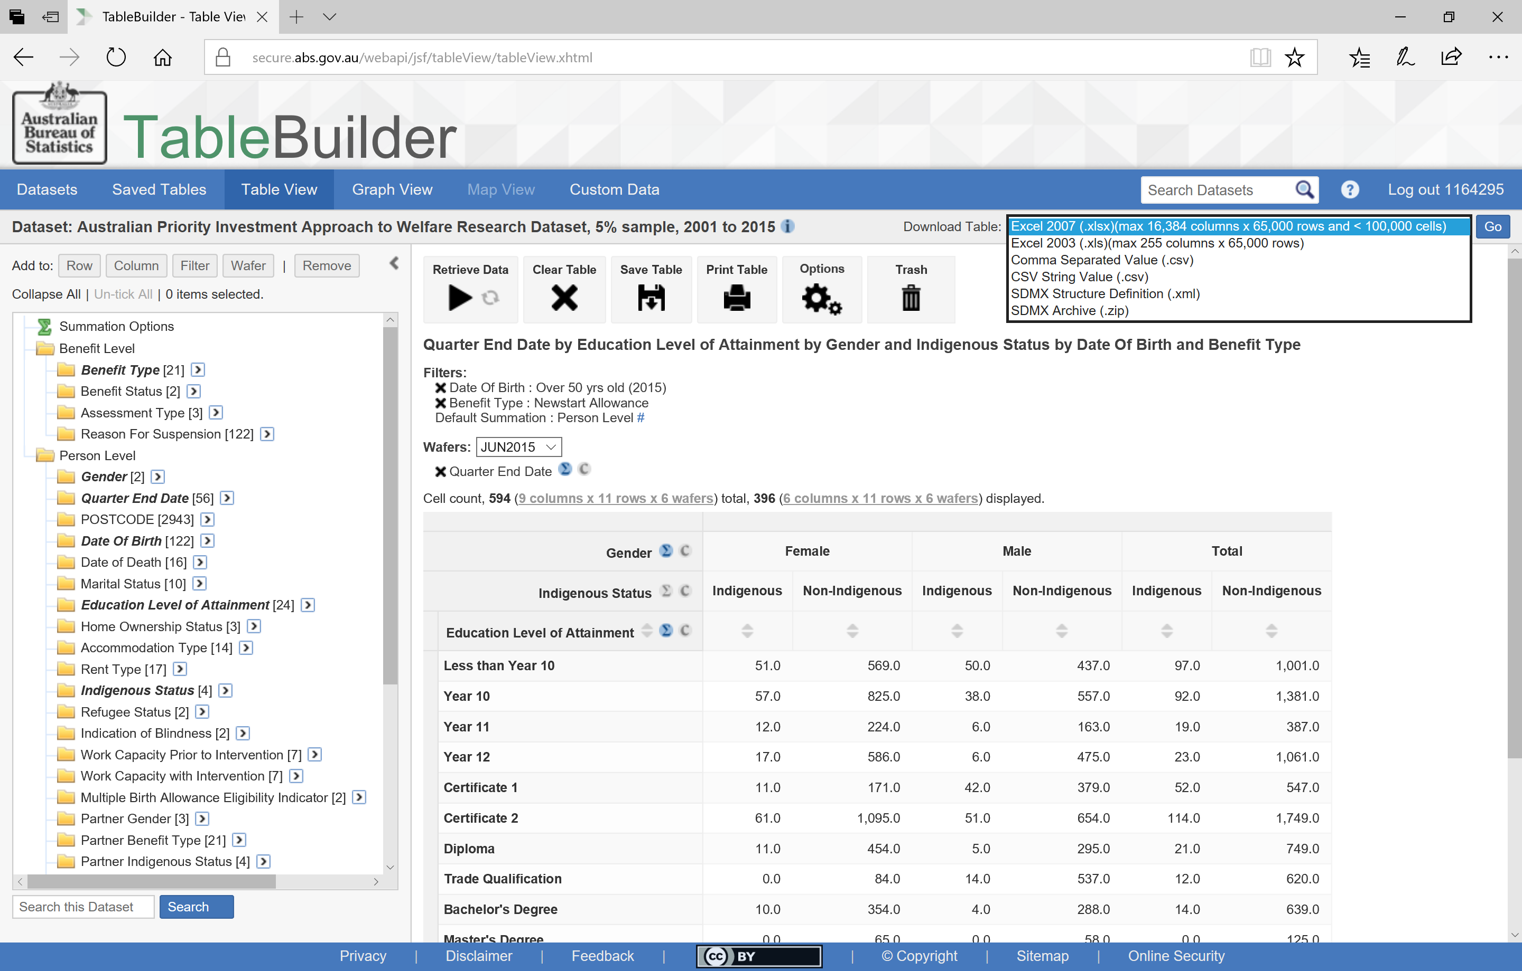
Downloading your data
Notes:
You can also download the tables you build in TableBuilder.
To do this, select the type of file format and
then select ‘Go’.
Before downloading this table I have added a number of other quarters to the Wafer.

Slide 50
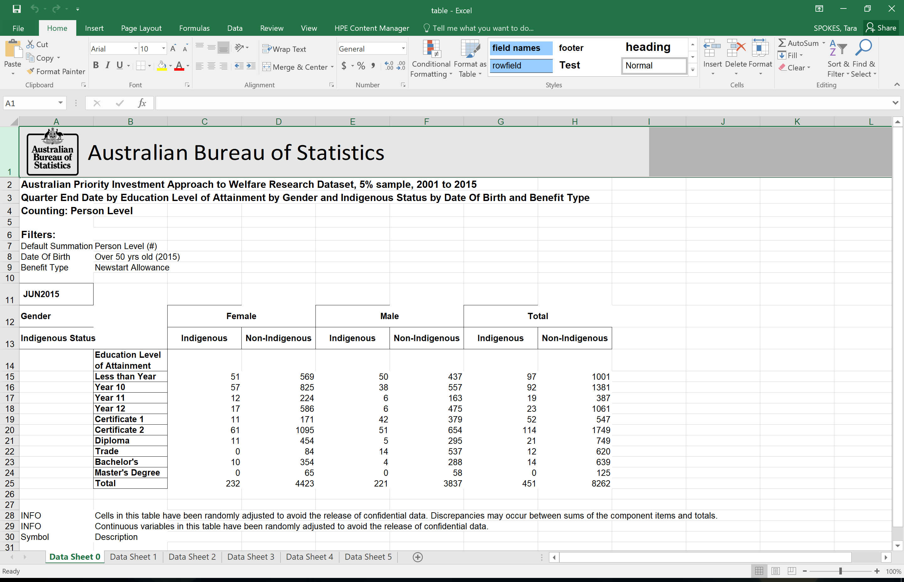
Opening your downloaded table
Notes:
When there are multiple categories in the wafer of your table (such as we have now with the multiple quarters), the excel worksheet you download will contain the data for each wafer on a separate tab.
You can identify the wafer that each tab refers to by the category identified in the cell above the table.
You can also see the Filters that have been applied

Slide 51
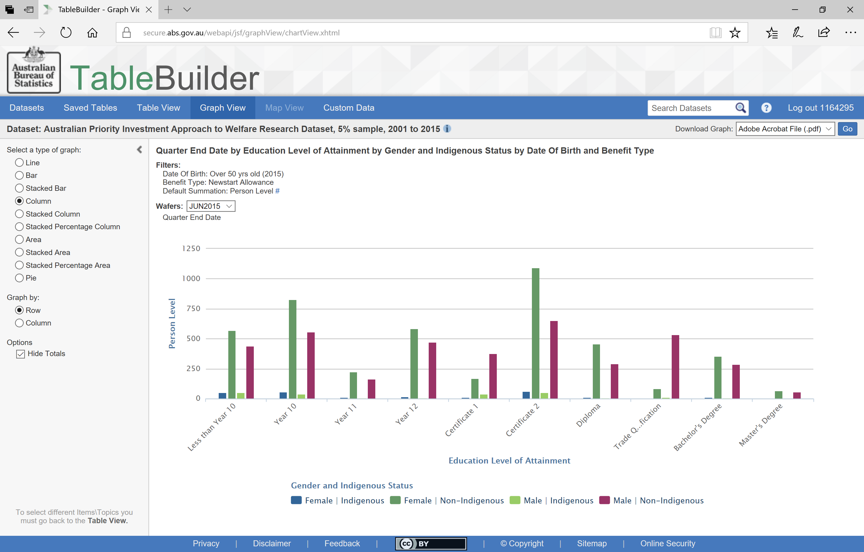
Reviewing a graph with multiple variables
Notes:
The Graph View of this table shows the number of Newstart recipients aged over 50 in the June 2015 quarter
for each education level
for each group by gender and indigenous status

Slide 52
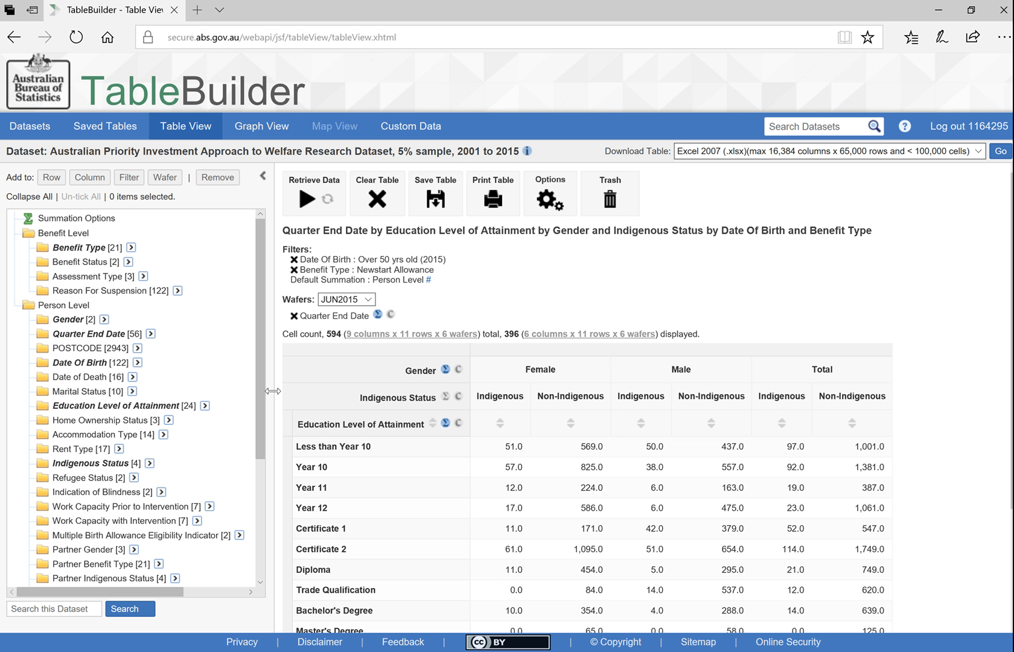
Changing the order of nested variables
Notes:
You can reorder the nested variables.
PLAY: To do this just click, drag and drop to place Indigenous Status above Gender

Slide 53
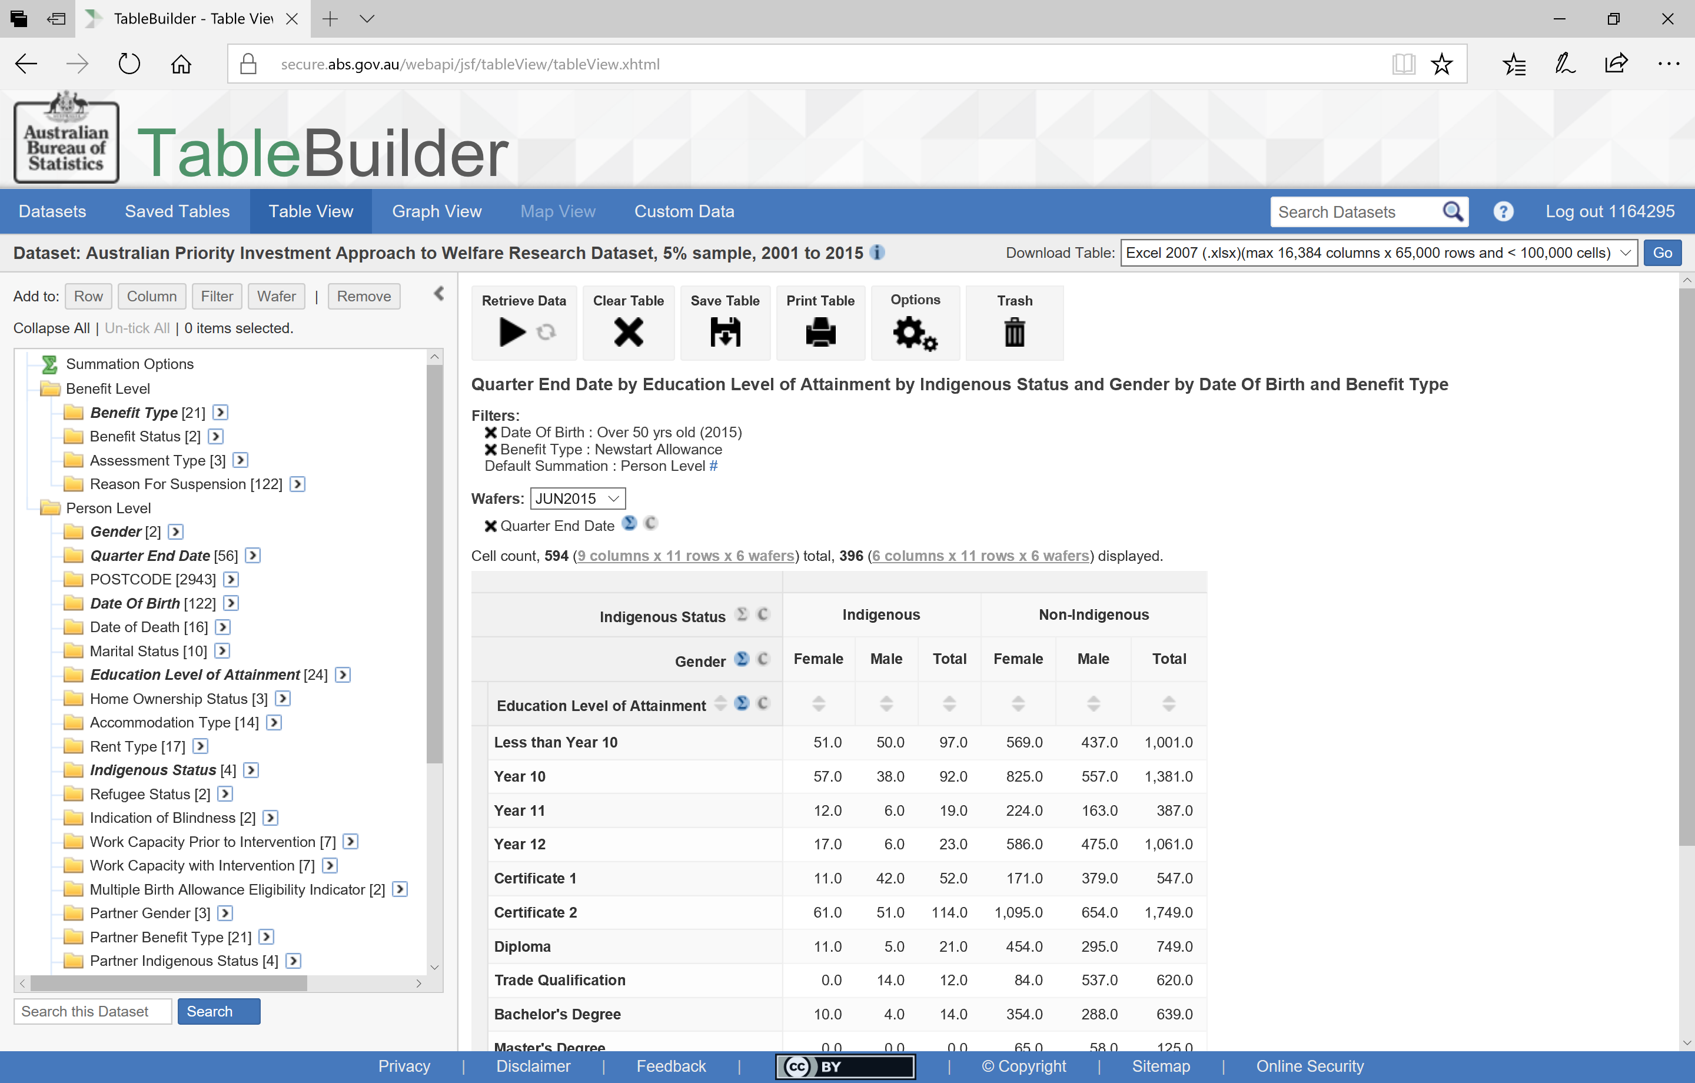
A changed nested table
Notes:
Now the data will show as Indigenous Status split by Gender

Slide 54
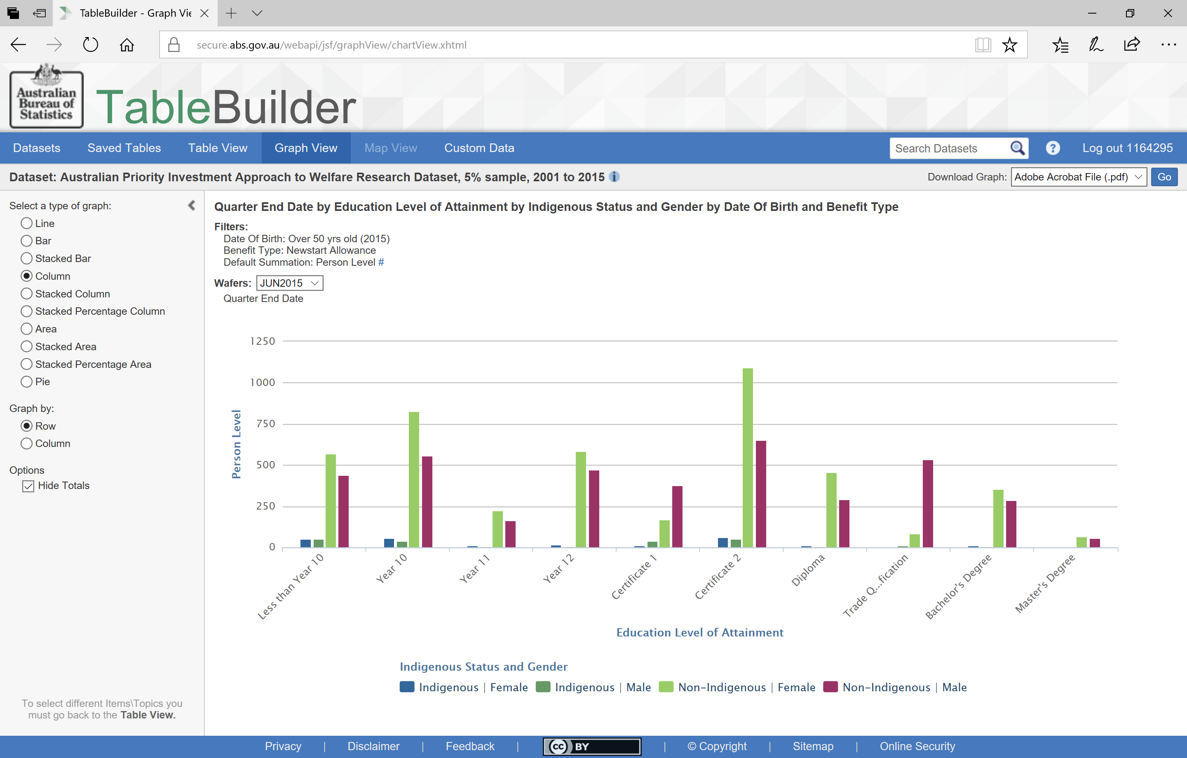
A changed graph from a changed table
Notes:
Now the graph has female and male indigenous presented next to each other and then female and male non-indigenous next to each other.
The presentation order is a matter of which data you want to compare.

Slide 55
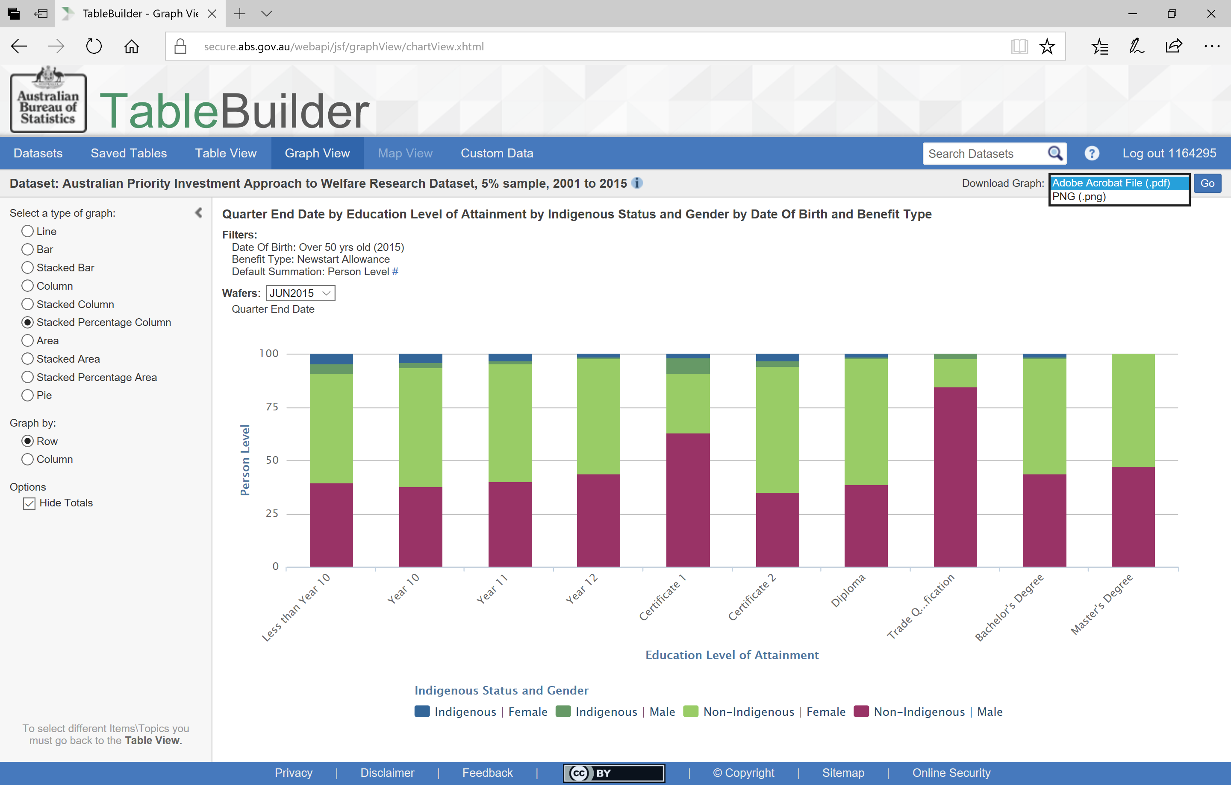
Downloading a graph
Notes:
Sometimes the order will be particularly important for a particular style of graph.
You can present the data in a number of ways using the options on the left.
When you have a graph you like, you can download using the ‘Go’ button at the top right.

Slide 56
Any Questions?
Thank you.
Tara Spokes, PhD
Policy Research Officer
tara.spokes@dss.gov.au
Notes:
A lot of this functionality will be things you can discover with use. Please make use of the ABS TableBuilder User Guide and the PIA background information available on the TableBuilder site.
At this stage, are there any questions?

