Slide 1
Strong and Resilient Communities
Program Logic awareness session 2021: unemployed people cohort

Slide 2
Workshop outline
Objectives of the session
Understand the overarching aims of the Strong and Resilient Communities program
Learn about designing activities under SARC and how to meet target cohort needs
Understand outcomes and how to support these through program logics and measurement
Notes:
The Department of Social Services wants to know more about the outcomes being achieved for funding. We believe that because this is a key priority for us, that means it is something that you will need to know about as well.
The main objective of this session will be to explore SARC overall and what we hope to achieve from the program, and we will particularly be examining the indicative program logic for the unemployed people cohort. This program logic (available via GrantConnect) shows you the sorts of things that we would hope fundees would be focusing on in their work. You don’t need to feel limited by this but it gives you an idea of what we would want to see changing for this cohort.
We want to be clear that there are many ways of telling the story of what your activities do and how they make a difference in peoples’ lives. Program logics are just one way of telling that story. It is a useful way to get your thinking right about your planned activities. What we hope you will get out of this session is some new ideas on how you can focus on outcomes and not just on the delivery of outputs.

Slide 3
Strong And Resilient
Communities (SARC)
SARC aims to build strong, resilient, cohesive and harmonious communities to ensure that individuals, families and communities have the opportunity to thrive, be free from intolerance and discrimination, and have the capacity to respond to emerging needs and challenges.
Notes:
To start us off let’s take a look at the Strong and Resilient Communities program and the upcoming round.
SARC is a grant program which contributes to the Department of Social Services’ Outcome 2 Families and Communities.
SARC has been providing grants funding from 1 April 2018.
SARC provides one-off grants to organisations to deliver activities that assist vulnerable and disadvantaged communities and individuals.
The aim of SARC is to build strong, resilient, cohesive and harmonious communities to ensure that individuals, families and communities have the opportunity to thrive, be free from intolerance and discrimination, and have the capacity to respond to emerging needs and challenges.
Focus of SARC
So what do we know about the problem overall that SARC is seeking to address?
There has been a lot of research conducted into social connection and the benefits of individual and community wellbeing.
Individuals in communities who experience low social cohesion, racial, religious and cultural intolerance do not thrive, are more socially isolated and are at greater risk of poor life outcomes.
Communities with low levels of social cohesion lack the capacity to respond to emerging needs and challenges.
Individuals who are not well connected to government or non-government services or who lack digital capacity or access, experience multiple levels of disadvantage.
SARC aims to fund projects that address these issues and has had a deliberately large scope in which organisations can achieve the program objectives. SARC has historically included a diverse range of service delivery models, all with an overarching goal to bring communities together and develop capacity within them to address local needs and boost community resilience.
Evaluation of SARC program
Work has been underway to understand what is working in the SARC program and what could be improved.
DSS engaged the Social Research Centre in 2020 to undertake an evaluation of SARC to assess its effectiveness, appropriateness and performance. The evaluation report can be found on the DSS website (www.dss.gov.au).
The evaluation found that SARC has positively contributed to whole of community and early intervention responses to address cohesion, improvements in economic participation, engagement with services and positive attitudes towards the community.
It also found there could be improvements made to the program to achieve better outcomes. The department is taking a more focused approach with SARC moving forward and is encouraging strong logics to underpin activities as well as evidence-based and measureable approaches.

Slide 4
SARC - Inclusive Communities
Aims to support community efforts to help vulnerable cohorts on a path to a productive life, by addressing barriers to participating in community activities, such as reducing social isolation, supporting activities that develop soft skills, including educational and awareness activities.
Notes:
Following the SARC evaluation SARC has been consolidated into one stream: inclusive communities. For further information on the changes that were recommended, we encourage you to read the SARC evaluation report at DSS.gov.au.
SARC: Inclusive Communities has an objective to support community efforts to help vulnerable cohorts on a path to a productive life, by addressing barriers to participating in community activities, such as reducing social isolation, supporting activities that develop soft skills, including educational and awareness activities.
The policy goal therefore is to support the social and economic participation of vulnerable and disadvantaged people and place them on long term pathways towards self-reliance and thereby being able to lead productive lives.
Within the redesigned SARC the emphasis is on short term 2 year projects that make a logical contribution to social and economic participation. The important part of this is the idea of contribution because we don’t expect 2 year projects to create impact at scale.
Activities under SARC might include projects that require some seed funding to help test or prove a model, that then has potential to be self-sustaining.
We believe that projects under SARC that have a clear outcomes focus and good measurement practice will help achieve great work under SARC.
Funded activities under SARC will be required to report through the Data Exchange as part of the Partnership Approach. This means that we will ask fundees to not only report on basic demographics of their participants but also report on outcomes. Therefore funded organisations will need to measure outcomes being achieved and this helps develop a strong evidence base for the SARC program.

Slide 5
SARC Program – unemployed people
Unemployed people of working age
and
Who are in particularly vulnerable areas (SEIFA Index of Relative Socio-Economic Disadvantage, quintile 1 to 3)
Notes:
As you know, there are four key target cohorts for SARC:
children and young people aged 12- 18 years
unemployed people of working ages
vulnerable and disadvantaged women
people with disability or mental health issues
Applicants of course can propose projects that work across cohorts as long as the project aims to meet SARC objectives.
SARC will include a focus on unemployed people of working age by providing grants that support the connection, inclusion and participation of unemployed people through providing pre-employment activities.
We want to ensure that this cohort is also targeted in areas of highest need and in highly vulnerable communities. For this, we are using the Australian Bureau of Statistics’ Socio-Economic Indexes for Areas (SEIFA) as an accessible measure regarding disadvantage.
The index in SEIFA 2011 we will utilise is the: Index of Relative Socio-Economic Disadvantage (IRSD) and we will be focusing on areas of high disadvantage as defined through the IRSD quintile 1 to 3.

Slide 6
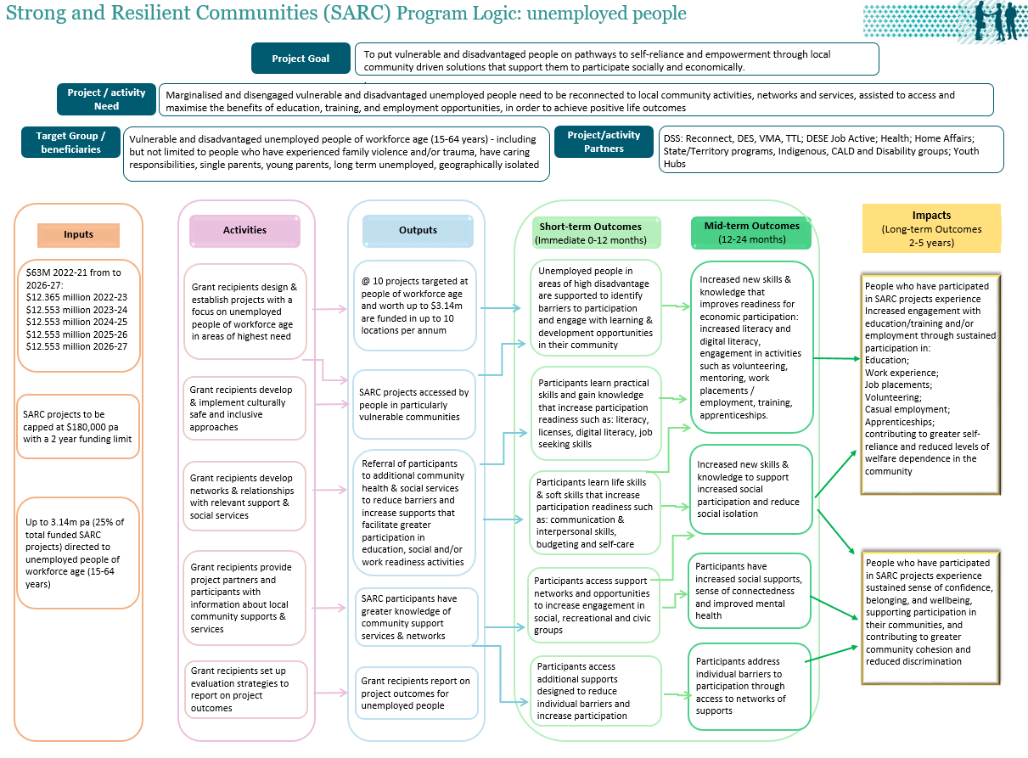
The importance of taking an outcomes focus
Indicative program logic
→
Notes:
Don’t worry I don’t expect you to be able to read the detail on this! This is a snapshot of the indicative program logic which is available on the GrantConnect website. We have developed this cohort specific program logic as a guide for you that sets out how activities will all contribute to the overarching SARC program logic.
We are expecting that grant applicants are able to describe what they plan to do and how their proposal will lead to outcomes for the target cohort. It is important to be able to clearly define and measure the intended outcomes of any program activity or project.
What is a program logic?
First a quick word on language. We call it a program logic but there are other terms like program actions, models of change, and theory of change. It doesn’t matter which term you use as long as the logic of the activity is articulated well. Other methods may be used to demonstrate how a project or activity is designed to lead to outcomes but theory of change and program logics are common ones used.
A Theory of Change is one term you may have heard of. It can help you identify the activities and interventions that you will need to undertake to achieve these. The theory shows the causal links between the inputs, activities, outputs and outcomes involved in your program, activity or intervention.
A theory of change can be thought of as the narrative or story that sits behind a well designed activity and a common summary of this is the Program Logic. Program logics are a useful way to explain how an activity works. One way to look at it is it is a series of if-then statements. If we do x…then we will see y.... as a result.
Program Logics are generally a simple graphic of a linear model on a page that summarises how the various inputs and activities are translated into achieving the sorts of outcomes you want to see.
Program Logics can also be used to design the specific evaluation strategy that allows you to make decisions about what data to collect and when in order to show whether the activity is working as intended.
It is just as valid to describe a logic as a narrative. You can also tell the story of an activity and outcomes in a series of “if...then” statements to show the underlying logic of an activity.
When thinking through a logic it can raise assumptions being made about an activity and also highlight where you will need to collect some data to show improvements are being achieved. Going through the process can also raise potential issues that need to be addressed in order for the project to be a success.
One of the benefits of thinking about the logical links between activities and outcomes is that it will allow you to map out how doing something with participants could be expected to lead to flow on benefits. This helps you to avoid making the mistake of having “miracle leaps”.
Example
If you are delivering counselling sessions to people it would be a leap to say that just by attending sessions they will be able to participate in social opportunities. In order for you to describe how the counselling will be effective you need to make some educated guesses about what will change about the client’s experiences that will lead to greater participation. This might mean the gain some increased confidence from being in the group and given opportunities to practice talking with others to. The group might offer them chances to learn new skills and develop strategies to manage their emotions. With practice, this can help them have more positive experiences in social situations.
So in summary, developing a program logic is a useful step in your thinking so that you can assure yourself and others that some great things will not only be achieved but that you can demonstrate those achievements.

Slide 7
Outputs versus outcomes
An output is the thing that gets produced as a result of your intervention.
An outcome is the benefit gained from the intervention – how the participant’s life is improved as a result.
Notes:
It is really important to understand the difference between an output and an outcome.
An output is the thing that gets produced as a result of your intervention.
An outcome is the benefit gained from the intervention – how the participant’s life is improved as a result.
If you refer to the program logic there are some examples of outputs in there.
You see we want projects to be accessed by people in particularly vulnerable communities. Now look at the column that is labelled “outputs” and see they might be accessing things like work readiness workshops that deliver the output of training session completions.
Another example in the program logic is referrals to other services.
A good check for whether or not something is an output is can you count it. In these examples you can count the number of workshops held and the number of clients who attend them. You can also count the numbers of referrals made to other services.
Now refer to the outcomes in the program logic – these are the columns in green in your document. Short term ones for these short projects would be happening in the first 12 months of the activity. The outcome for the participants might be increased social connection through having more friendships as well as increased confidence to engage in group settings. Outcomes are things like the new skills, knowledge and/or behaviours that have been gained by participating in the activities. These can’t be easily “counted” but rely on asking questions of participants about what has changed in their lives.
The mid-term outcomes in this program logic would be expected in the 12-24 month period of the project. Ideally this timeframe would allow participants to take new knowledge and turn that into new experiences that benefit them. For example by going to an art workshop over time they might have made some new friendships that have increased their confidence, helping them to engage socially. In time, this experience may increase a person’s ability to seek employment.

Slide 8
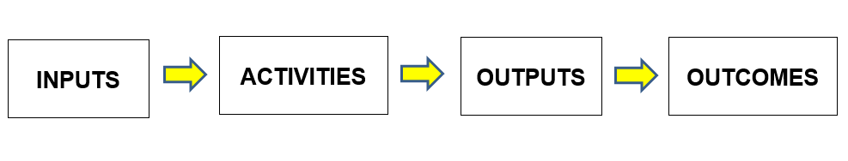
Program logic – the basic format
Notes:
This slide shows the very basic format of a program logic.
Inputs are the things that are invested in a project or program – the money, the staffing, the time.
Then there are the activities that are done, with the particular cohort being focused on, such as running workshops.
These activities then lead to outputs - the things being delivered such as a series of group workshop sessions or x number of counselling sessions.
The outcomes are the short, medium and longer term changes or the benefits that result from conducting the activities.
Program logics tend to be very linear. They also often have arrows that show how one thing leads to another.
Programs and activities tend to only contribute partially to the bigger picture results therefore all the activities need to sit within a broader context to articulate the ways in which the activities contribute to overall outcomes.
This means that projects set a reasonable boundary around what it is expected to achieve.

Slide 9
Simple example…
Problem: hunger
Desired outcome: feel less hungry / satiation
Input: food, plates, cutlery, space to eat
Activities: cooking / preparing, eating
Outputs: sandwiches, cupcakes
Immediate / short term outcome: less hungry
Longer term outcome: satisfied
Notes:
This slide shows a really basic example of a logic.
1. So we start with clarifying what the problem is that we want to address – in this example it’s hunger.
2. Then with constructing a theory of change or the logic of the activity we begin with the end in mind and in this case the desired outcome would be to feel less hungry / satiation.
3. Our inputs are: food, plates, cutlery, space to eat.
4. Then we describe the activities we will be doing such as cooking / preparing, eating.
5. The outputs would be for example 10 sandwiches and 20 cupcakes.
6. The immediate outcome – the thing that will change very soon as a direct result of the activity will be that participants are less hungry.
7. The longer term outcome will be that they are satisfied.
There may also be some unintended outcomes from the activity that you might suspect could occur such as being over-full and feeling discomfort. Perhaps providing cupcakes results in people developing diabetes. Thinking about these sorts of things can help you design to minimise the risks of these unintended outcomes.
We also need to examine the assumptions behind the activity such as that we are providing food that is safe to eat and that it is suitable for our target cohort. For example if our target cohort are vegetarians we would not want to serve them meat in our activity. So a key assumption will be that the food is suited to our participants otherwise they won’t eat it and our activity won’t lead to the outcome of them being less hungry.
Hopefully from this example you will see that a key to having a good logic is really understanding the needs of your target cohort. When you understand what they need and how they experience a particular problem, you can design activities that will really address their issues.

Slide 10
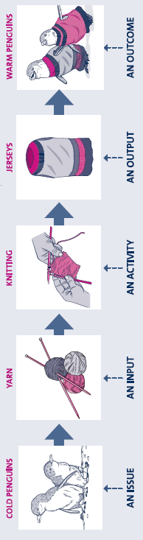
Program logic (with penguins)
Notes:
One way we like to explain how a program logic works is through using penguins as an example. This also helps you to understand the importance of describing outcomes.
We got this example from a New Zealand government publication Evaluation Handbook Dec 2017.pdf (dpmc.govt.nz) [https://dpmc.govt.nz/sites/default/files/2018-03/Evaluation%20Handbook%20Dec%202017.pdf]
Imagine a container ship runs aground near a penguin colony and spills a load of oil into the ocean. It’s spotted quickly and the relevant authorities leap in to action and rescue all the oil-slicked penguins and take them off somewhere to be cleaned. This removes all the heavy mineral oils from their feathers, but also strips them of the natural oils they use to keep their feathers from getting waterlogged whilst they swim and stop them freezing to death. So now we have a batch of clean but very cold penguins.
We need some kind of program to intervene and fix this mess. How do we buy the penguins enough time to regrow their natural oils (2-3 weeks) without freezing? Enter the knitting nanas. We give them needles, wool and patterns (inputs) and they knit (activity) little penguin jumpers (outputs). Have the jumpers solved the problem? Only if they get put on the penguin and the penguin warms up. The outcome is the measure of our effectiveness.
You often see program logics written with an additional step of impact at the end. This can be the long term benefits accruing to an individual from changes they experience and/or the aggregated benefit at a group or community level of changes/outcomes.
The thing we want you to take away from this is that focusing on what is done as an activity (knitting jumpers and putting them on penguins) is not enough. We need to understand what happens as a result.
Did the penguin get warm?
Was it able to regrow its natural oils and swim off happily into a freezing ocean?
Or did all its feathers fall out because it was allergic to the acrylic yarn we used?
If we only think about the outputs we wont know if our money and effort were wasted. We will have lots of things to count, but no understanding of what we achieved and whether it was worth it.
Remember, just doing things that look like the right thing is not enough. The outcome is the main game.

Slide 11
Developing a logic: start by being person centred
Situation/problem
Outcomes
Outputs and activities
Inputs
Measurement of outcomes
Notes:
This slide shows the steps in building the logic itself.
Situation/problem – the issue that we want to improve, address, eliminate.
First step is to understand the problem and the needs that exist for particular cohorts. This can be done through qualitative and quantitative research, needs analyses, stakeholder discussions and so forth.
This requires understanding the needs and experiences of the target cohort. We refer to this as being person-centred. Think about your target cohort. What are their challenges? What things make their experiences in life better or worse? What additional barriers do they face that mean they are not as able to make the most of supports?
Through understanding the issues for the cohort really well we can gain some insights into the possible solutions that might help address their issues.
Outcomes
This helps us describe the sorts of outcomes we want to see - the value, benefit and differences that are made to people’s lives.
These changes in the immediate term are about new things that participants have learned – new self-awareness, knowledge, skills, attitudes, opinions, motivations etc that the participants gain.
In the medium term the changes will be about new actions that have been taken by participants – the new behaviours and decisions that people are able to demonstrate.
The longer term outcomes or impacts that come from programs and activities may be about changes that individuals experience in their circumstances – perhaps improved economic participation or stable housing. Longer term impacts might also be about the new conditions in the world that have come about as a result – the new social, economic, civic, environmental conditions that exist.
All the different levels of outcomes are also subject to external factors and these can be helpful to the program achieving outcomes or they can hinder success. Sometimes we can guess what might occur and other times it is hard. COVID-19 and other disasters are an example of specific external events that have happened that impacted services. Some of the services were able to make quick changes as a result and other did not.
Outputs
We can then consider the outputs and activities that we would need to have to achieve all those outcomes. To design activities we often turn to best practice literature and stakeholder discussions.
At the same time you would be thinking about the activity outputs – these are the things that are done and who they are done with – the delivery of services, events, products and so on.
Outputs include things like:
Service delivery instances (for example, workshops, counselling sessions), products (for example, resources, curriculum).
These result from providing activities such as running inter-agency meetings, developing partnerships and running workshop sessions.
Delivery of 10 training sessions or 20 counselling sessions are outputs but remember that these are not outcomes. The outcome you might want from 10 training sessions might be that 10 participants learnt a skill and applied it in practice.
The outcome you might want from 20 counselling sessions is that participants have improved mental health as demonstrated by changes in their Depression Anxiety Stress scores.
Inputs
Then you can think about inputs – these are the necessary resources to be invested so you can deliver the activities.
Inputs include: staff, volunteers, time, money, materials/venues, equipment, technology, partners.
Measurement of outcomes
Finally you need to think about how you will demonstrate outcomes. Measurement forms part of your logic and you can measure things at each stage throughout the logic model. Once you have a draft logic you can plan how you will collect data that shows the outcomes being achieved. For a short 2 year project you might consider collecting some baseline data like an entry questionnaire and then a year into the project activity doing another questionnaire with those participants. What you use as your data collection tool will depend on what improvements you are hoping to see from their involvement in the activity. We can’t expect to measure all things or control all external factors in order to know what difference we are making so we need to make some measurement choices based on time and resourcing.

Slide 12
Connection, inclusion and participation of unemployed people
Strengthened community connections
Economic and social participation
Self-reliance
Increased levels of wellbeing, mental health and self-care
Notes:
So now we’ve covered some of the basics of developing a logical story for an activity let’s look at this specific SARC cohort of unemployed people.
Through the focus on unemployed people, we want to achieve increased connection, inclusion and participation through providing pre-employment activities and this means they will experience:
strengthened community connections
increased economic and social participation
increased self-reliance
increased levels of wellbeing, mental health and self-care
We are particularly interested in supports for the most vulnerable unemployed such as
people who experience multiple barriers due to having had long periods of unemployment
people who have had long periods of illness
people with caring responsibilities
people who have experienced family violence or trauma
people who have needed to relocate to a new area, so they lack connections into their community
people who have never had a job
people who have missed opportunities to build “employability skills”, such as the necessary communication skills or qualifications to enter the workforce
people with a history of poor educational attainment.
For people to achieve sustained connection, inclusion and participation in social and economic life, we might look at their engagement in things like:
education and training
work experience
job placements
volunteering
casual employment
apprenticeships
Project activities may help them to access and make the most of these opportunities. For example, do they need support to gain a white card or a car licence in order to engage in an apprenticeship?
We want to ensure applicants are able to explain the “logic” of how activities will lead to outcomes. This means having some ways of measuring improvements. It’s worth keeping in mind how you might get people to share their experiences of your activities. We would encourage you to plan ahead to have strategies for dealing with any measurement or reporting challenges. These might be related to the age of the participants or if activities are delivered in group settings, thinking about how you might assess the achievements of the group activity.
To develop a logic think about how you might define and reach people. Are there particularly vulnerable sub-cohorts in this broader group? Gaps that you know need to be filled?
What might a pathway to economic and/or social participation look like for this cohort?
Some of the things you may need to consider are how your planned activity can reach the most at risk or the most marginalised people. Think about what other programs already operate in the community for this cohort and design your activity to meet an unmet need. For example if there are programs helping people develop their readiness for employment through volunteering, could your activity focus instead on helping unemployed people to develop soft skills and communication skills that will help them function well within group situations like volunteer groups?
What might success look like for these people? If they were to develop some new communication skills, how might their circumstances change as a result? Think about how people might gain new confidence within volunteering or casual work environments and how this might translate into better engagement in the workforce or in community activities. This might come through support and mentoring activities that help a person to reflect on how they engage with others.
Perhaps it will be through providing safe structured spaces to practice new skills. With greater self-awareness and skill, someone who has previously seen themselves on the fringe of their community may be encouraged to join more groups and engage in work readiness activities. Over time this can help build a pathway to future social and economic participation.
It might mean helping facilitate access to other supports necessary for them to participate fully in social and economic life such as accessing stable housing or finding child care.
Supporting this cohort means looking at how your planned activity can help shift participants further along the pathways of participation.
Your planned activity does not need to achieve changes in every aspect of the person’s life but try to focus in on the most important changes that you would want to occur as a result of what your project does and contribute to SARC’s overarching objectives.

Slide 13
Key assumptions
Increased engagement in social and economic opportunities
Helps build confidence, connection, social skills, and positive mental health
Reduces social isolation
Supports greater self reliance and helps build pathways to a productive life.
Notes:
Assumptions are the beliefs we have about a program or an activity, how the various parts of the design work together, the evidence on why things should work etc.
There will be assumptions made about the inputs and the outputs (such as their availability, reliability, how fit for purpose they, how useful they are, how satisfied people are with them, how accessible they are, and so on).
Example
Taking a look at the program logic for this cohort, these are some of the assumptions being made about how the program leads to benefits.
Increased engagement in social and economic opportunities
Helps build confidence, connection, social skills, and positive mental health
Reduces social isolation
Supports greater self reliance and helps build pathways to a productive life.
Timeframes
Any SARC project activity will need to operate within a 2 year project timeframe. When designing the activities for a project, keep in mind you will need to demonstrate clear short term outcomes within that timeframe. Your logic sets out how you would expect changes and benefits to keep happening after the project finishes. Therefore your project can’t be expected to deliver the longer term impacts, however your project should be able to demonstrate it is contributing to some key improvements such as setting someone on a pathway to more self reliance and a productive life.
Assumptions
Think also about the assumptions you have for your activity. For example your activity will depend on having the right staff to deliver it so ensure you stick within the areas of expertise that you have access to. It will need to be culturally appropriate – remember the example I gave about addressing hunger and not feeding meat to vegetarians? You need to ensure you know the cohort well so the activities are sensitive and appropriate.
You also need to ensure you can reach the cohort you are trying to engage – how will you find participants? Will they need transportation? Are you delivering services online and if so, what assumptions are you making about accessibility? What referral networks do you need to use or develop to support the project?

Slide 14
Client Circumstances
Physical health
Mental health, well-being and self care
Personal and family safety
Material wellbeing and basic necessities
Age appropriate development
Family functioning
Employment
Education and skills training
Community participation and networks
Financial resilience
Housing
Notes:
It was mentioned earlier that any fundees under SARC will need to report through the Data Exchange. This slide shows some of the client circumstances that are within the Data Exchange.
Let’s use an example of education and skills training because we believe that having education and skills sets a strong foundation for economic participation.
The problem is that people who don’t have formal education or skills will likely experience disadvantage when it comes to gaining employment. Lack of access to employment opportunities can lead to poverty, stress and reduced options in life. Longer term, these issues can lead to increased crime, depression and welfare dependence.
The desired outcome is that people can access education and skills training that they need to participate in the workforce.
How might we help them access this? We help them to reduce barriers that make it hard to participate – perhaps they need support with juggling caring responsibilities or access to transport.
So the theory might be: people who don’t get access to necessary education or skills training may lack skills that help them participate fully in economic life. Lack of knowledge and skill can lead to challenges accessing employment. Lack of stable employment may leave them vulnerable to financial and emotional stress. So by providing them with support to reduce their barriers they will experience greater engagement with training or educational opportunities.

Slide 15
Client Goals
Changed knowledge
Changed skills
Changed behaviours
Empowered to make own decisions
Engagement with relevant support services
Changed impact of immediate crisis
Notes:
So then to follow this example through the Data Exchange there are also client goals that can be reported upon.
How do we provide people with the knowledge to help them succeed on their own?
We provide them with resources – support to develop knowledge and skills that will help improve their education, training, employment and civic engagement.
Now here is an example of a causal theory statement (if/then statement):
If we provide support for unemployed people they will gain the necessary skills and understanding to be able to gain and maintain employment. With skills people can develop their independence, increasing their options in life and contributing to overall wellbeing.
Measurement
We can measure increased skills and knowledge by asking at the start and then at the finish of an activity so we know how much of a difference it made.
What we probably won’t know is how likely the activity is to have a sustained impact 10 years later. We can’t necessarily ensure participants can take new knowledge and turn it into new behaviours in the longer term. However we know from the evidence it is likely if we can help people to complete skills training, they are more likely to be able to find stable employment.

Slide 16
Logic checklist
  Is it clear what the project will do?
  Are the outcomes described really outcomes or are they outputs?
  Are the causal links clear?
  Is it clear how the project contributes to the SARC Program objectives?
Notes:
It’s a good idea to develop your logic and test it with colleagues to ensure that it is logical!
Is it clear what the project will do?
Are the outcomes described really outcomes or are they outputs?
Are the causal links clear?
Is it clear how the project contributes to the SARC Program objectives?
You need to also ensure you have some plans for collecting data to show the outcomes being achieved.
The Data Exchange Partnership Approach will be compulsory for SARC fundees and keep in mind any specific challenges with measuring outcomes for the cohort.

Slide 17
Tools and resources
www.Grants.gov.au [ref: FOSARC21]
www.SARC@dss.gov.au
Notes:
The benefits you may achieve through developing a logic for your activity are:
You will uncover the assumptions that you are making in the causal chain. You can either choose to build in ways to test your assumptions (like extending a program’s post intervention survey so you can see if the changes stuck) or you can devise new aspects of the program and its strategy that will help increase the chance that the program will be a success.
You may see some gaps in your logic that you will need to find solutions for or ways to mitigate the risks.
You will be able to refine the specific target groups and boundaries around what the program will be able to do within the timeframe and resources.
You will determine the necessary partnerships to make it successful.
You will be able to decide which outcomes are the most important to your program and therefore which ones you will need to measure so you know with a degree of confidence that it made a difference.
It also highlights where we might need more research and evidence to back up why different steps are likely to work/lead to results.

Slide 18

Questions?…
Notes:
A set of Questions and Answers is available on the GrantConnect website.

Slide 19
Thank you
DSS SARC Policy Team
SARC@DSS.GOV.AU
Grant Opportunities
www.Grants.Gov.au
Notes:
This brings us to the end of the presentation.
Resources from this series of information sessions are available on GrantConnect.

